Slide 1

Financial Literacy for Medical Students
Gayle Galletta, MD
Professor of Emergency Medicine
UMass Chan
gayle.galletta@gmail.com

Slide 2

Today’s topics
Doctors are targets
Financial security gives you #options
Budgeting
Bad debt
Emergency fund
Retirement
Life Insurance
Disability Insurance
Buying a house
Net Worth
Things to do NOW

Slide 3


Slide 4


FIRE versus YOLO

Slide 5
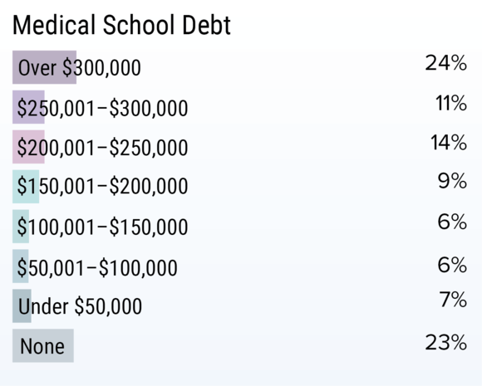

Slide 6
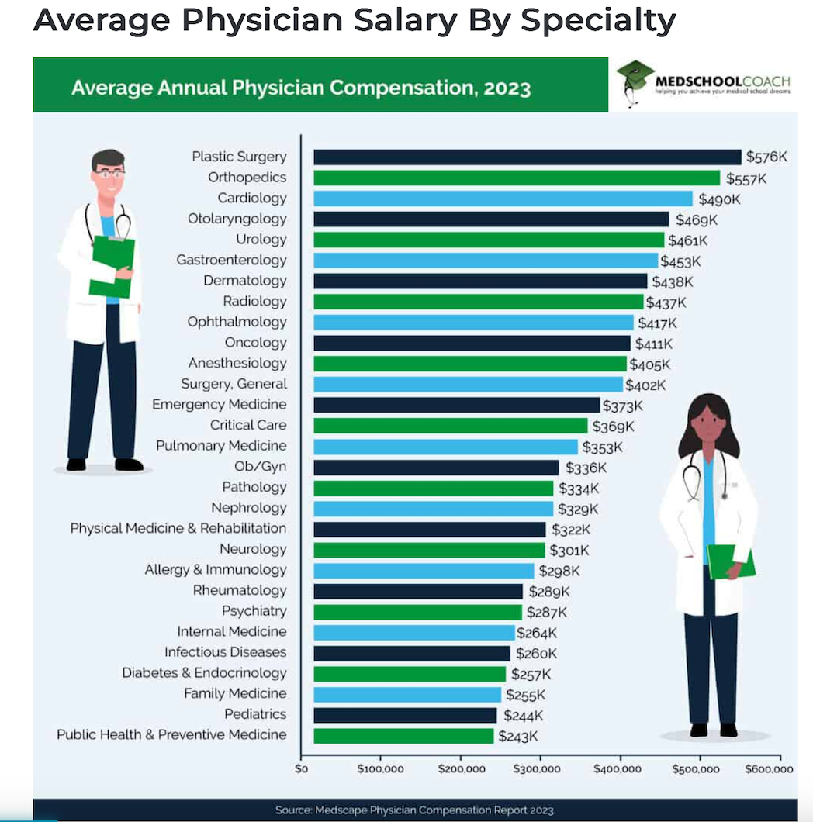

Slide 7


Helping doctors stop doing dumb things with their money since 2011.

Slide 8


Slide 9
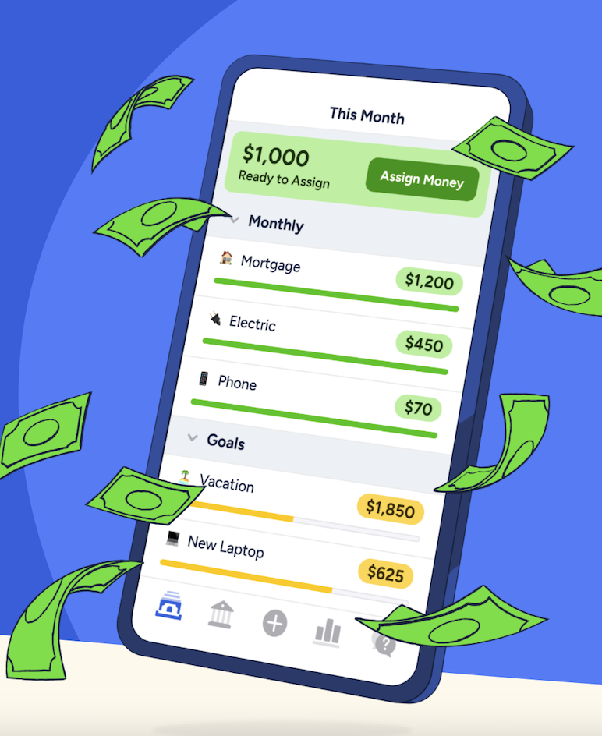
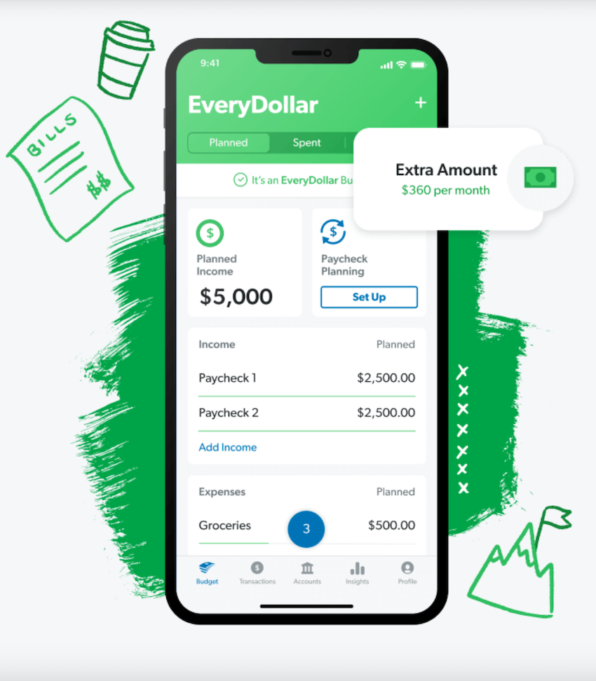
Budgeting
YNAB

Slide 10
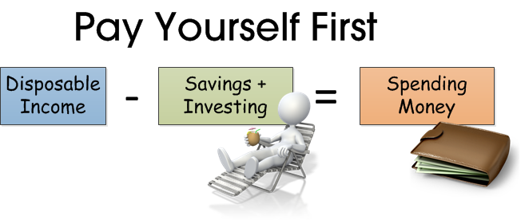

Slide 11


Slide 12

Bad Debt

Slide 13
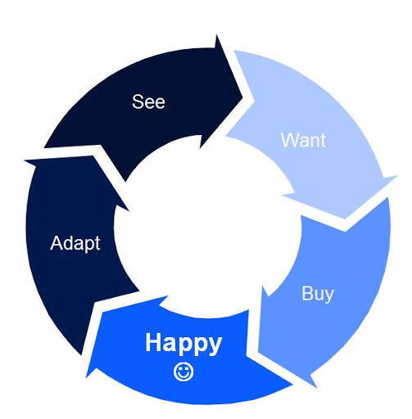

Slide 14
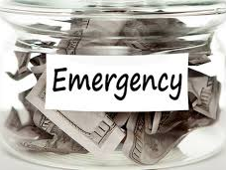
3-6 months living expenses

Slide 15
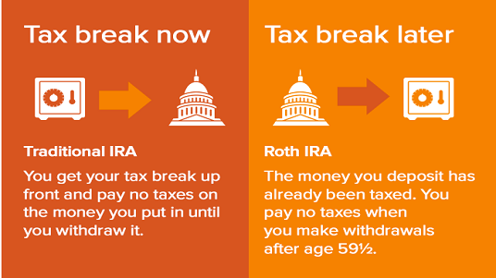

Slide 16
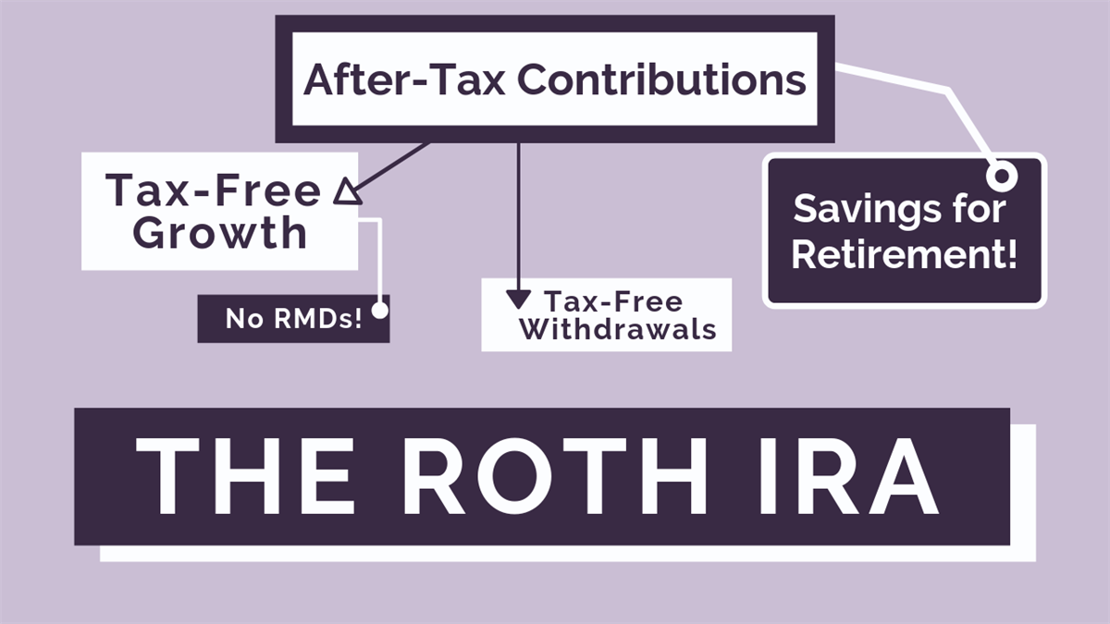

Slide 17


Slide 18


Slide 19


Slide 20


Slide 21
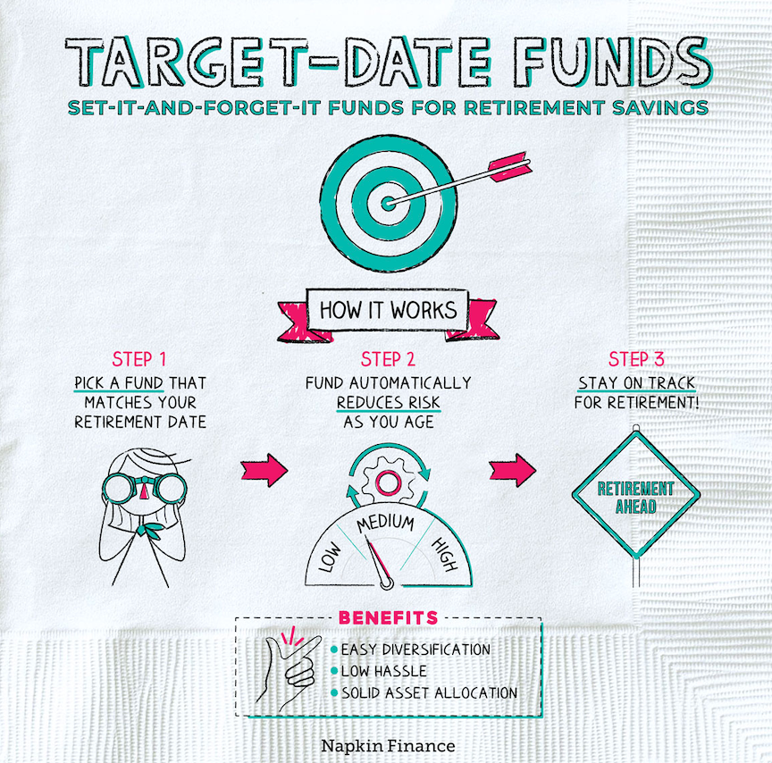
Plan to consistently save 20% of income

Slide 22
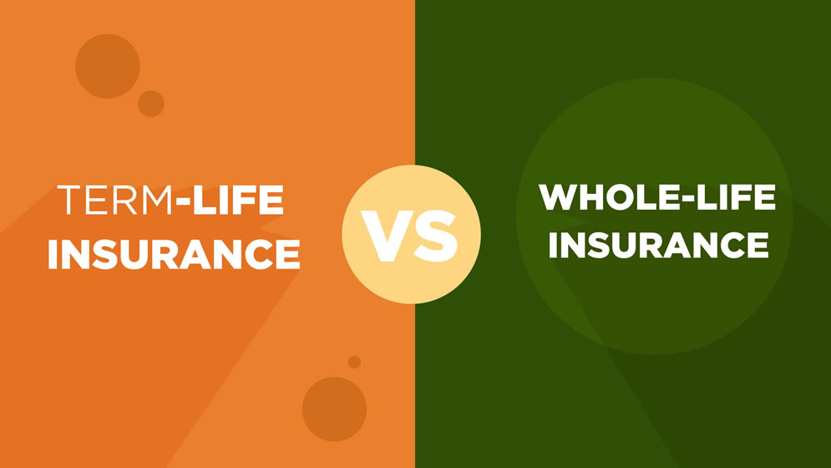

Slide 23

When do you want to lose money?

Slide 24

What’s your most important asset?

Slide 25
Disability insurance
25% chance of being disabled
Purchase as a resident
Own occupation
40-45% More expensive for women
More expensive in CA, FL, TX, NY
More expensive with age and illness
Individual policy, portable

Slide 26

Should you buy a house?
Stable job and personal life
3-5 years to recover closing fees
Most attending change jobs in first 2 years
2x annual income guide
  Will be higher in HCOL, VHCOL

Slide 27
Physician Loans
No cash
No job yet
No credit
Terrible debt-to-income ratio
Less than 20% down and higher loan amounts
No Private mortgage insurance
Higher interest or fees

Slide 28

What does it mean to be rich?

Slide 29


Slide 30


Slide 31
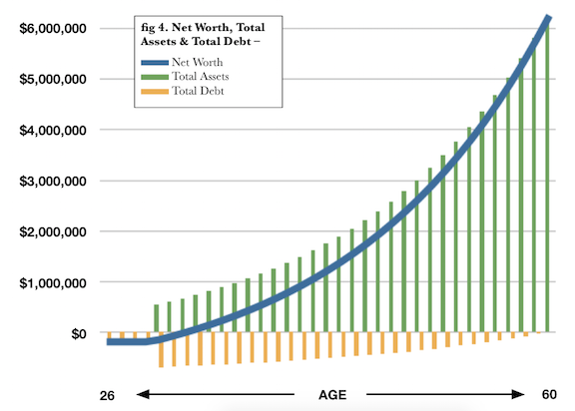

Slide 32

First year as an attending is most important in setting up for financial success

Slide 33
Things to do NOW
Buy disability insurance
02
Start an emergency fund
03
Refinance and pay down student loans
04
Contribute $7,000 annually to a Roth IRA (Vanguard, Fidelity, Charles Schwab)
05
Minimize your student loans
01

Slide 34
Key Concepts
Have a plan for student loan repayment.
Get own occupation disability insurance.
Pay off high interest debt.
Build an emergency fund.
Become financially literate.
Have an investing plan and stick with it.
Get term life insurance if you have dependents.
Contribute to a Roth IRA.
Do not confuse insurance salespersons for financial advisors.
One house, one spouse
Live below your means.

