Slide 1

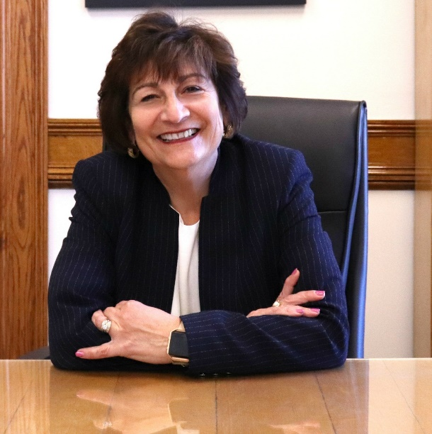
29th Annual Women in Medicine Leadership Forum
May 7, 2025
“The UnHoused in Our Community”
Keynote Speaker Dr. Matilde “Mattie” Castiel

Slide 2
Thank you to the WDMS Women’s Caucus
Annie Abraham, MD Jane Lochrie, MD
Janet Abrahamian, MD Bency Louidor, MD Maria Abruzzo, MD Kirti Nagpal, MD
Raquel Bitar, MS4 Stacy Potts, MD Nicole Cherng Manjul Shukla, MD
Lynn Eckhert, MD Rebecca Spanagel, MD
Marianne Felice, MD Martha Waite, MD
Arianna Gray, MS4 Jennifer Yates, MD
Hari Kirin Khalsa, MD Lynda Young, MD (Chair)
Rebecca Kowaloff, DO

Slide 3
Upcoming events
Annual Legislative Breakfast – May 9, 2025, 7:30 am, Zoom
Meet the Author Series - May 21, 2025, 5:30 pm, UMMS
“Through My Grandma’s Eyes” - Facilitator: Lucia Knoles, PhD, Professor of English at Assumption University and a Board Member/Summer Instructor for the Worcester Clemente Program, with a panel of contributing student authors
229th Annual Oration - June 10, 2025, 5:30 pm, Mechanics Hall
Orator: Lisa Sanders, MD - is the Medical Director of Yale's Long Covid Multidisciplinary Care Center. In addition to her work as a physician and teacher, she writes the popular Diagnosis column for the New York Times Magazine and the Think Like a Doctor column featured in the New York Times blog, The Well. In 2019 she collaborated with the New York Times on an eight-hour documentary series on the process of diagnosis for Netflix.

Slide 4

Dr. Matilde “Mattie” Castiel
Commissioner for Health and Human Services Associate Professor of Internal Medicine, Family Medicine and Psychiatry at UMass Chan Medical School

Slide 5

Thank you for joining us for the 2025 Women in Medicine Leadership Forum
Have a great summer!

