Slide 1
healthcare Stories from the Frayed Edge
Dr. Rick Sacra
Medical Missionary to Liberia/
Family Medicine Faculty at Family Health Center of Worcester
ricksacramd@outlook.com

Slide 2
Timeline
Acknowledgements
Threads of Truth
Stories

Slide 3
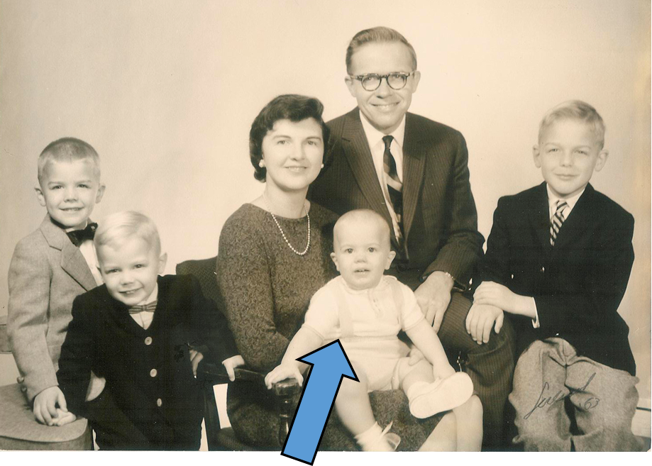
October 1962

Slide 4
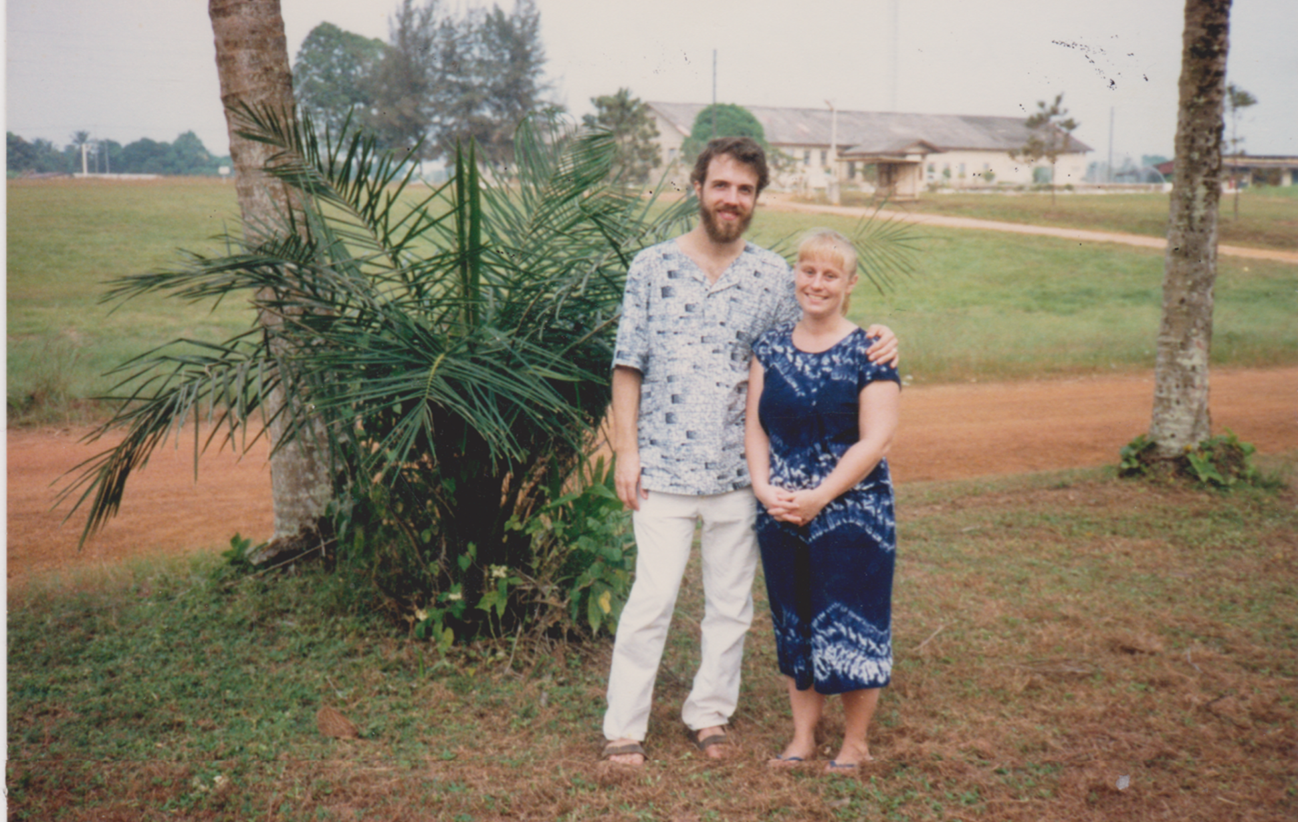
August 1987

Slide 5
June 1989—Graduated from UMass Medical School;
Start 3 year Family Medicine Residency in Bristol, Tennessee

Slide 6
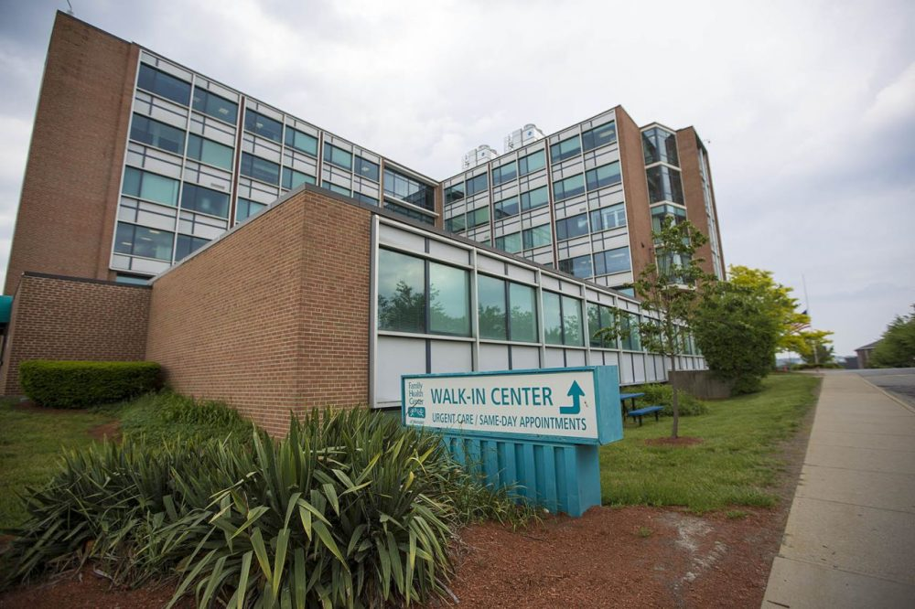
September, 1992—Start work at Family Health Center of Worcester (Former Worcester City Hosp)

Slide 7
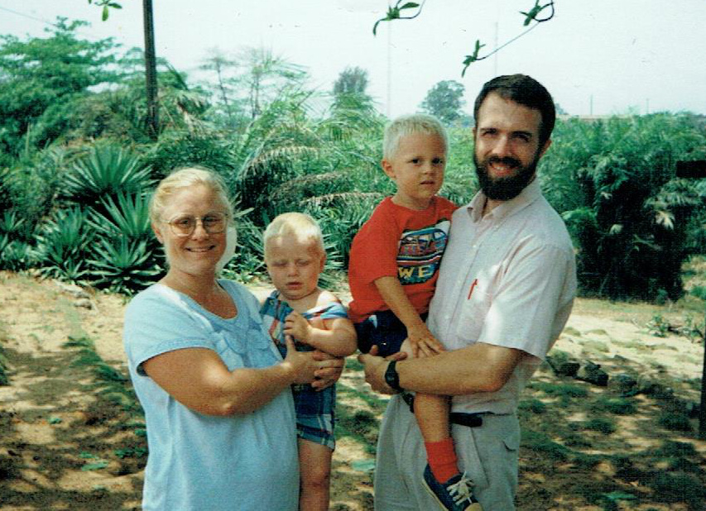
April 1995—Move to Liberia with Debbie and 2 sons

Slide 8
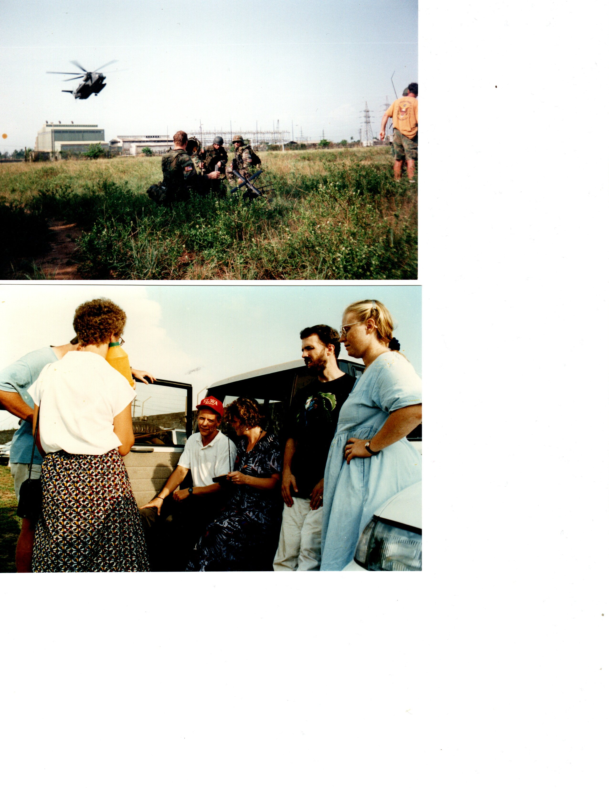
April 1996—First Evacuation due to Civil War

Slide 9
April 1997—Return to West Africa to work with Liberian Refugees in Côte d’Ivoire
June 1998—Return to Monrovia to work at ELWA

Slide 10
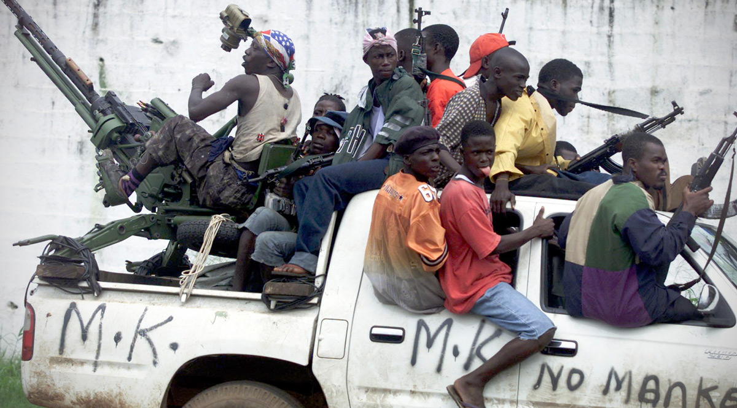
June-August 2003—Final Civil War Outbreak/Monrovia

Slide 11
2010 to 2013—Leave of absence from SIM (Mission), full time at Family Health Center of Worcester
Sept 2013—Resume missions work/visits to Liberia
August 2014—Contracted Ebola

Slide 12
July 2017—Liberia’s first Family Medicine Residency Program founded at ELWA Hospital
August 2020—First class of Family Medicine Specialists graduates
October 2021—Sacras return to USA full time

Slide 13
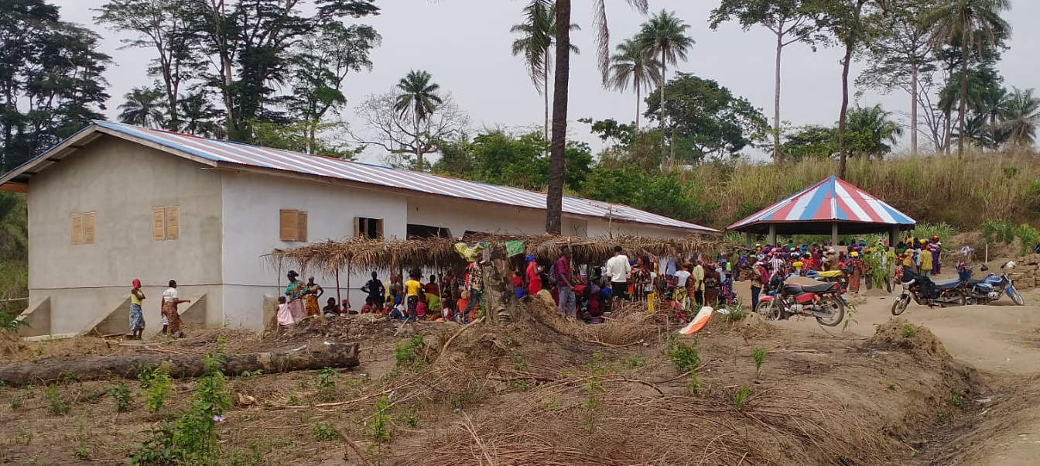
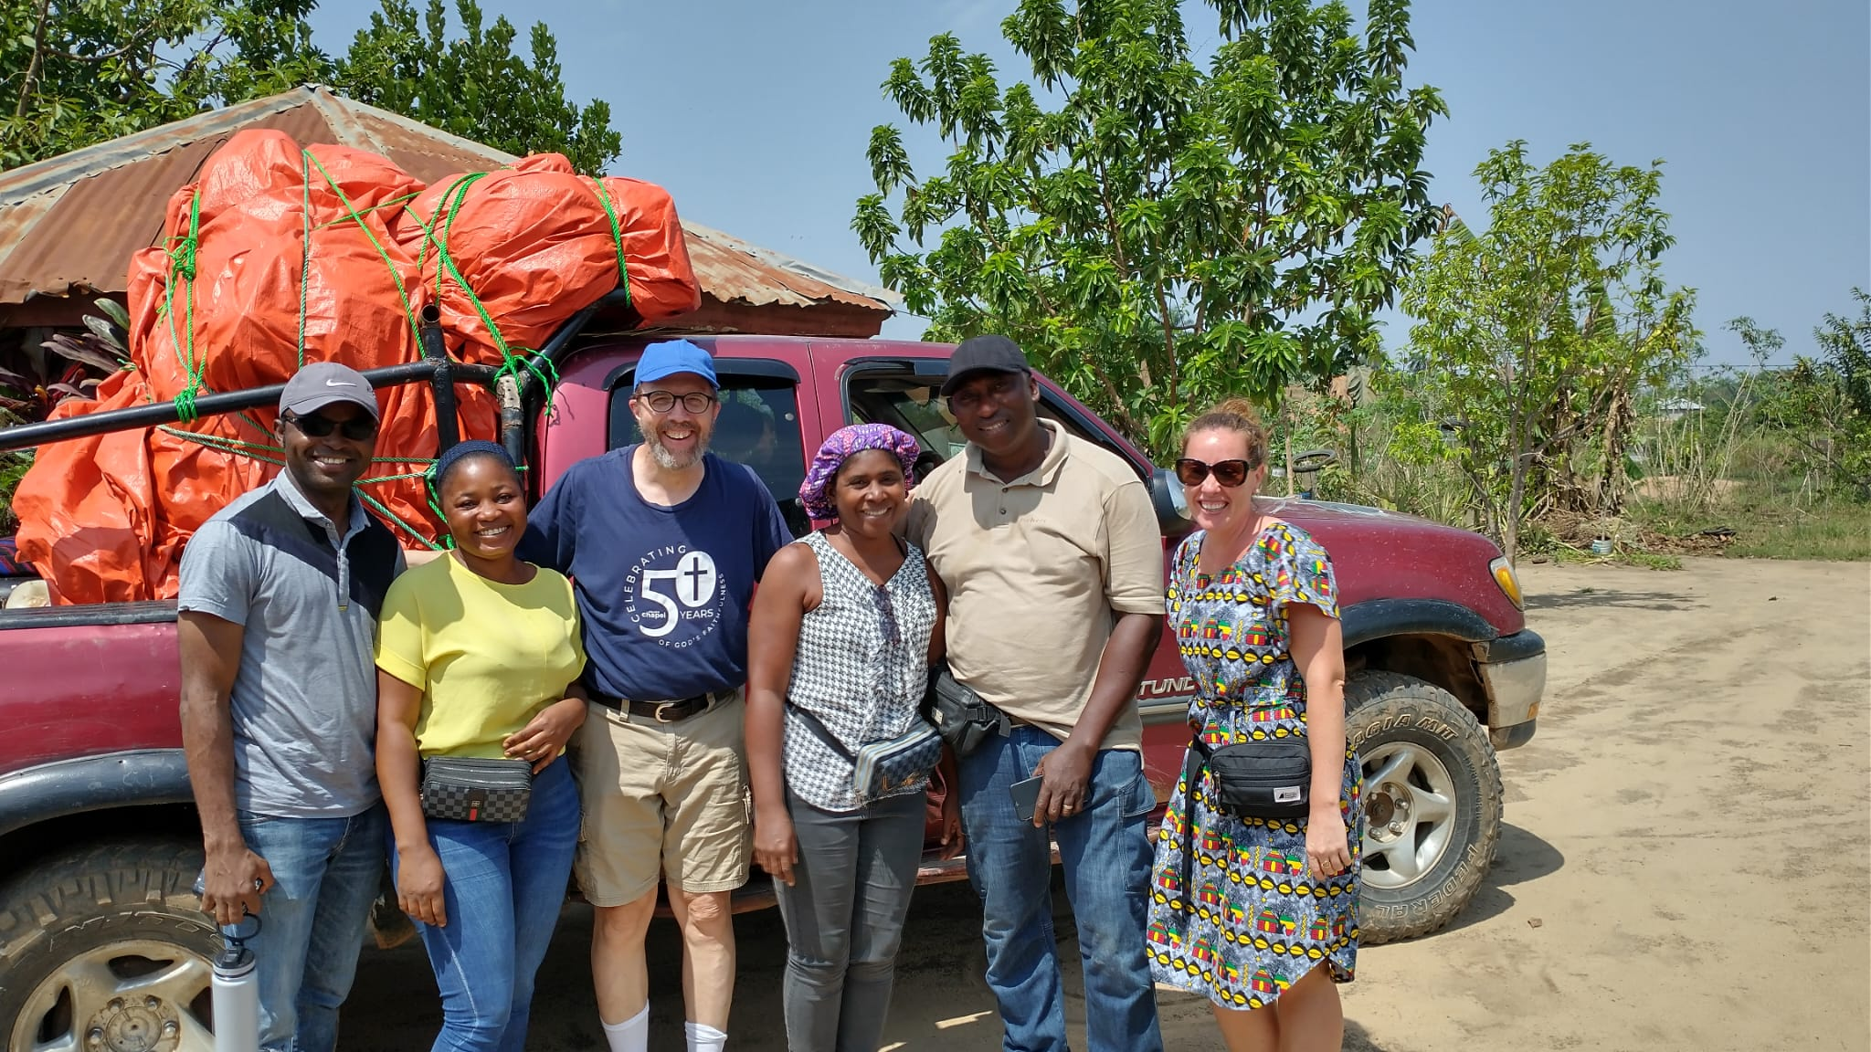
March 2024—Rick’s 1st trip to visit Quessemba Community Clinic, Lofa County, Liberia

Slide 14
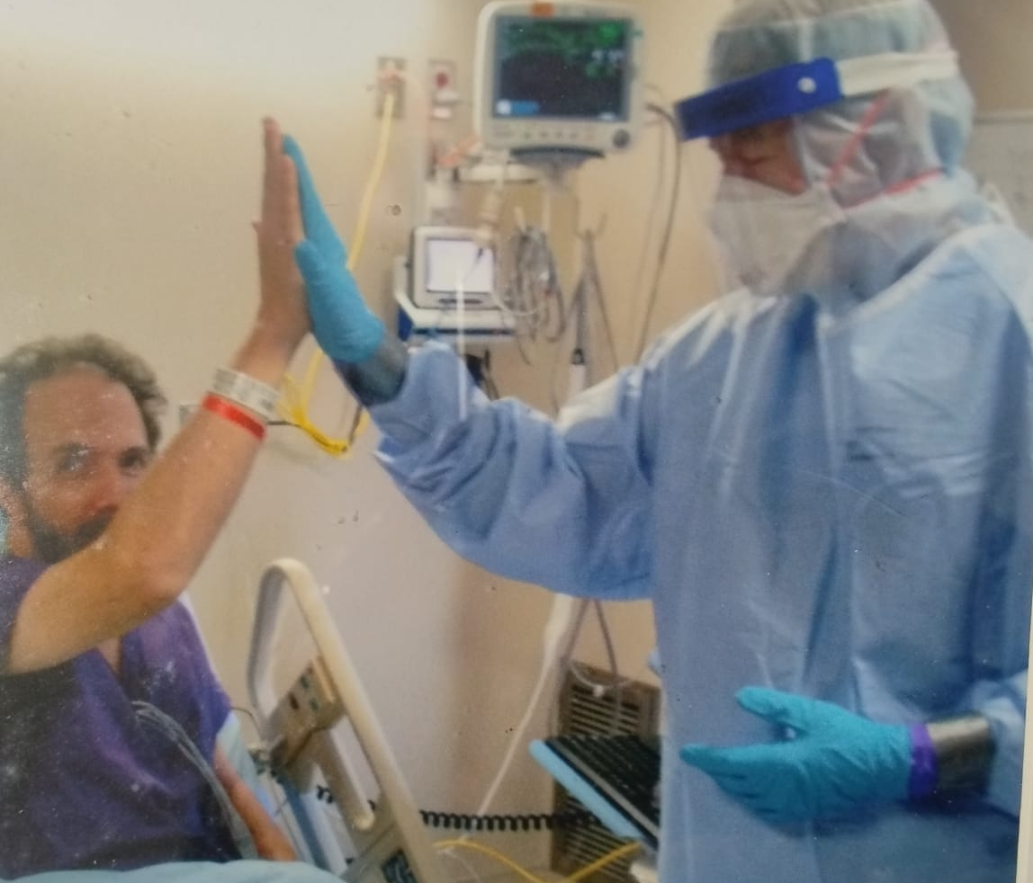
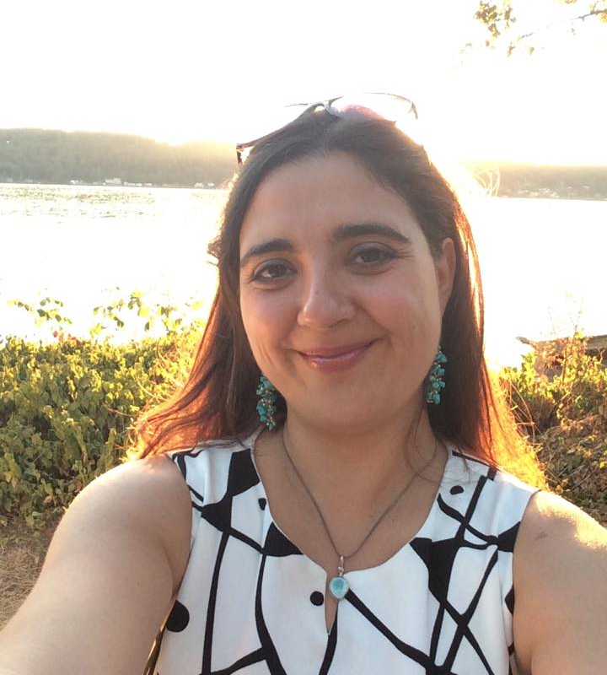
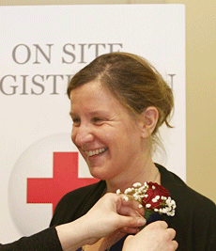
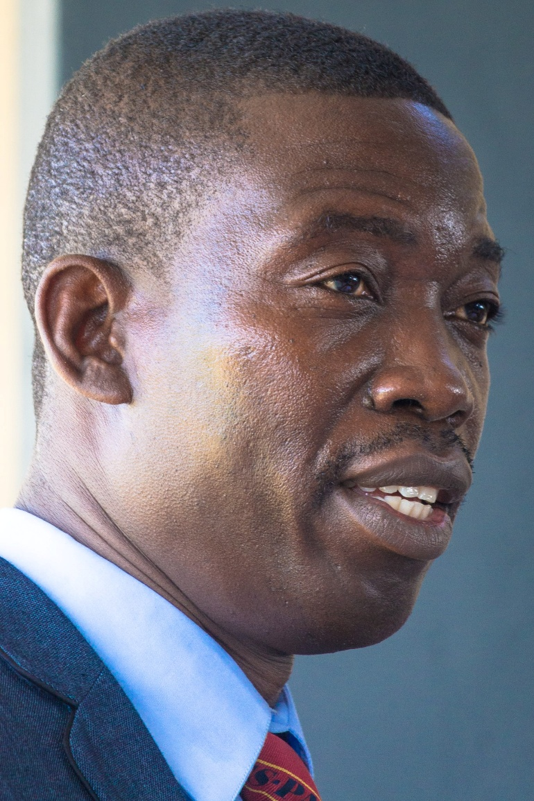
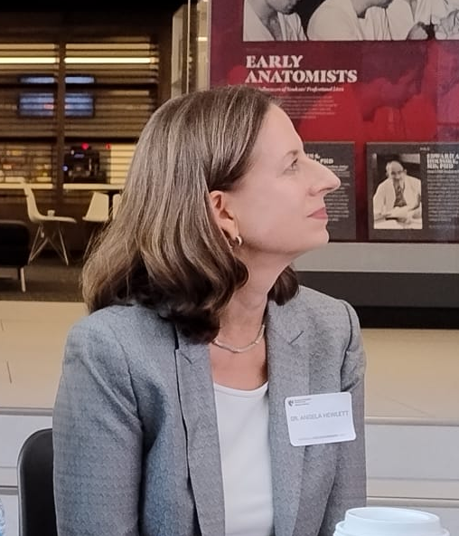
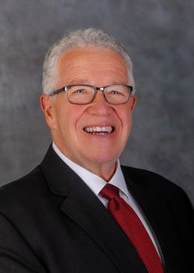
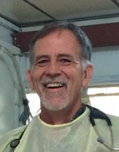
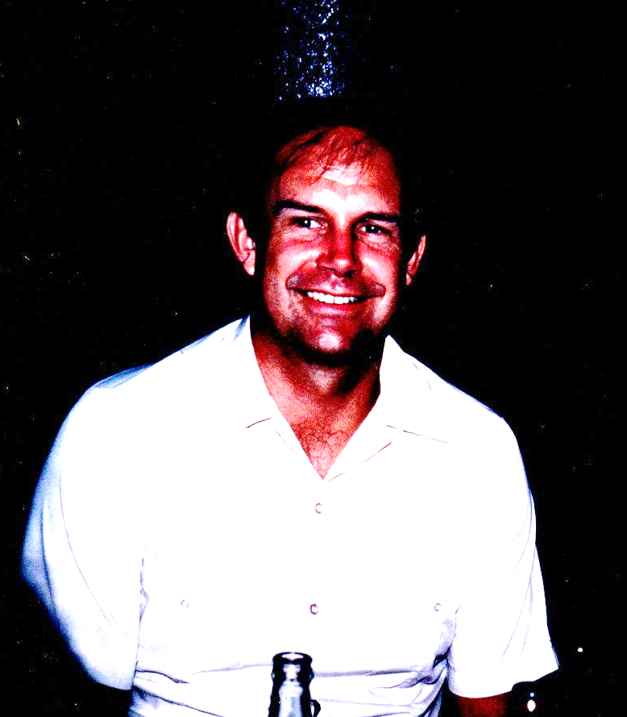
Acknowledgements/ShoutOuts!

Slide 15
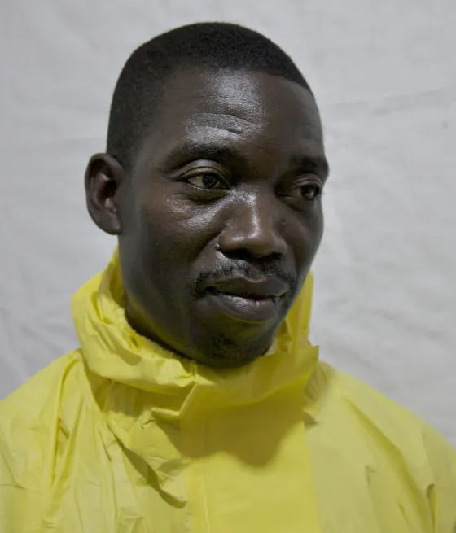
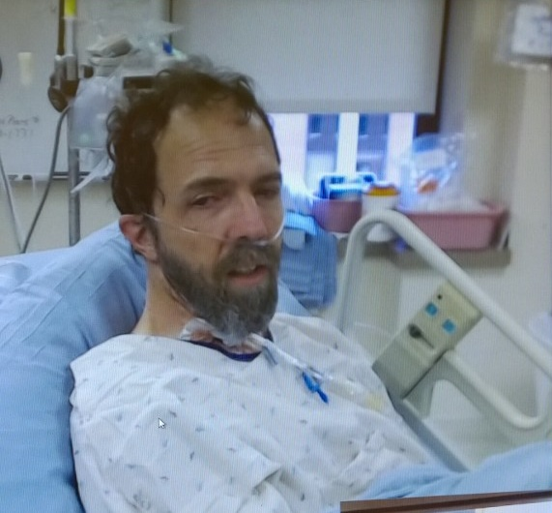
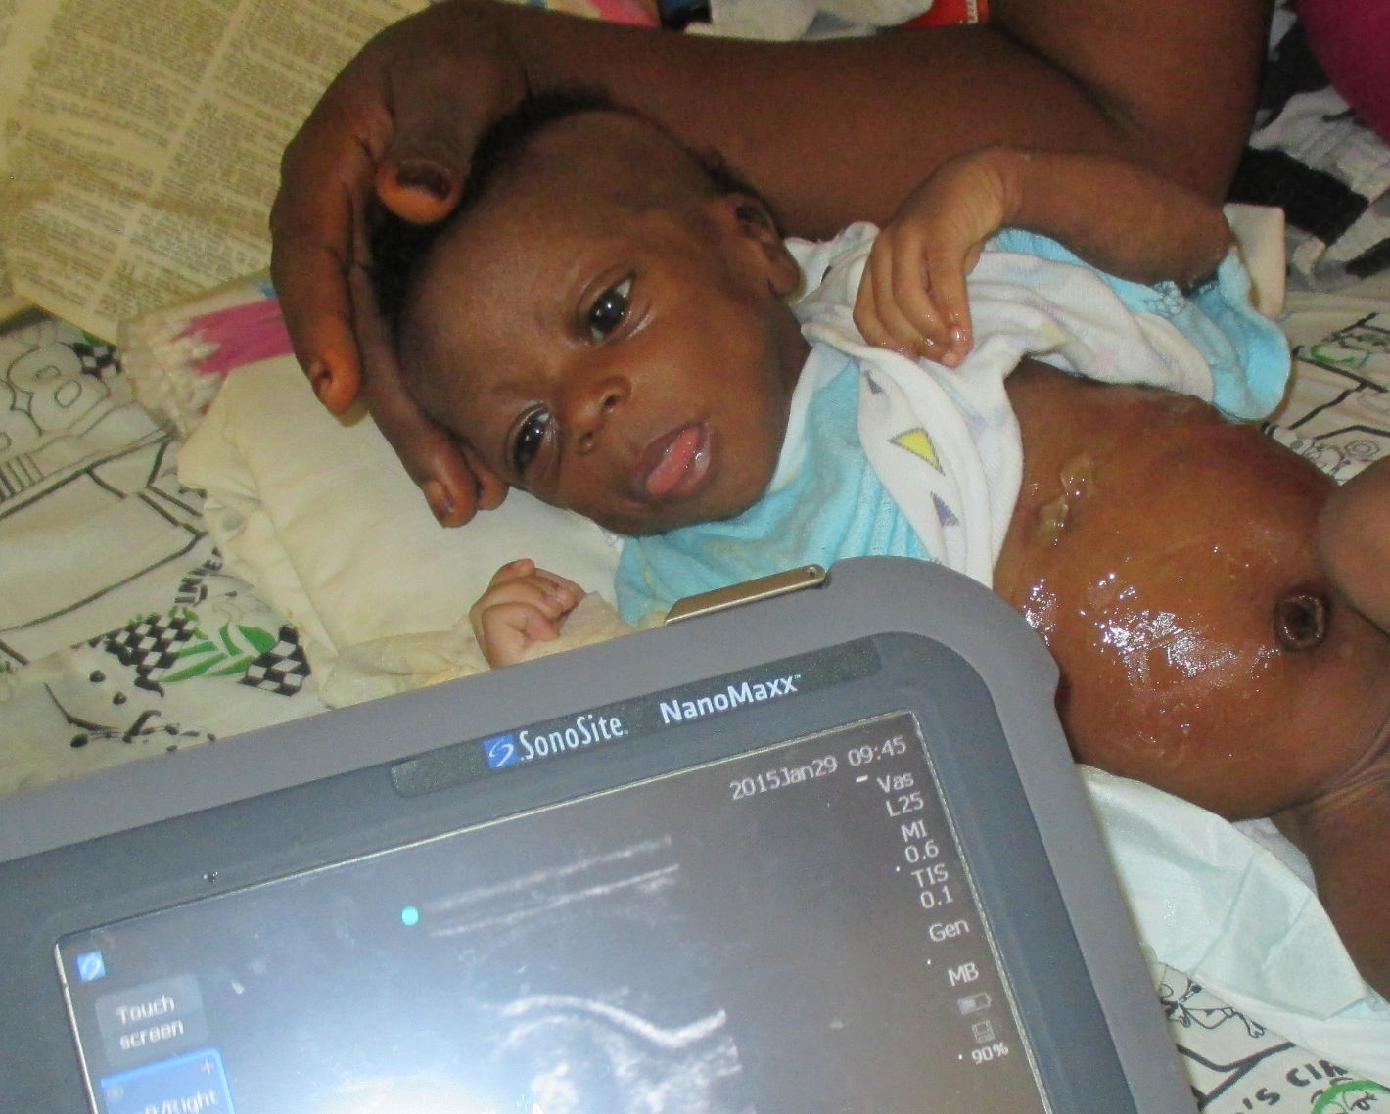
Threads to hold onto…
The “Imago Dei”
Healthcare as Calling
Facing Death/eternal Perspective

Slide 16
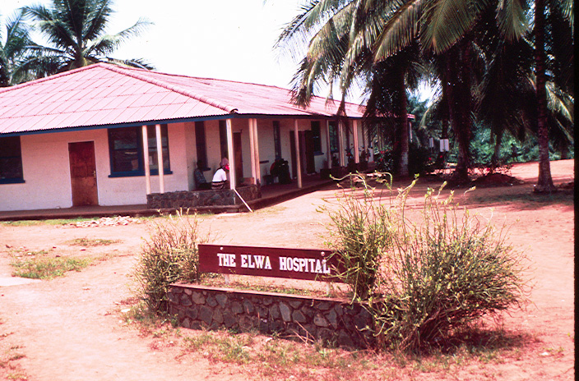

Slide 17
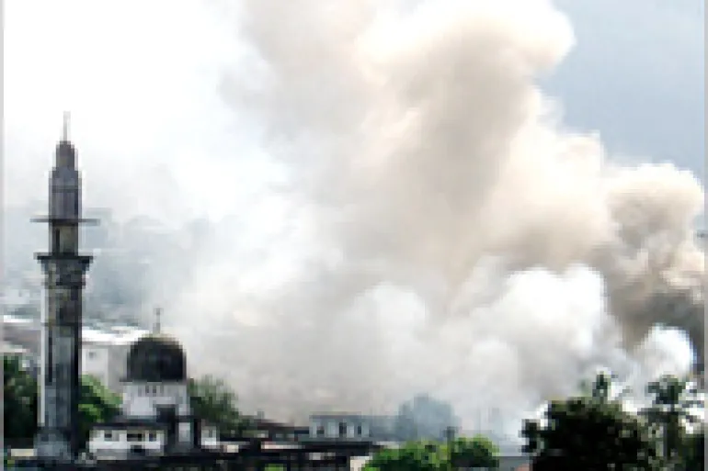

Slide 18
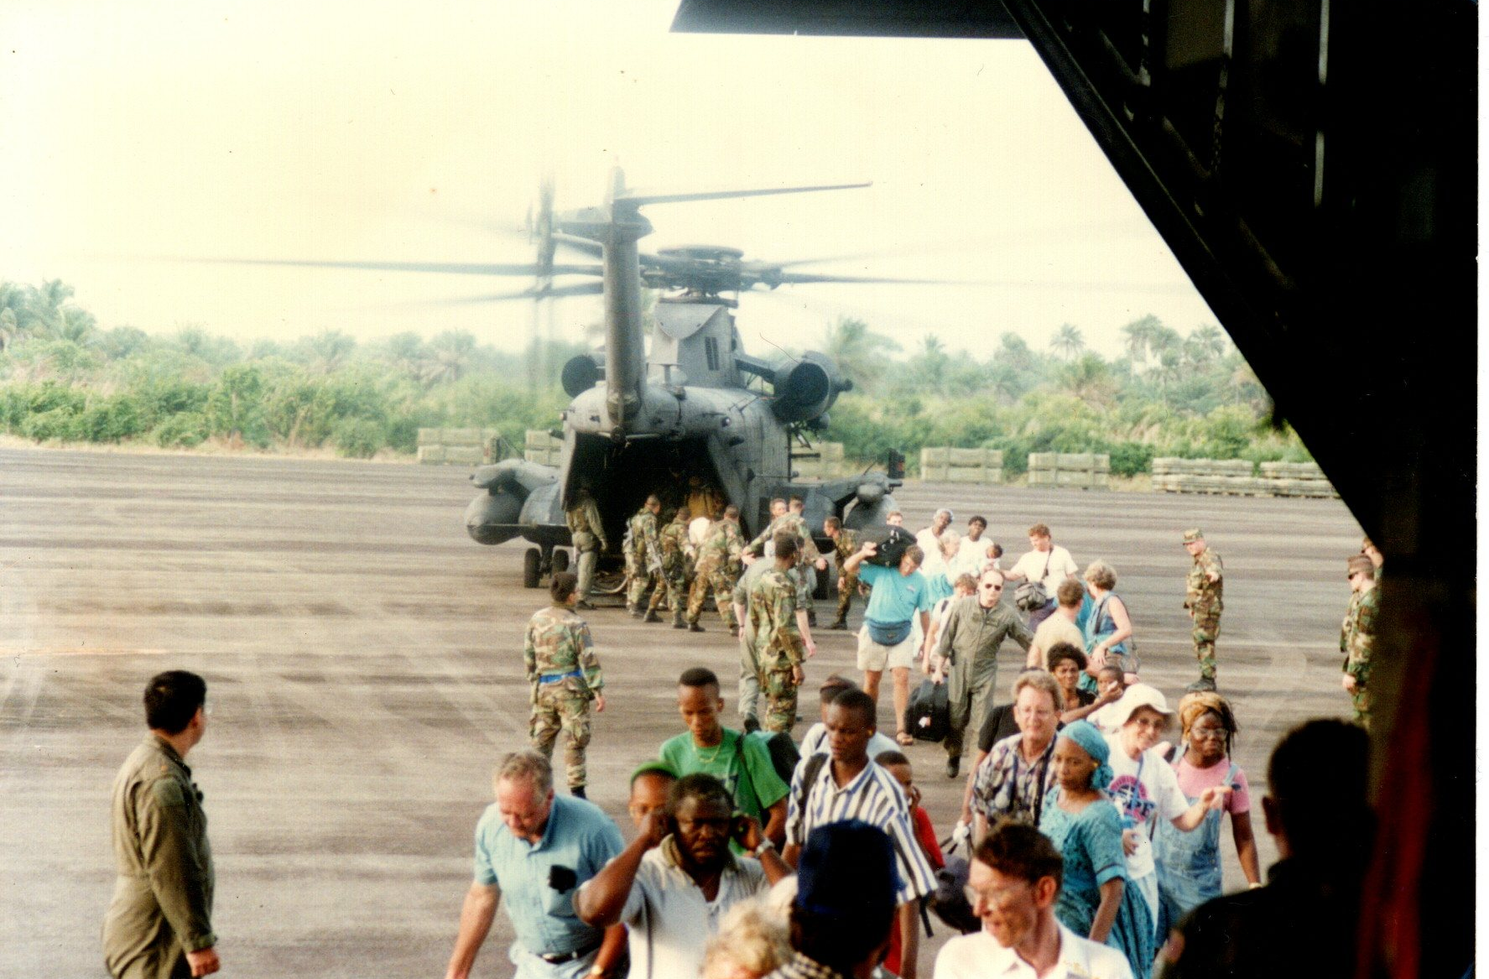

Slide 19
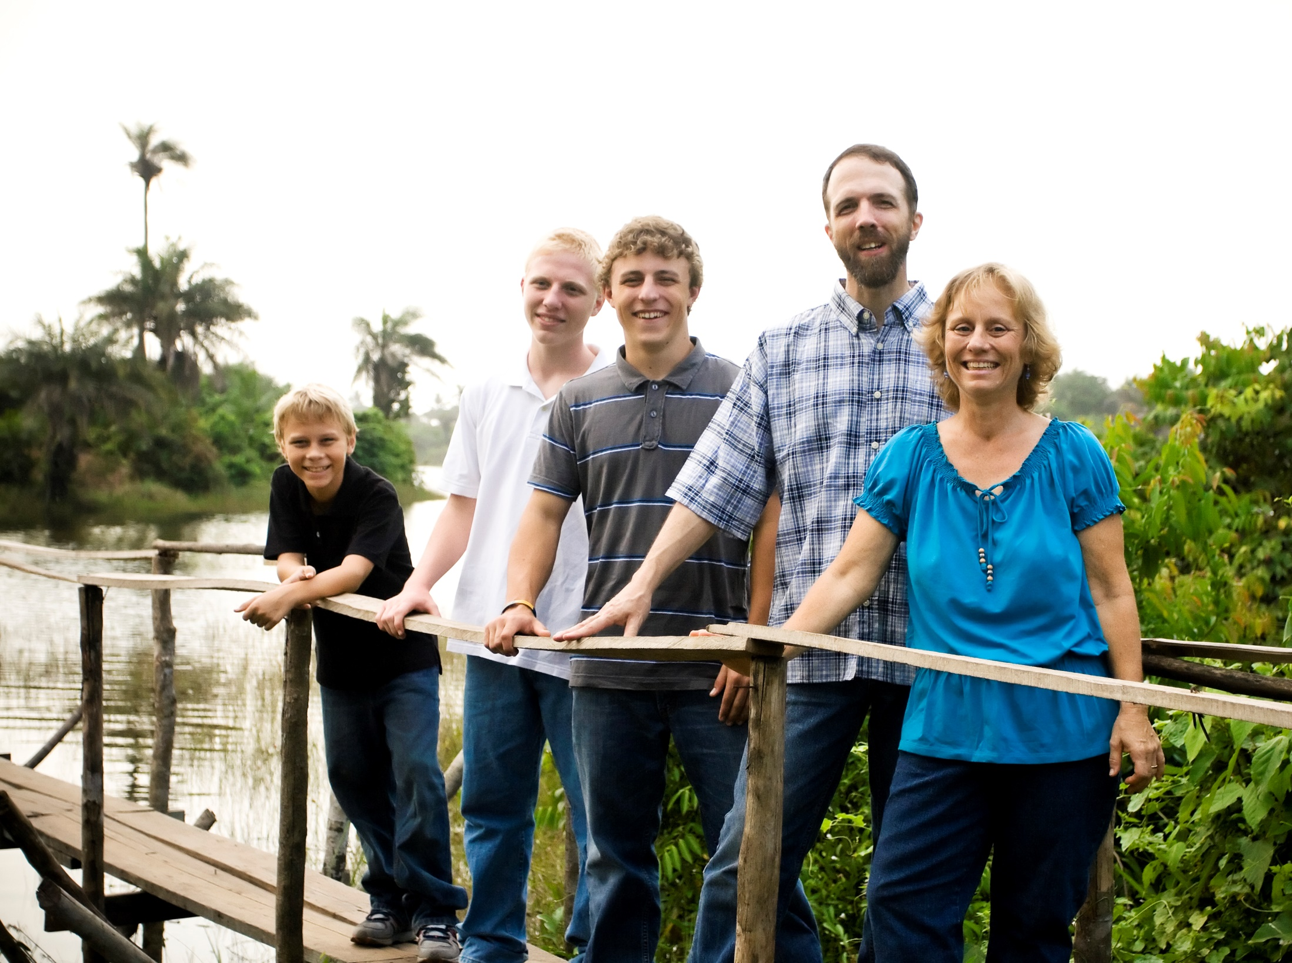

Slide 20
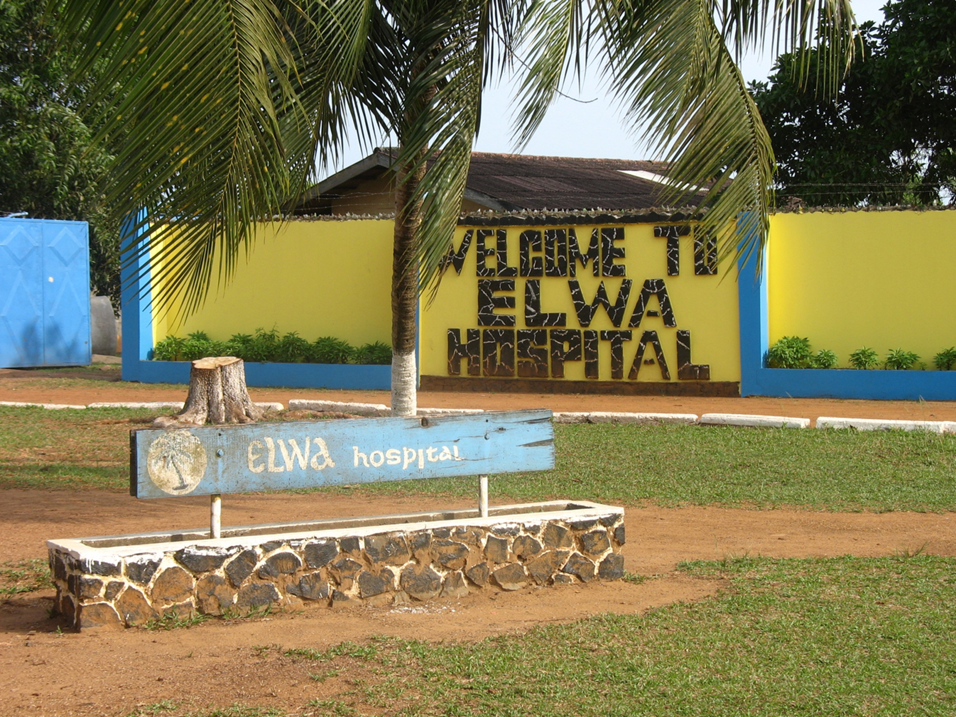

Slide 21
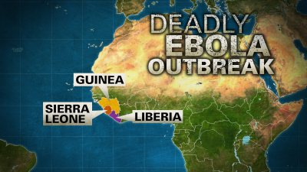

Slide 22
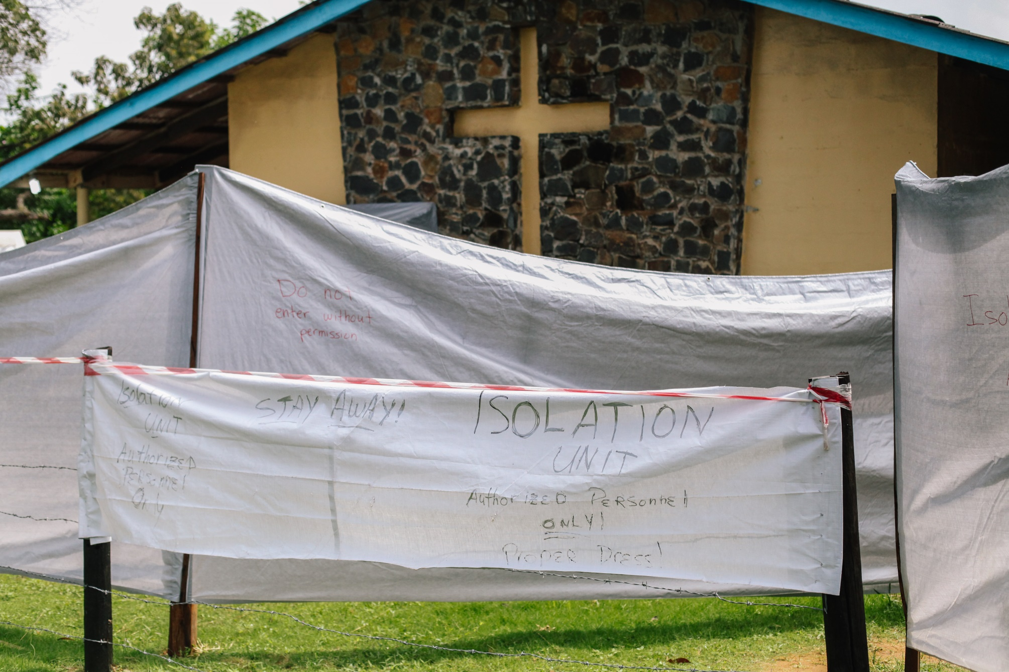

Slide 23
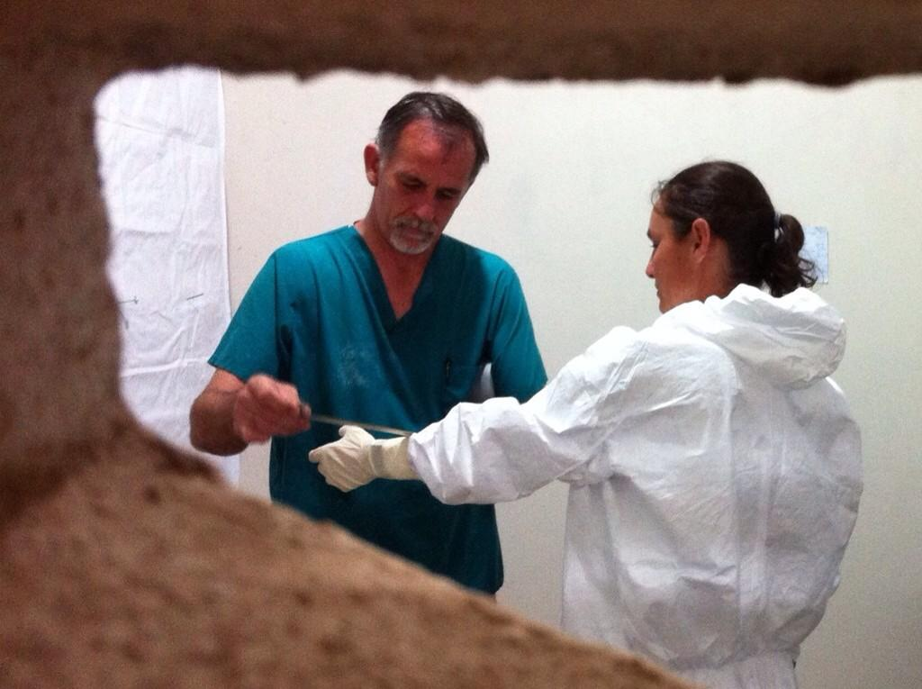

Slide 24
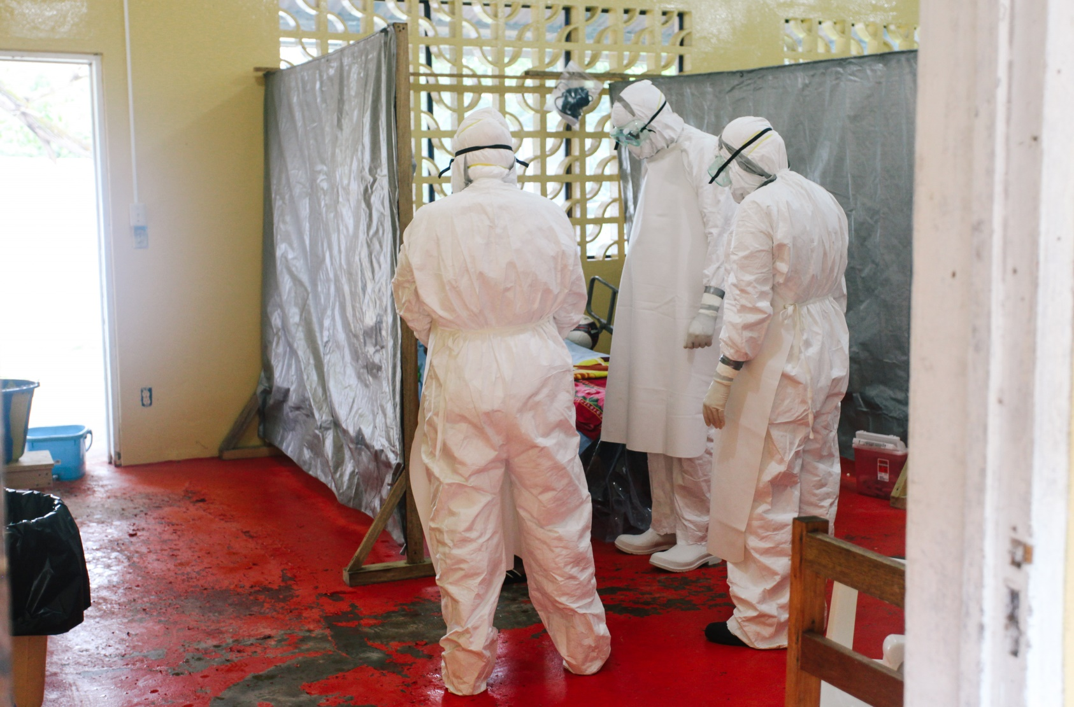
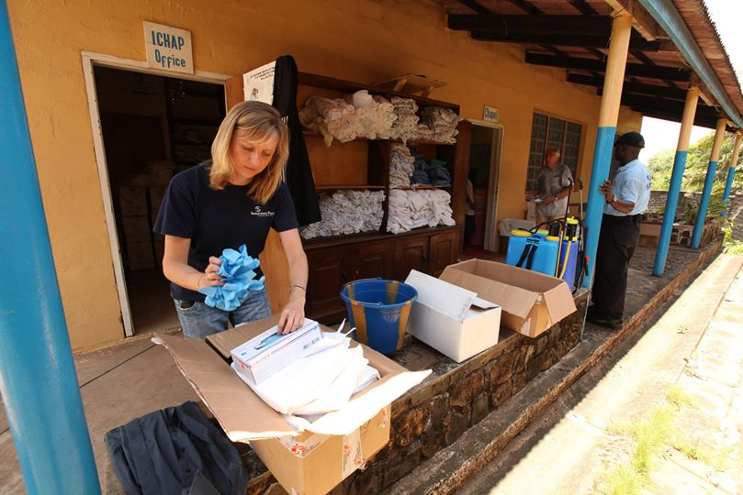

Slide 25
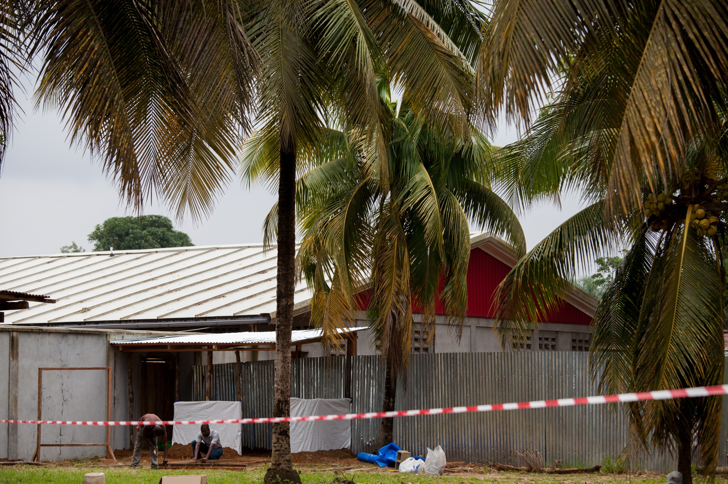

Slide 26
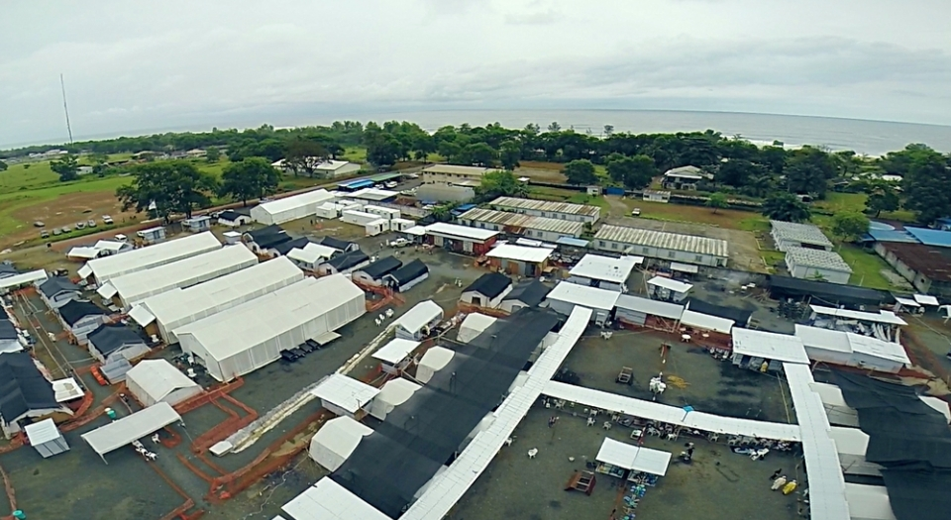

Slide 27
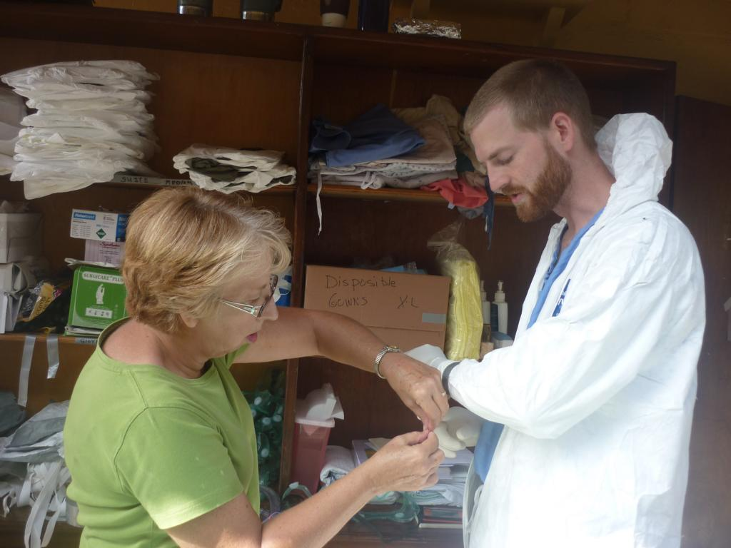

Slide 28
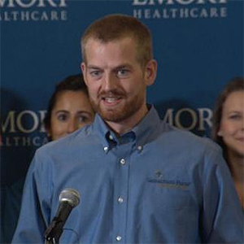
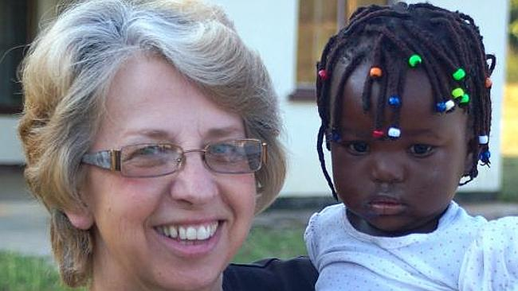

Slide 29


Slide 30
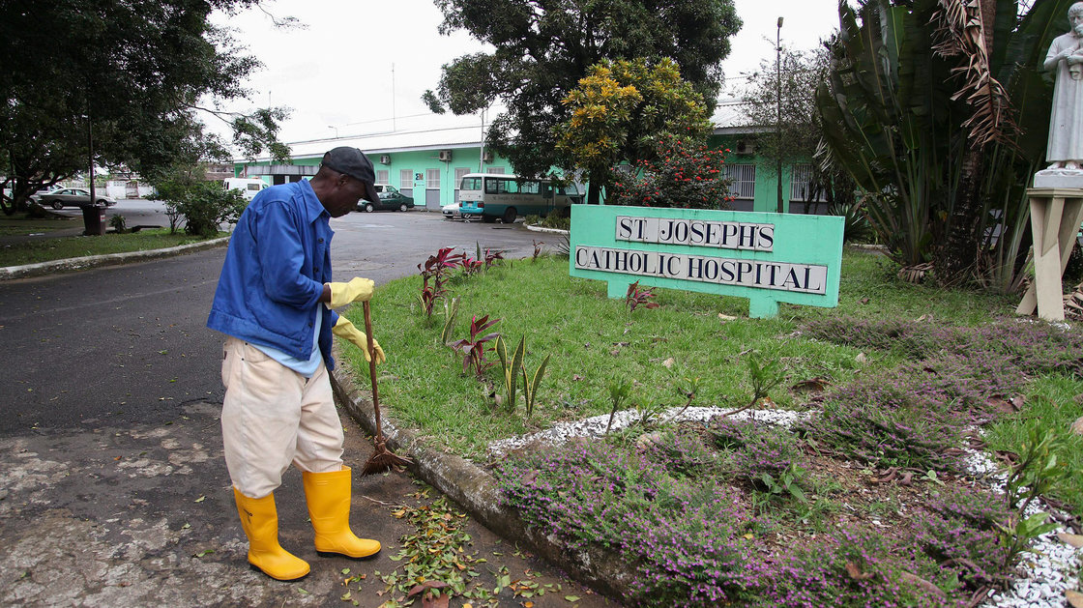

Slide 31
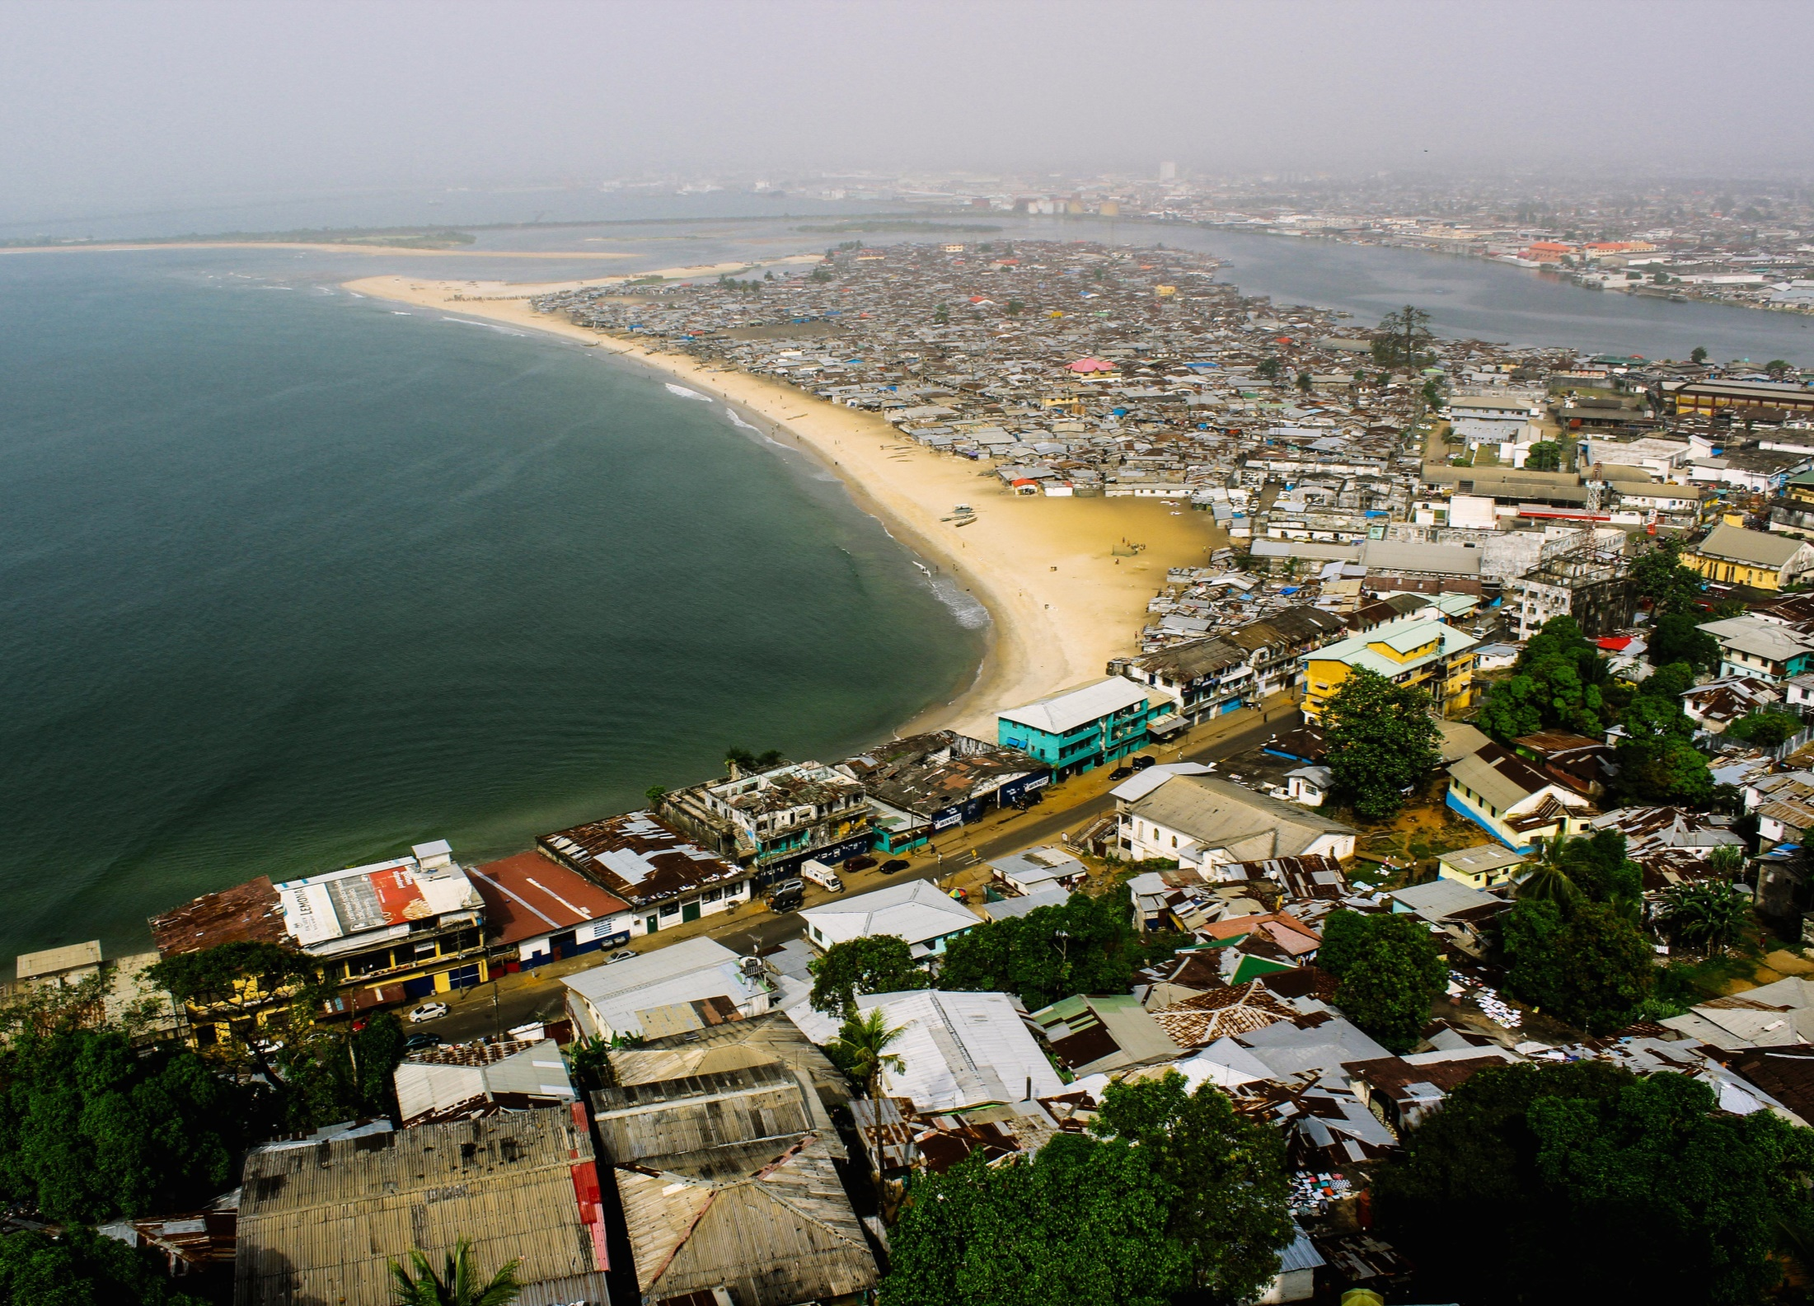

Slide 32
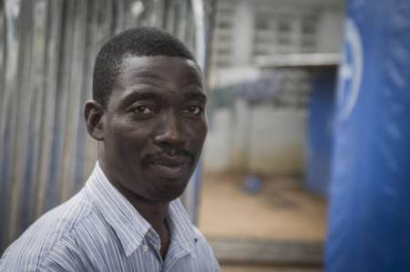

Slide 33
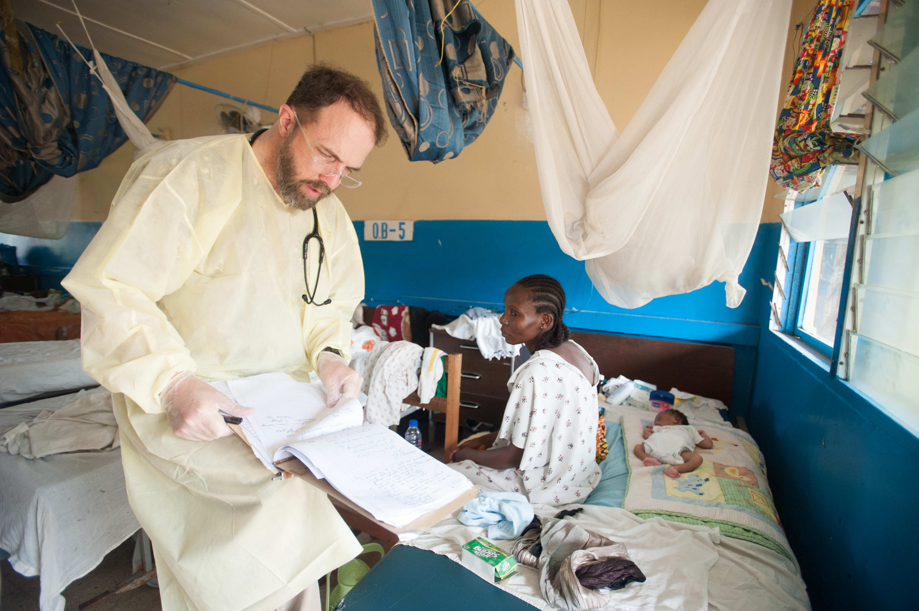

Slide 34
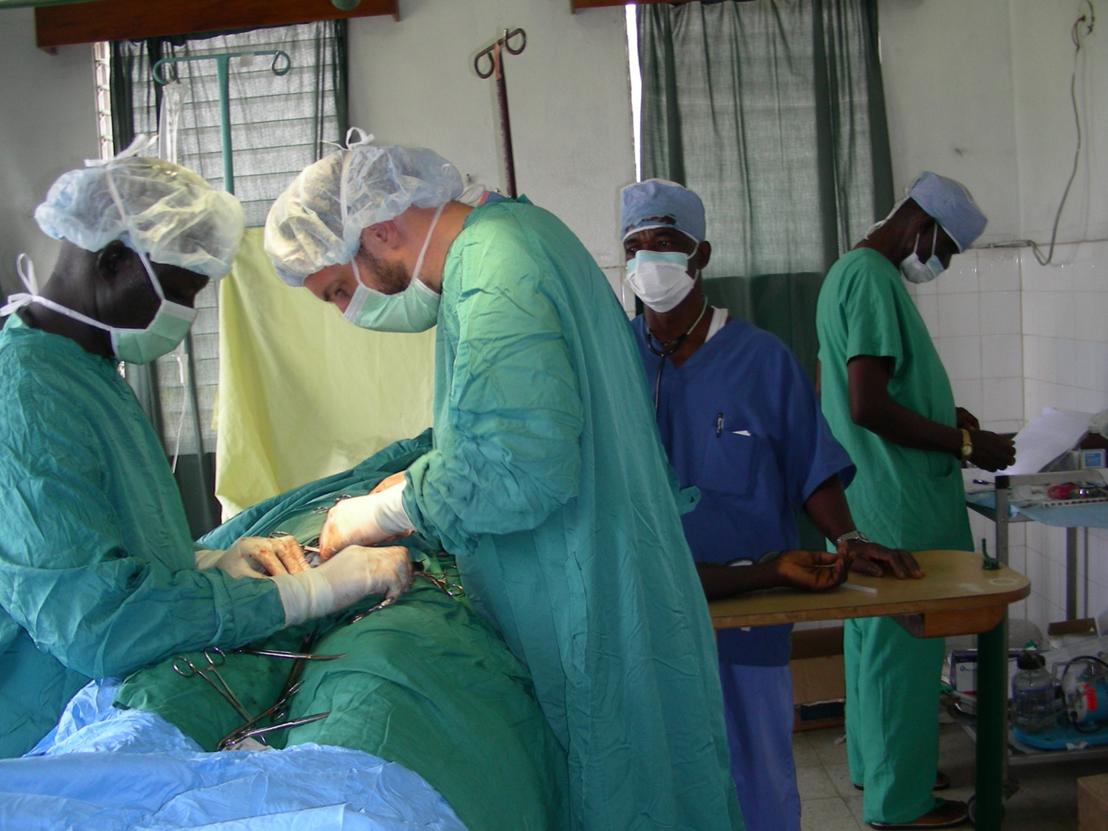

Slide 35
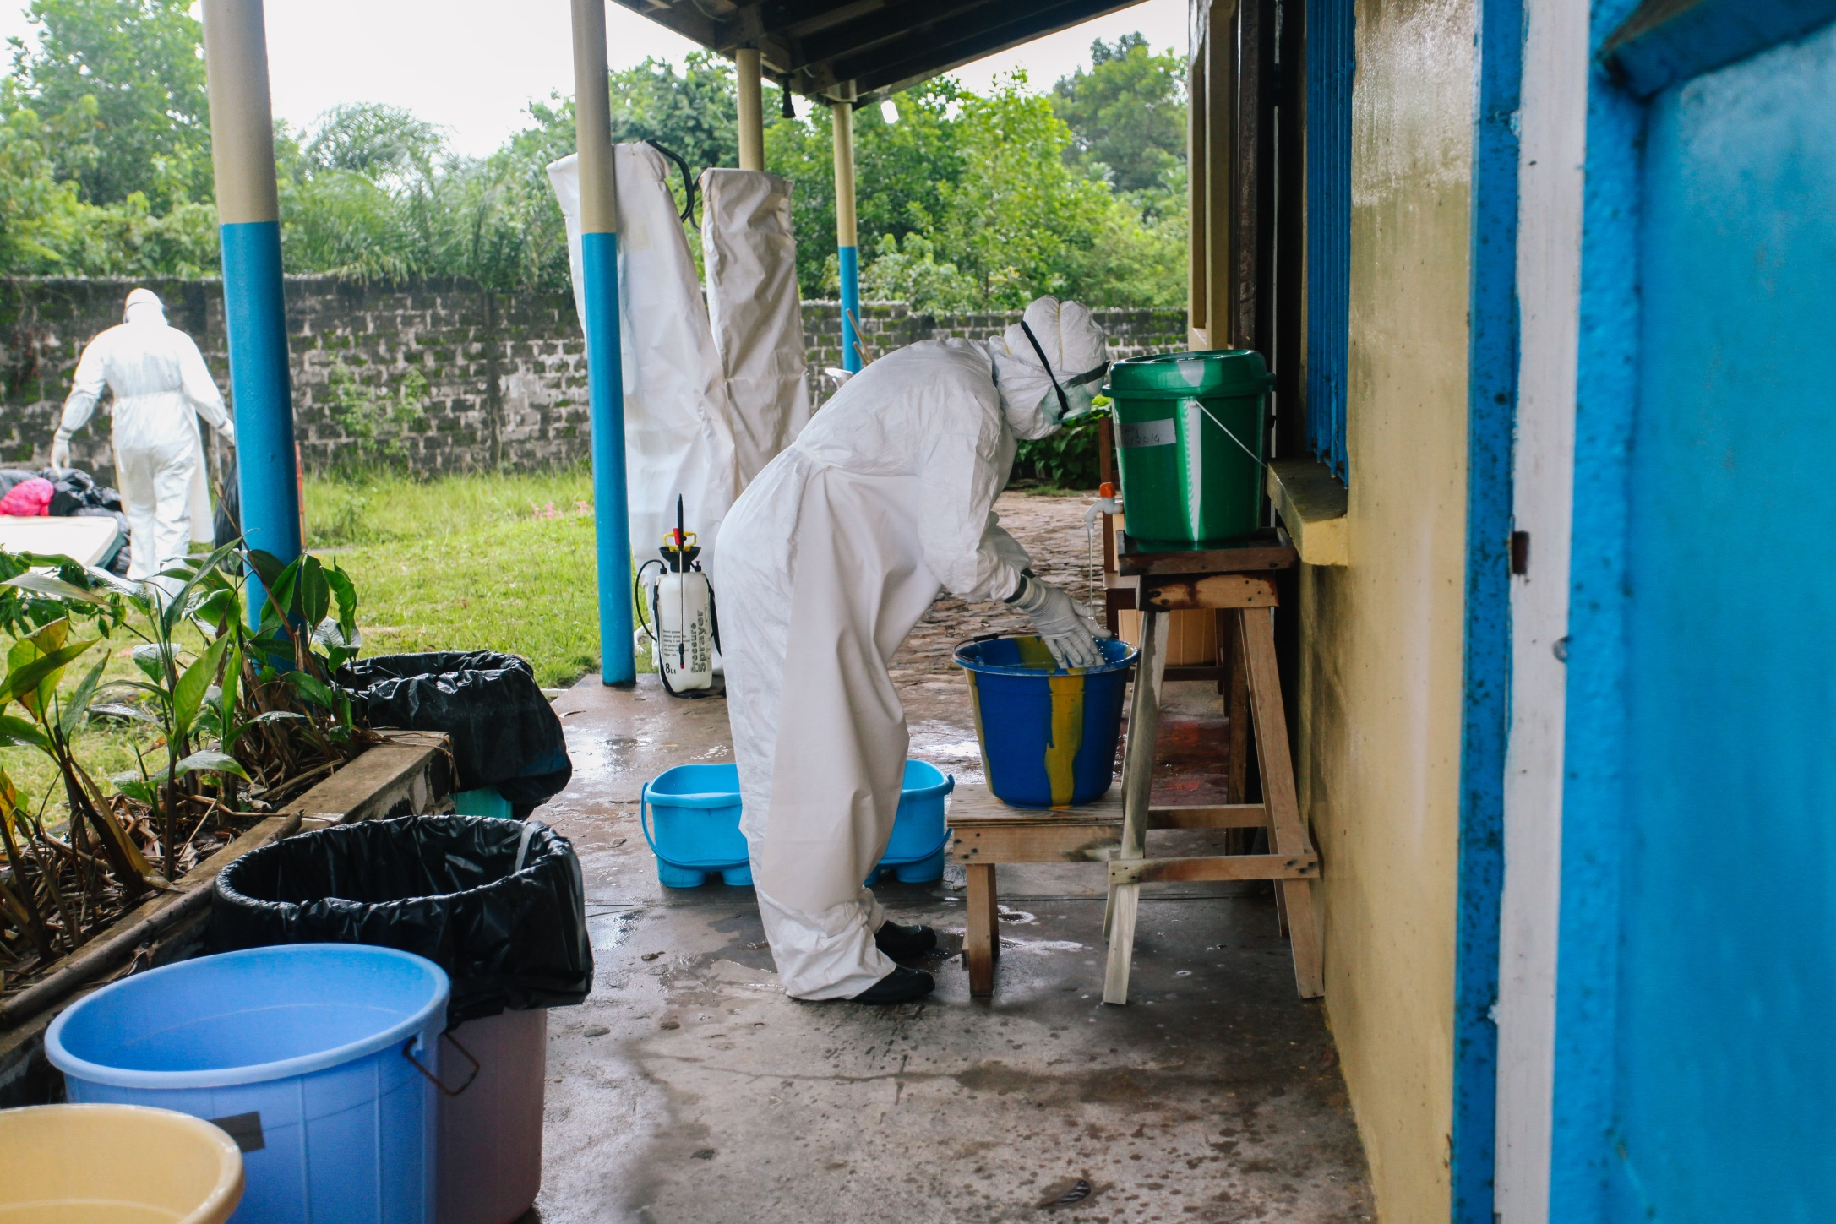

Slide 36
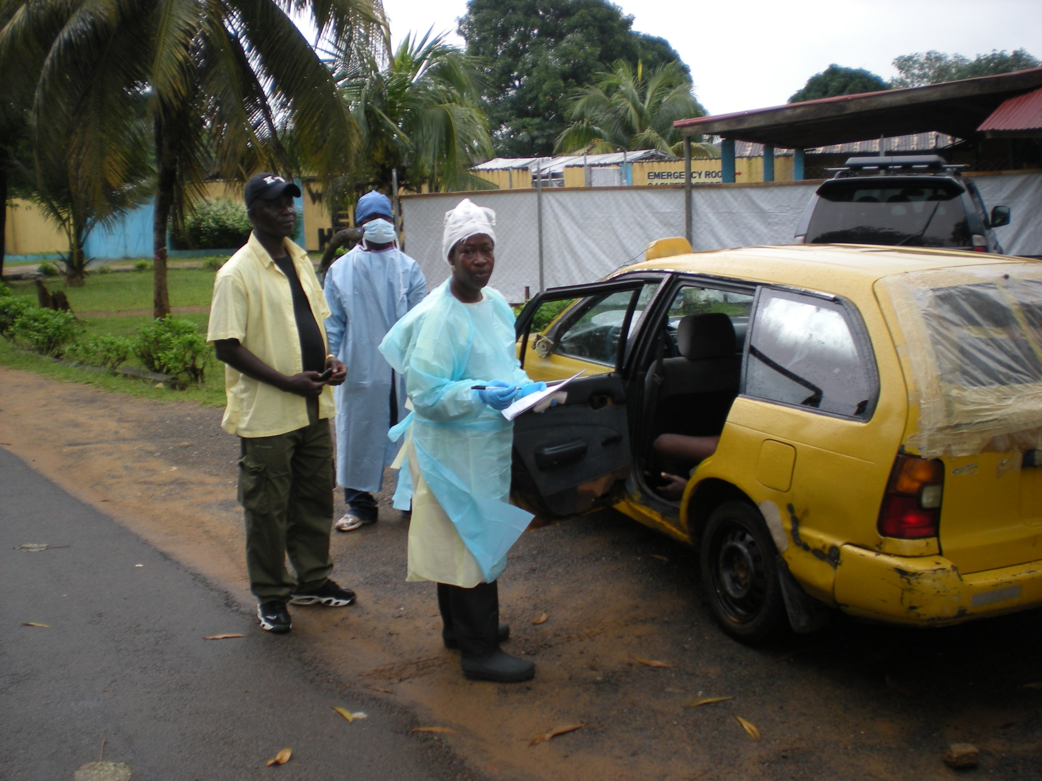

Slide 37
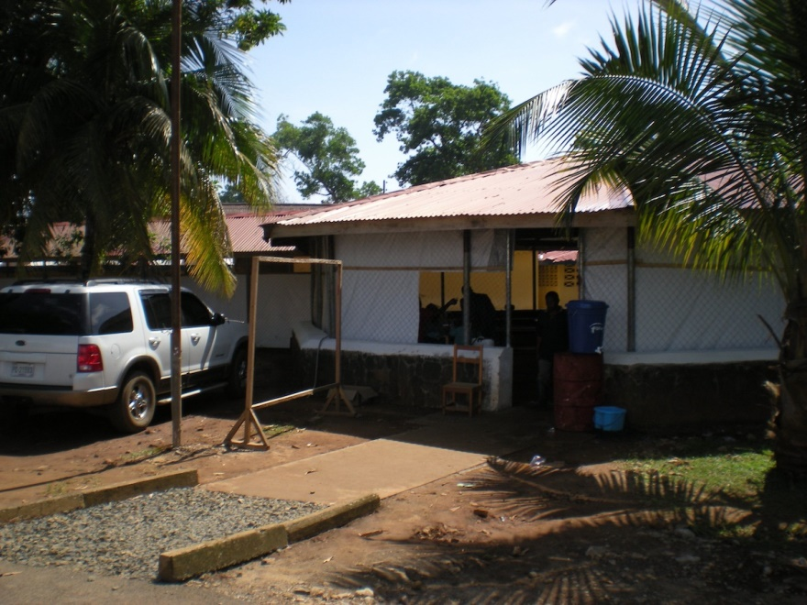

Slide 38
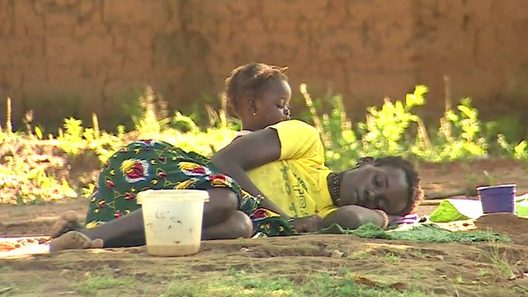

Slide 39
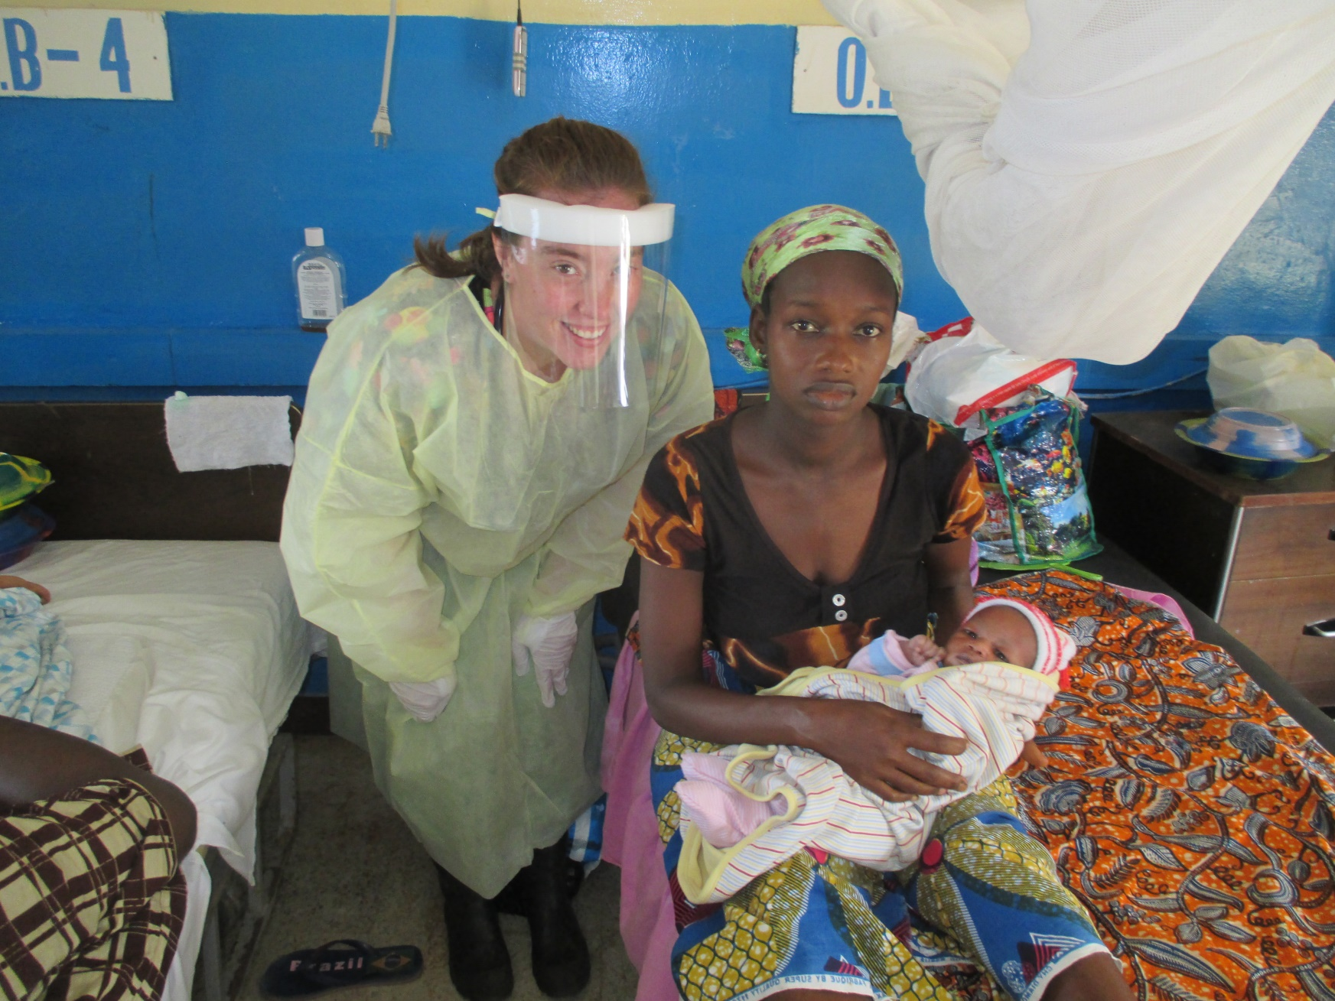

Slide 40
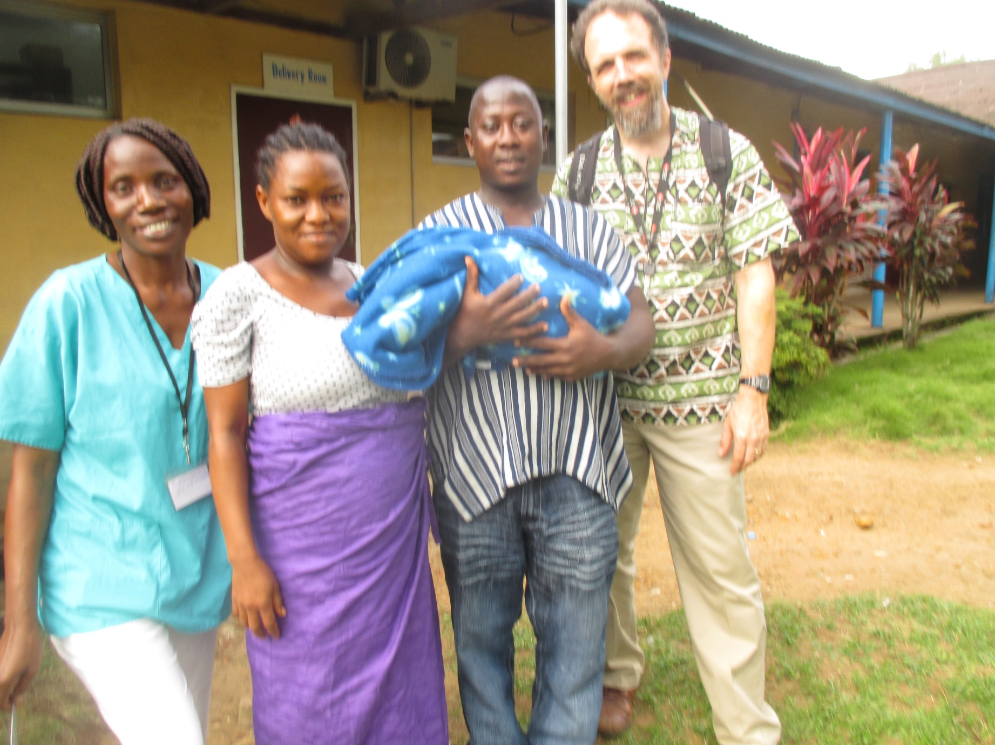

Slide 41
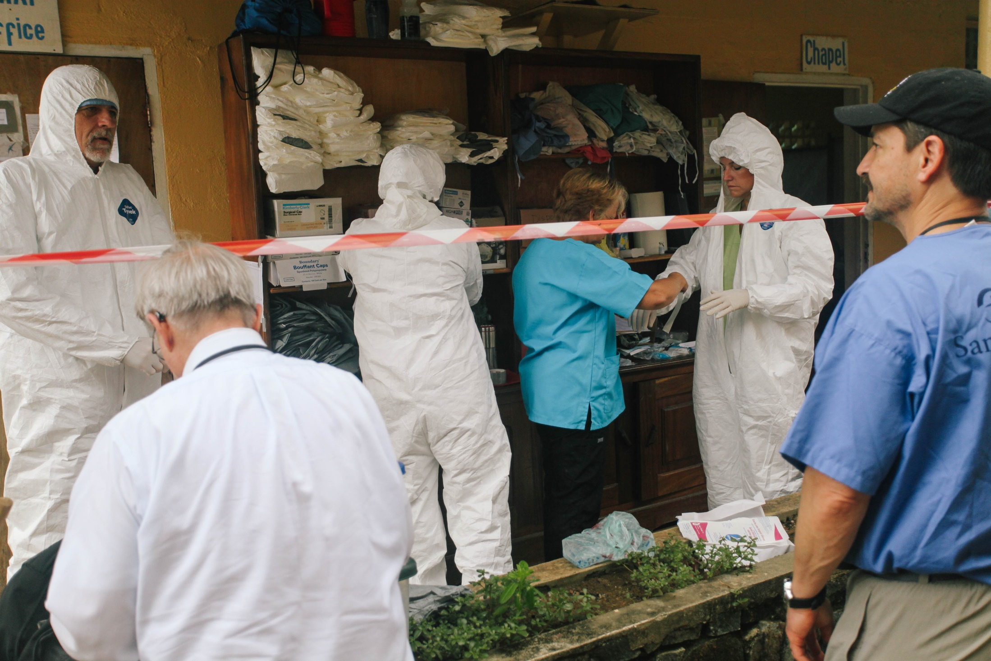

Slide 42
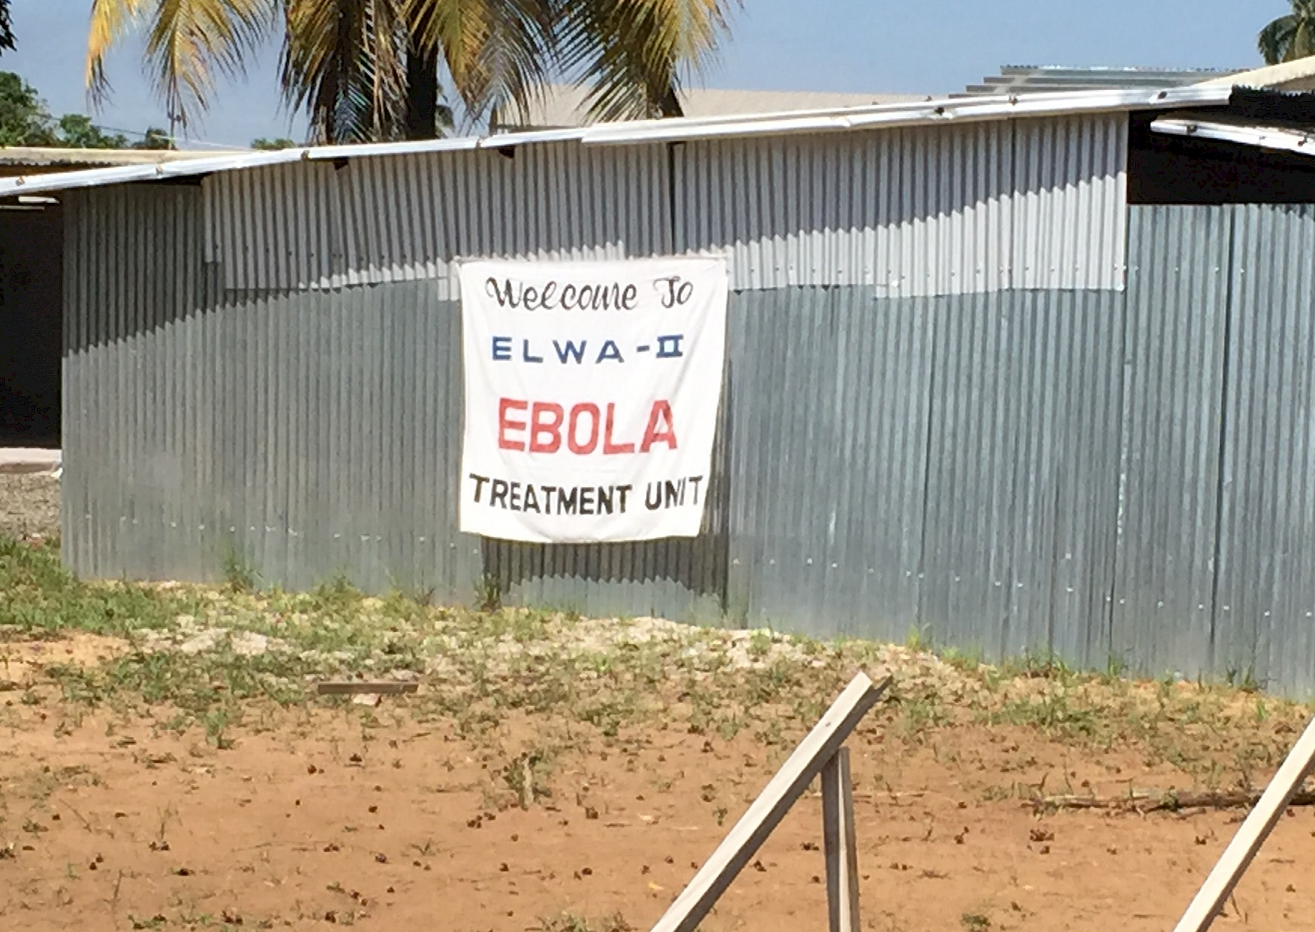

Slide 43
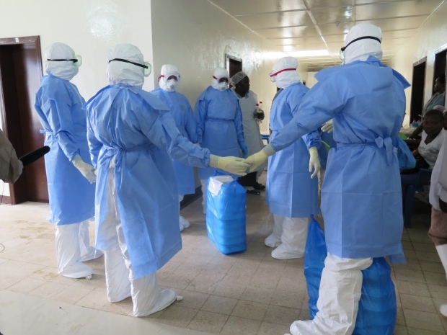

Slide 44
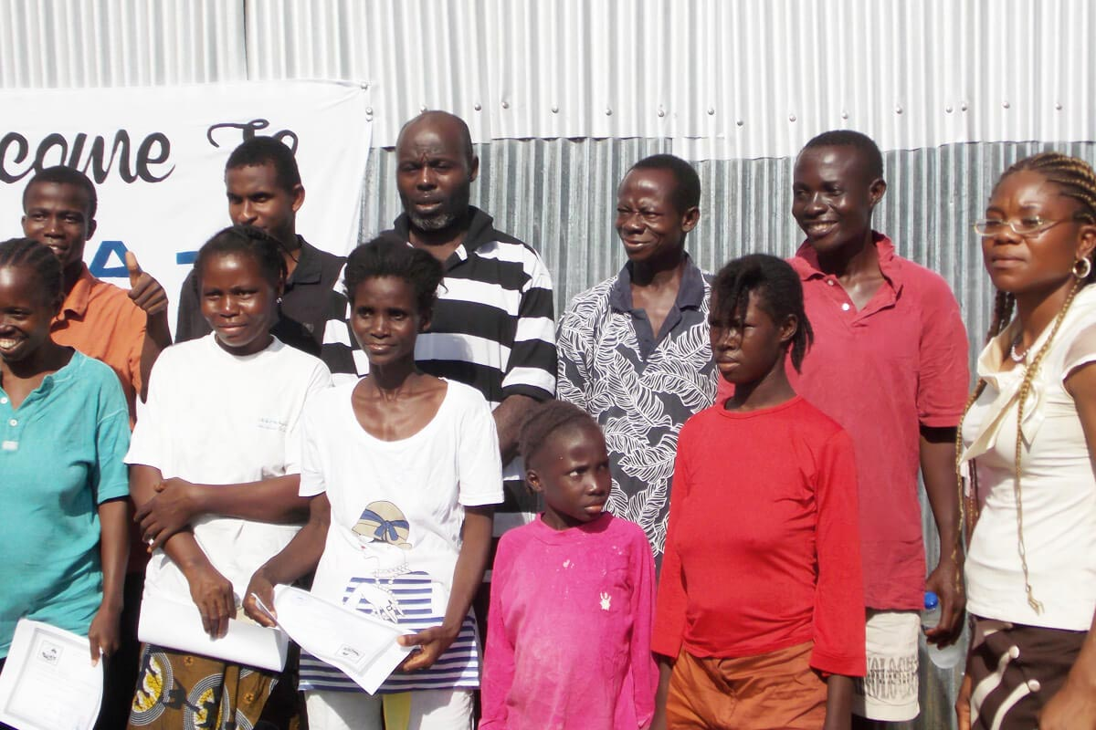

Slide 45
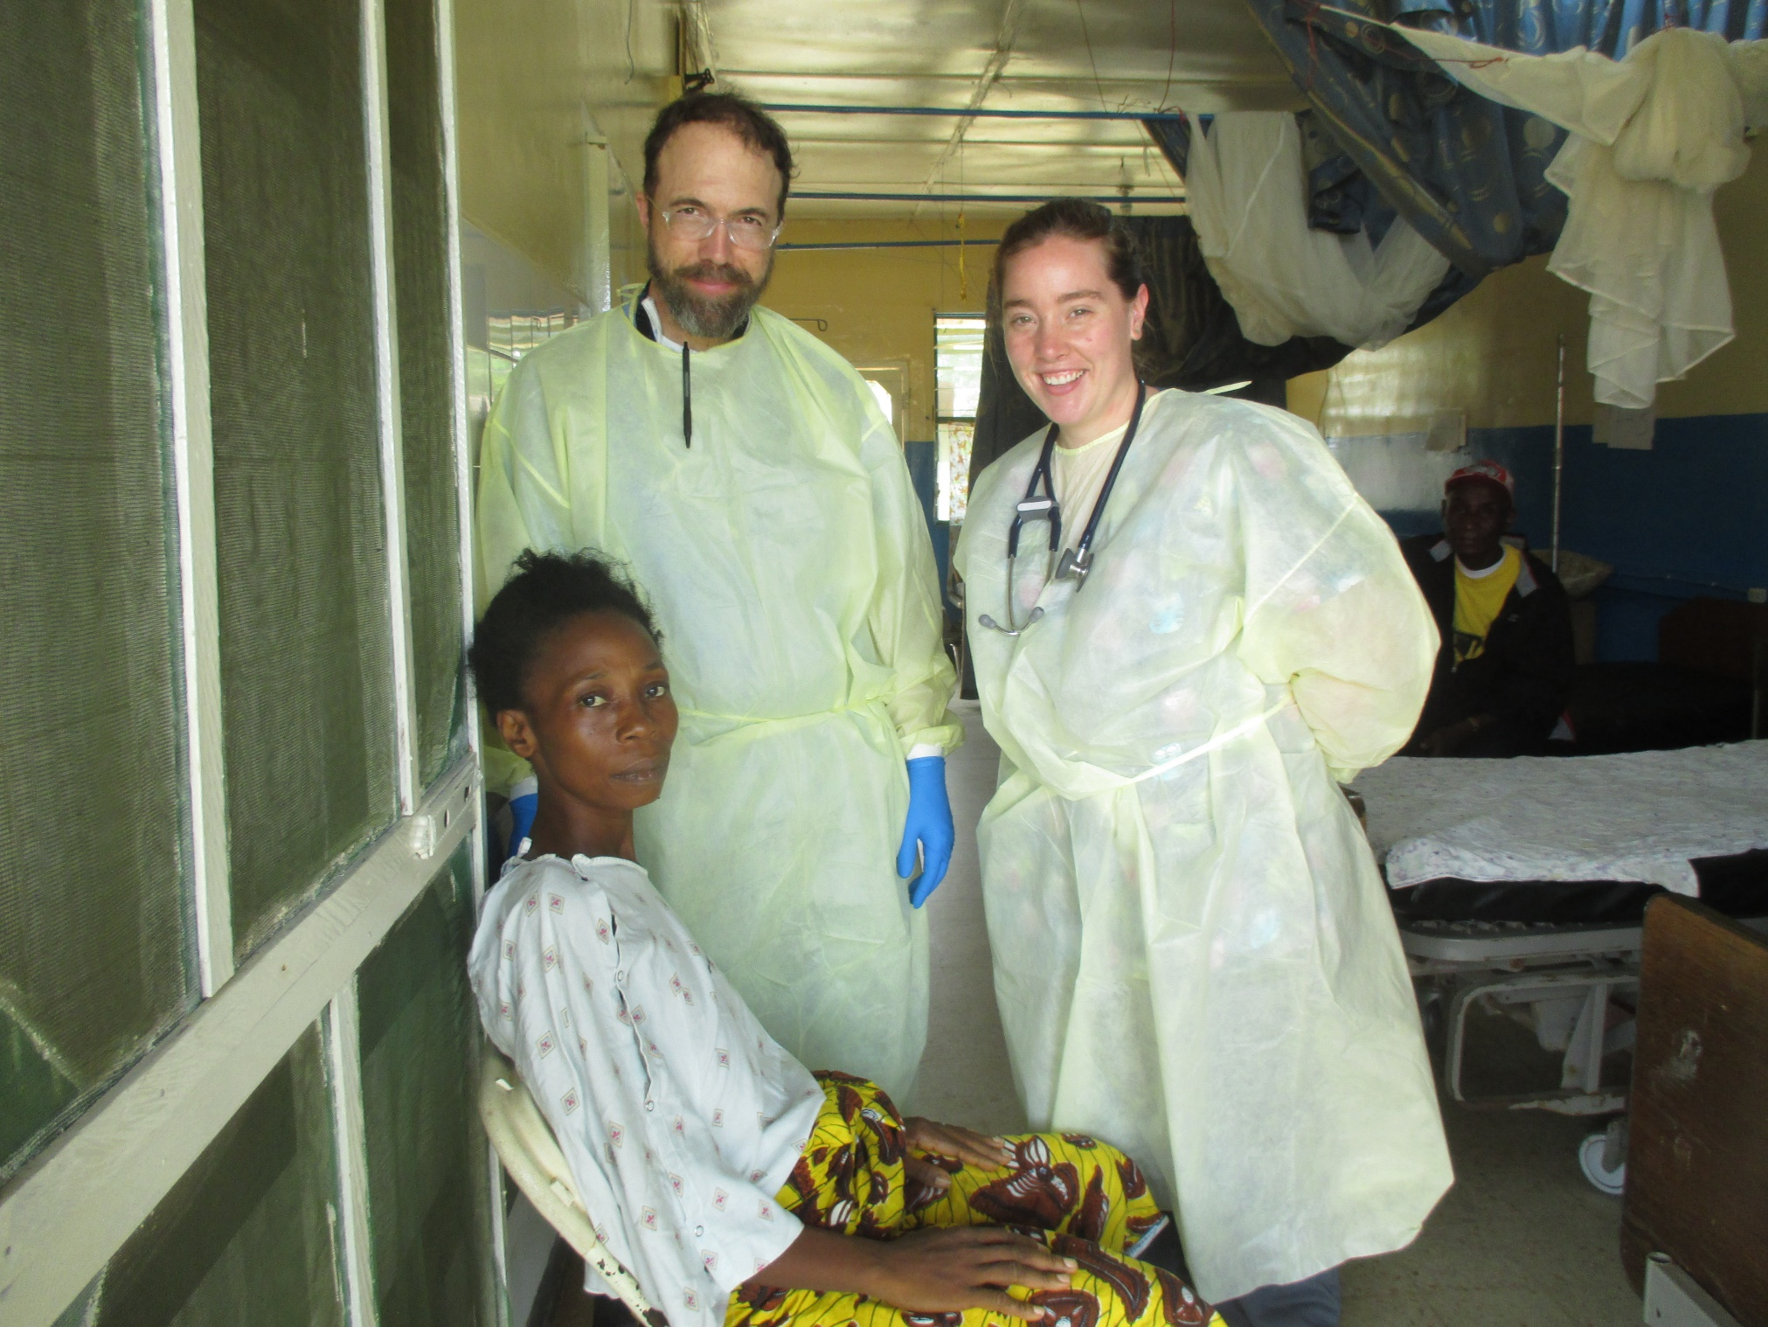

Slide 46


Slide 47


Slide 48


Slide 49


Slide 50


Slide 51


Slide 52


Slide 53


Slide 54


Slide 55


Slide 56


Slide 57


Slide 58


Slide 59


Slide 60


Slide 61


Slide 62


Slide 63


Slide 64


Slide 65


Slide 67


Slide 68


Slide 69


Slide 70


Slide 71


Slide 72


Slide 73




Slide 74


Slide 75



Slide 76



Imago Dei

Slide 77

You are called…

Slide 78

You are called…

Slide 79


When we face death, we find life

Slide 80

Thank you!
ricksacramd@outlook.com

