Slide 1

Welcome to the 2025 Worcester District Medical Society Annual Fall District Meeting and Awards Ceremony

Slide 2

Moment of Silence
Member Dates WDMS Member
Joseph Cocozzella, MD December 26, 1942 - June 29, 2025 1977-1986, 1996-1999
Satish Shrivastava, MD August 26, 1930 - May 2, 2025 dates unknown
Svend Brunn, MD (WN) September 11, 1939 - May 14, 2025 (Worcester North), since 1972

Slide 3
With Deep Appreciation to…
Awards Committee
Scholarship Committee
Book Award Donors: Drs. Amaral, Kadish and Pugnaire Families
Drs. Lillian Luksis and Herbert and Suzanne Nieburgs Trusts
St. Vincent Hospital
St. Vincent Hospital Medical Staff
UMass Memorial Healthcare
Reliant Medical Group
WDMS Scholarships, honoring Drs. Burte Guterman, Sanfrey Lilyestrom, Leonard Morse, Julius Tegelberg, Kenneth Kronlund and Ms. Carmen Carmona

Slide 4
Upcoming Events
MMS HOD I-25 Sessions – Via Zoom
Saturday, December 6, 9am to Conclusion of Business –
Monday, December 8, 7-8pm - Interim Meeting Ethics Forum – Ethics & CRISPR: Exploring the Moral, Ethical, and Policy Challenges Posed by Gene Editing Technology
Movie Night and Reception
December 10, 2025, 5:30 pm, Mechanics Hall
“The Doctor”, 1991 film starring William Hurt
230th Annual Oration
February 11, 2026, 5:30 pm, Beechwood Hotel
Orator: Dr. Richard Sacra, MD
Title: "Stories from Healthcare at the Frayed Edge"

Slide 5

Financial Report
Adib Karam, MD
Treasurer

Slide 6
Finance Committee
Dr. Adib Karam (Chair)
Dr. Philip Cohen
Dr. Lloyd Fisher
Dr. Dale Magee
Dr. Pankaj Ksheersagar
Dr. Sahdev Passey
Dr. Fred Schwartz
Dr. Peter Zacharia

Slide 7
Membership Report

Slide 8
Investments accounts
As of Nov 1, 2025

Slide 9
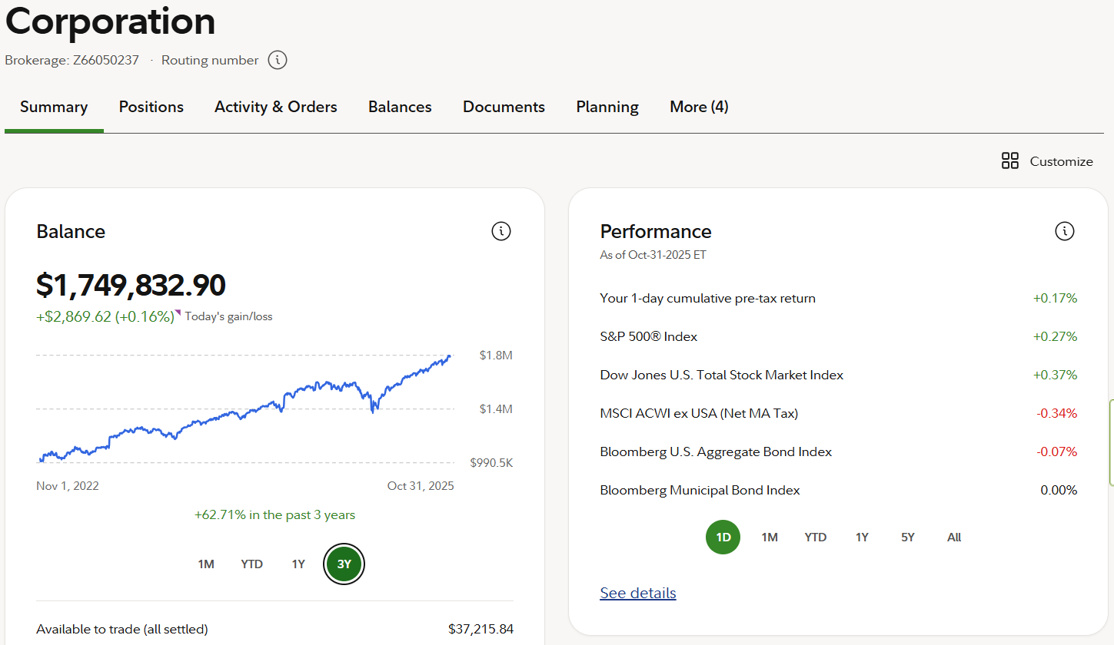
WDMS

Slide 10
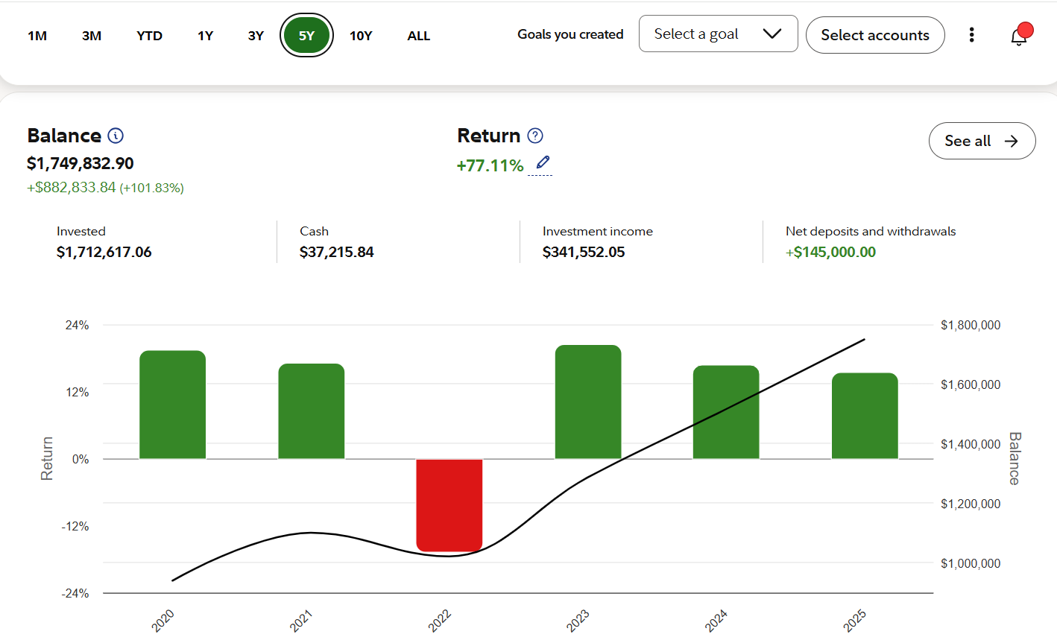

Slide 11
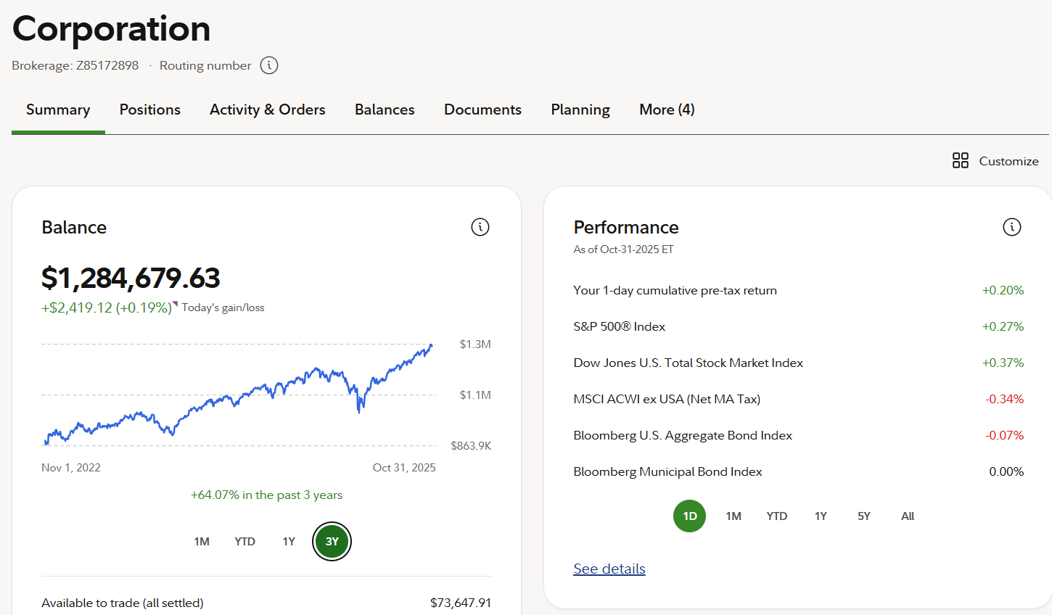
WML

Slide 12
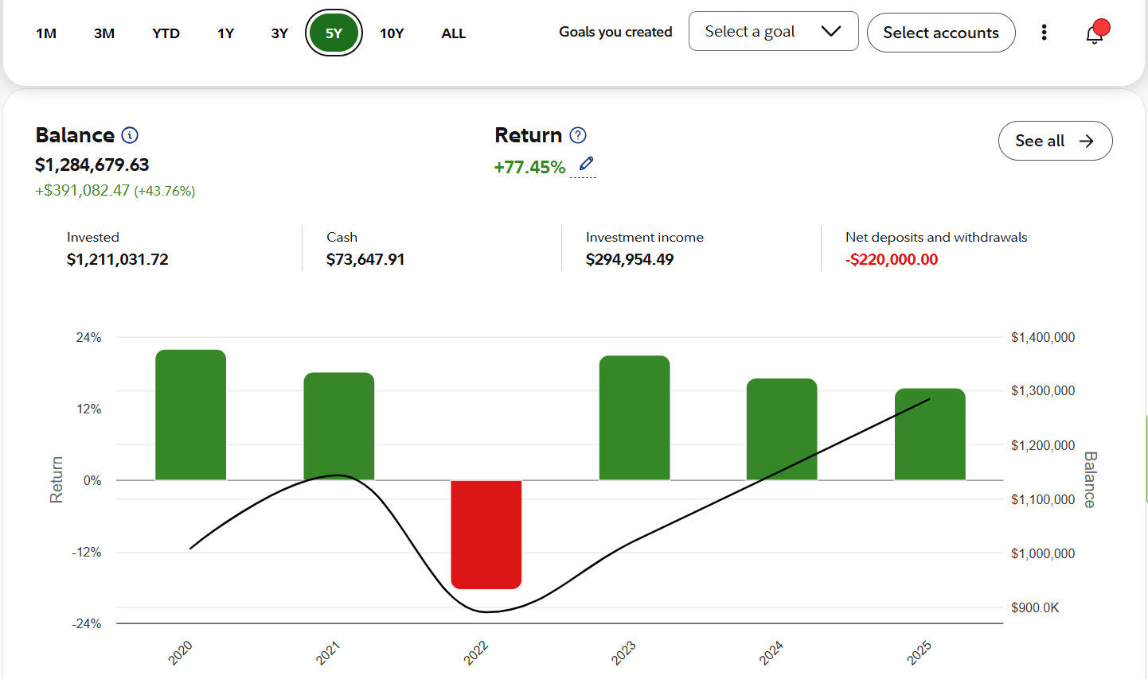

Slide 13
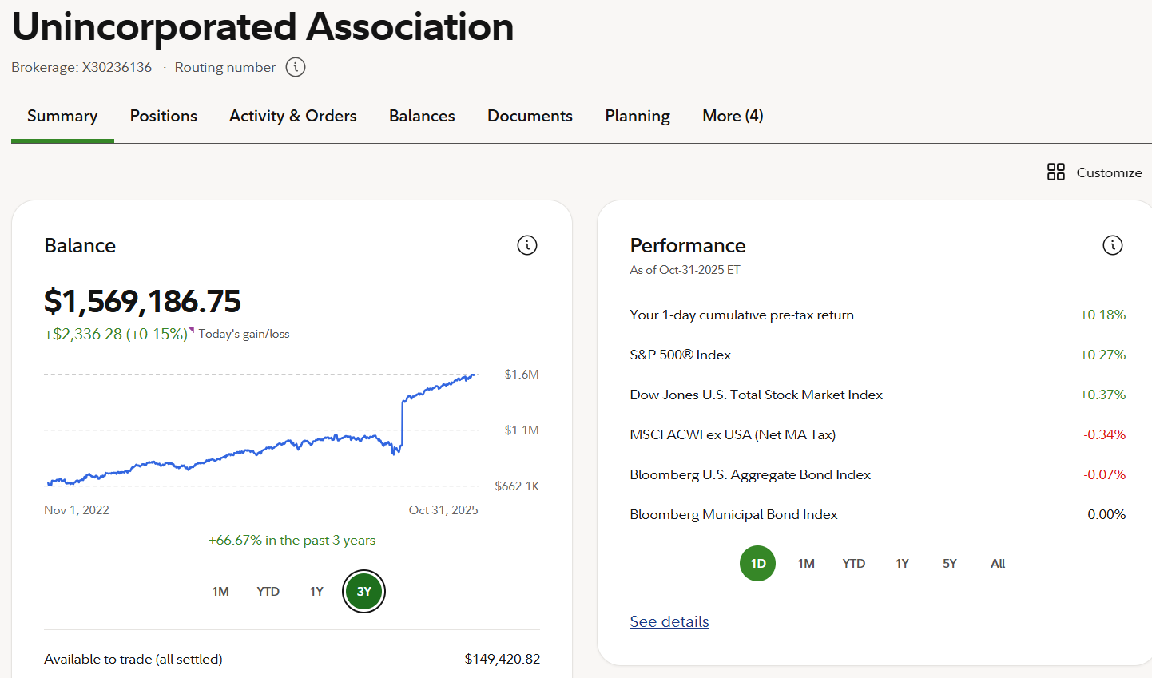
SF of the WDMS

Slide 14
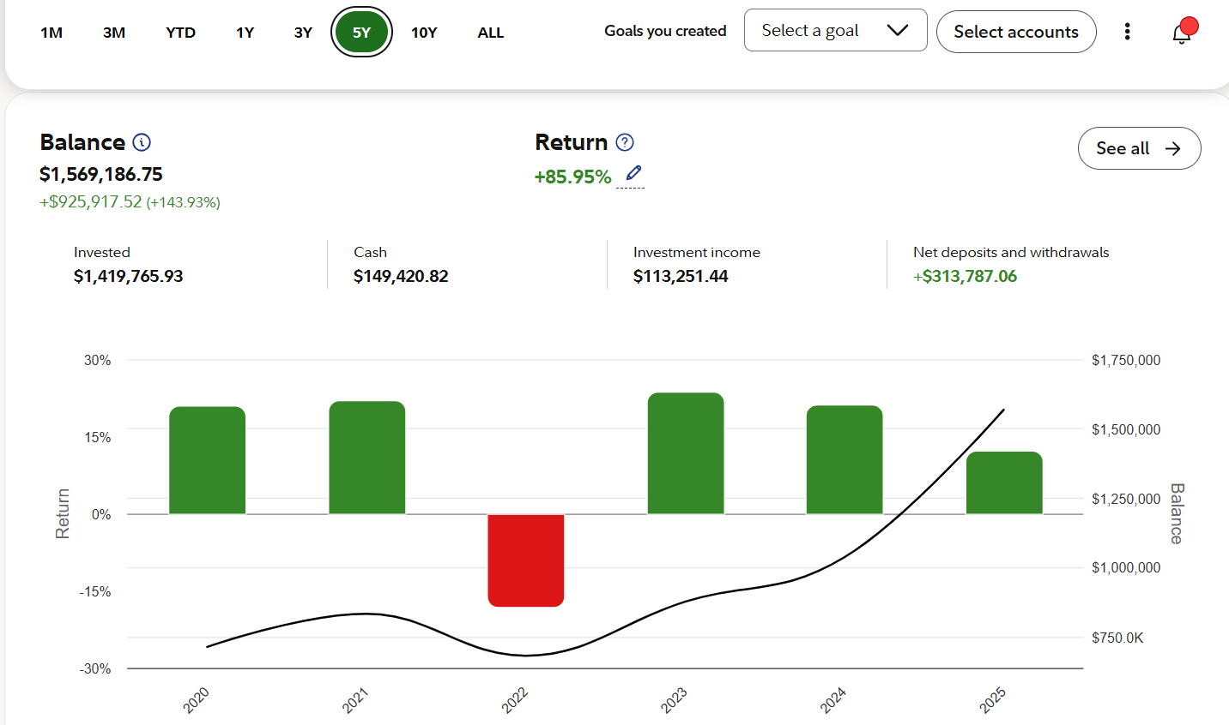

Slide 15
Proposed 2026 WDMS Budget

Slide 16
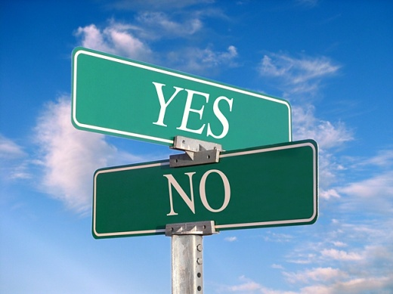
Vote on 2026 Budget

Slide 17

The Scholarship Fund of the Worcester District Medical Society
And
The Worcester District Medical Society Alliance
2025 Medical Student Scholarship Awards
2025 WDMSA Nursing Student Awards
1

Slide 18
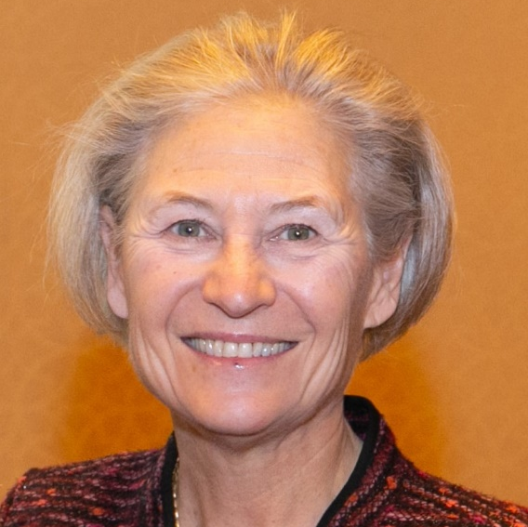
Dr. Michele Pugnaire
Chair, WDMS Scholarship Committee

Slide 19

WDMS Scholarship
Committee
Dr. Michele Pugnaire, Chair
Dr. Sahdev Passey, Trustee
Dr. Janet Abrahamian
Dr. Robert Bessette
Dr. Susan George
Dr. Rebecca Kowaloff
Dr. Heidi Leftwich
Dr. Jane Lochrie
Dr. Susan Moran
Dr. Nitin Trivedi
Dr. Karl Uy
Dr. Bennett Vogt
Dr. Martha Waite
Dr. Giles Whalen

Slide 20
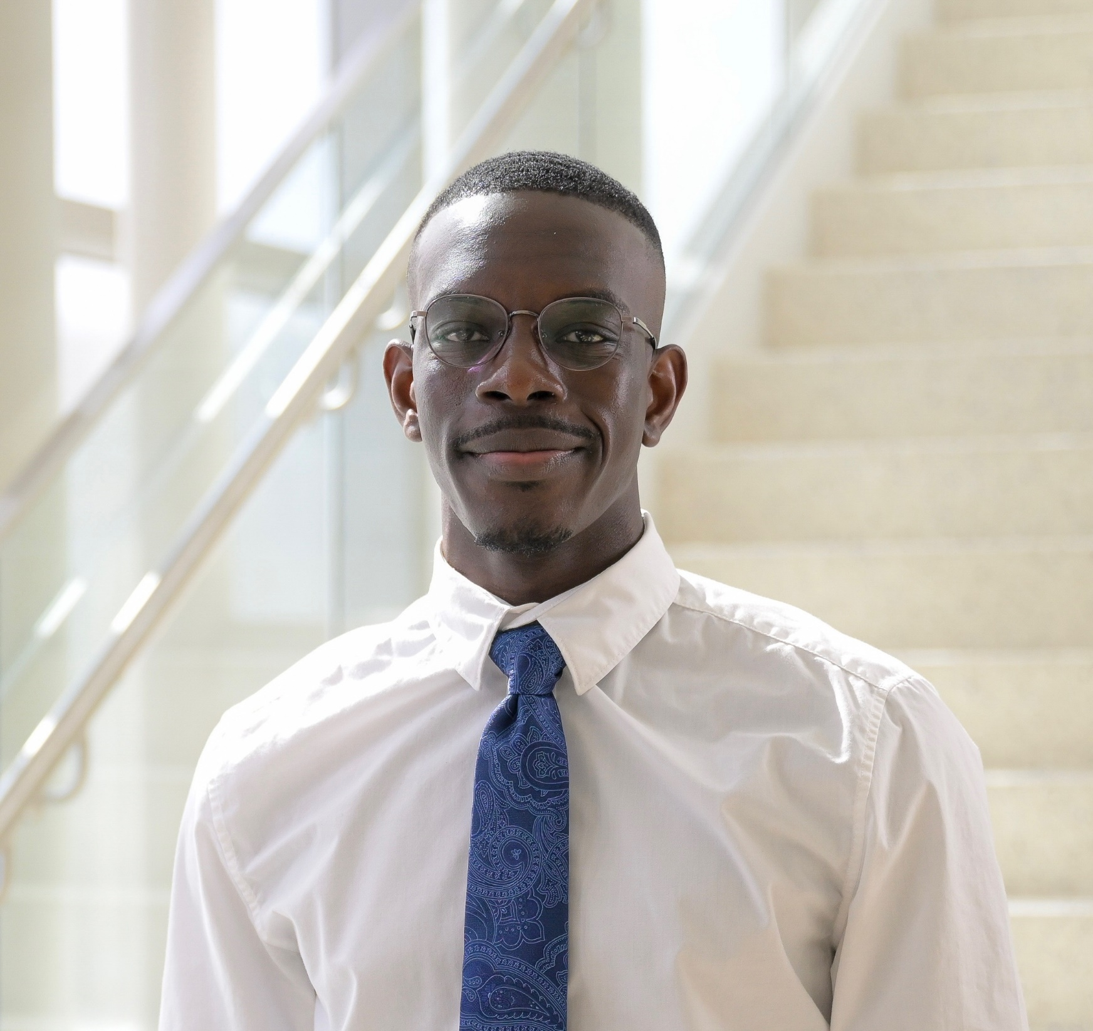
KwesiBanafo Abbeyquaye
UMass Chan Medical School
The Paulette Griffin-Pugnaire Book Award
and the Dr. M. Elizabeth Fletcher Book Award from Reliant Medical Group/Optum

Slide 21
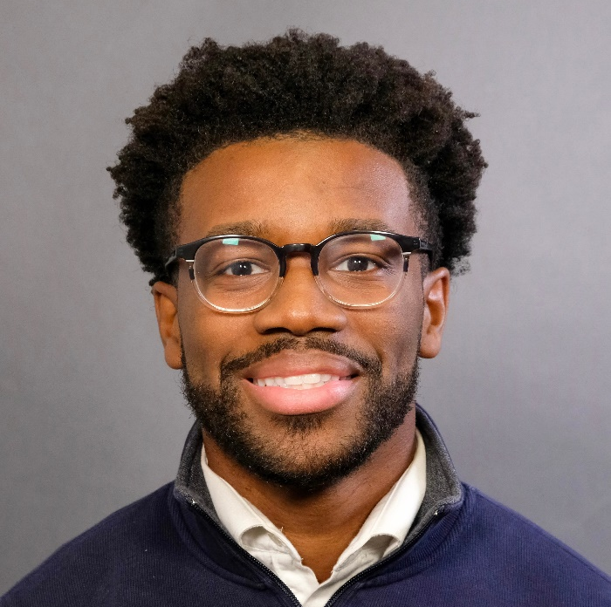
Jake Ayisi
Robert Larner, MD College of Medicine at the University of Vermont
The Dr. Leonard Morse Scholarship Award and Dr. M. Elizabeth Fletcher
Scholarship Award by Reliant Medical Group/Optum

Slide 22
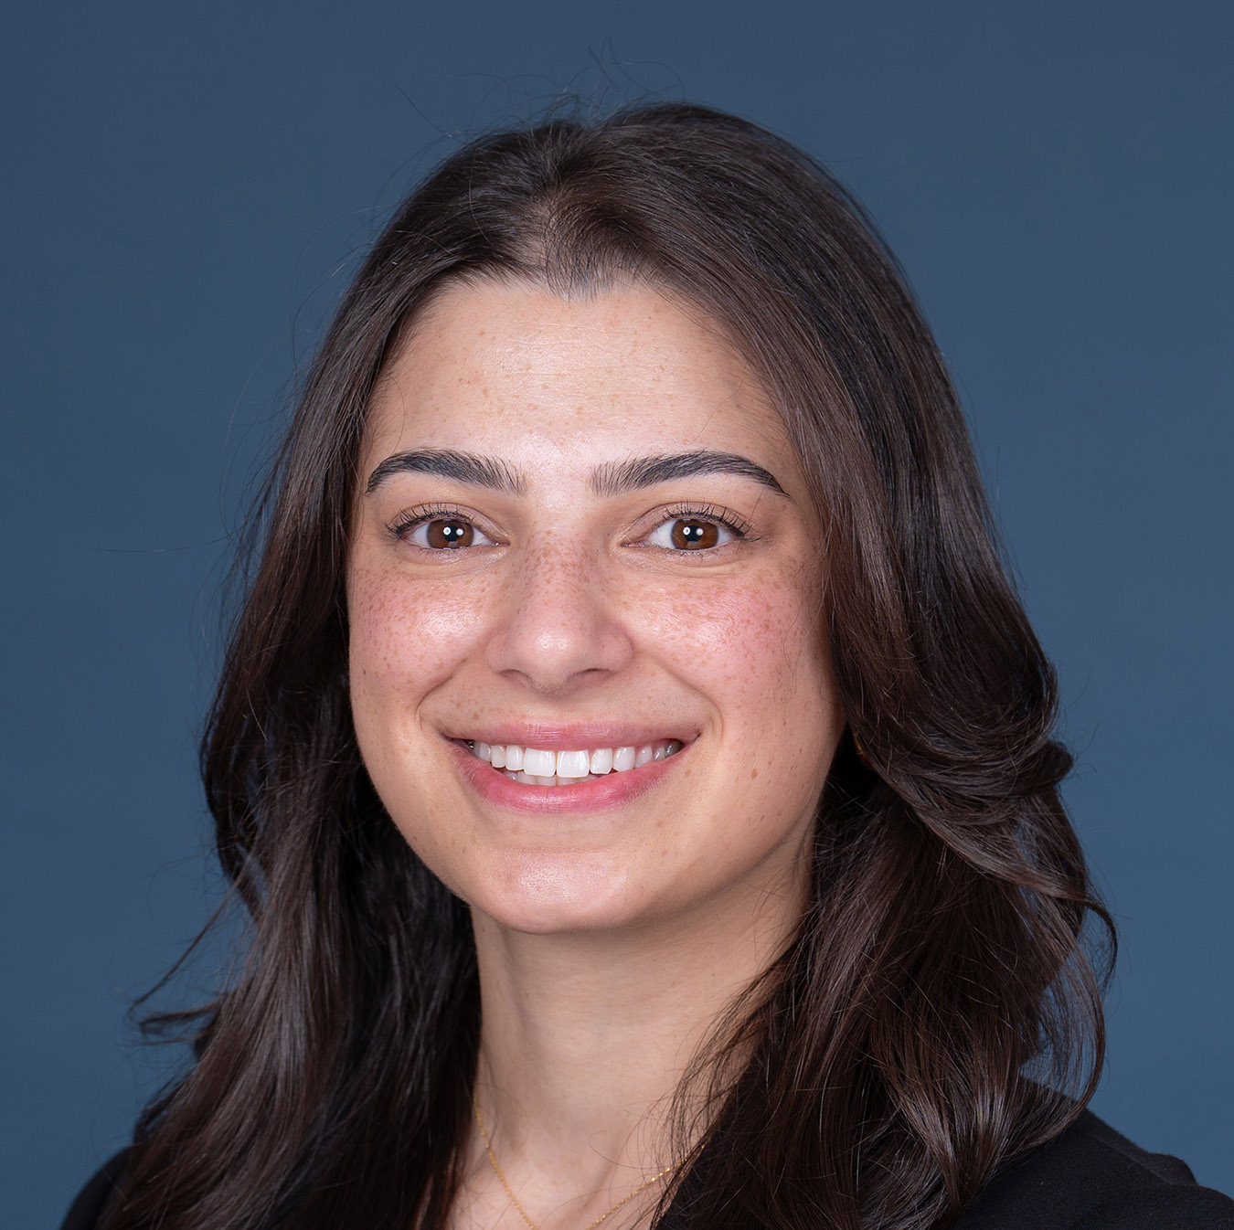
Racquel Bitar
UMass Chan Medical School
The Dr. Samuel Pickens Scholarship Award

Slide 23
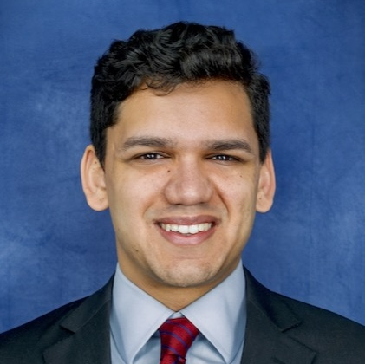
Arpan Bose
UMass Chan Medical School
The Dr. Burte Guterman Scholarship Award

Slide 24
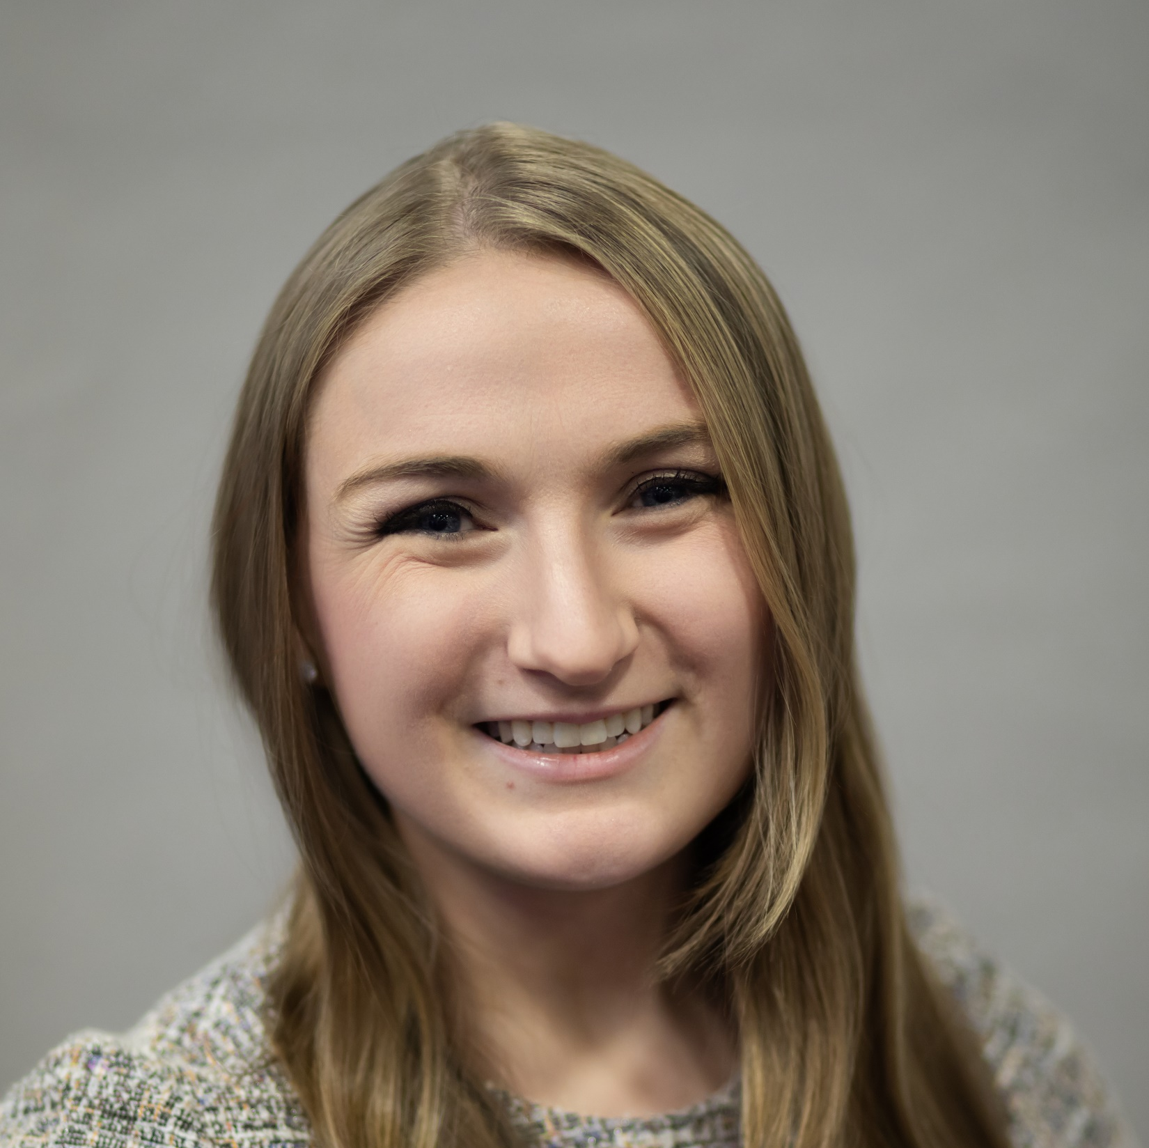
Brianna Chamberlain
University of New England School of Medicine
The Dr. Lillian Luksis Scholarship Award

Slide 25
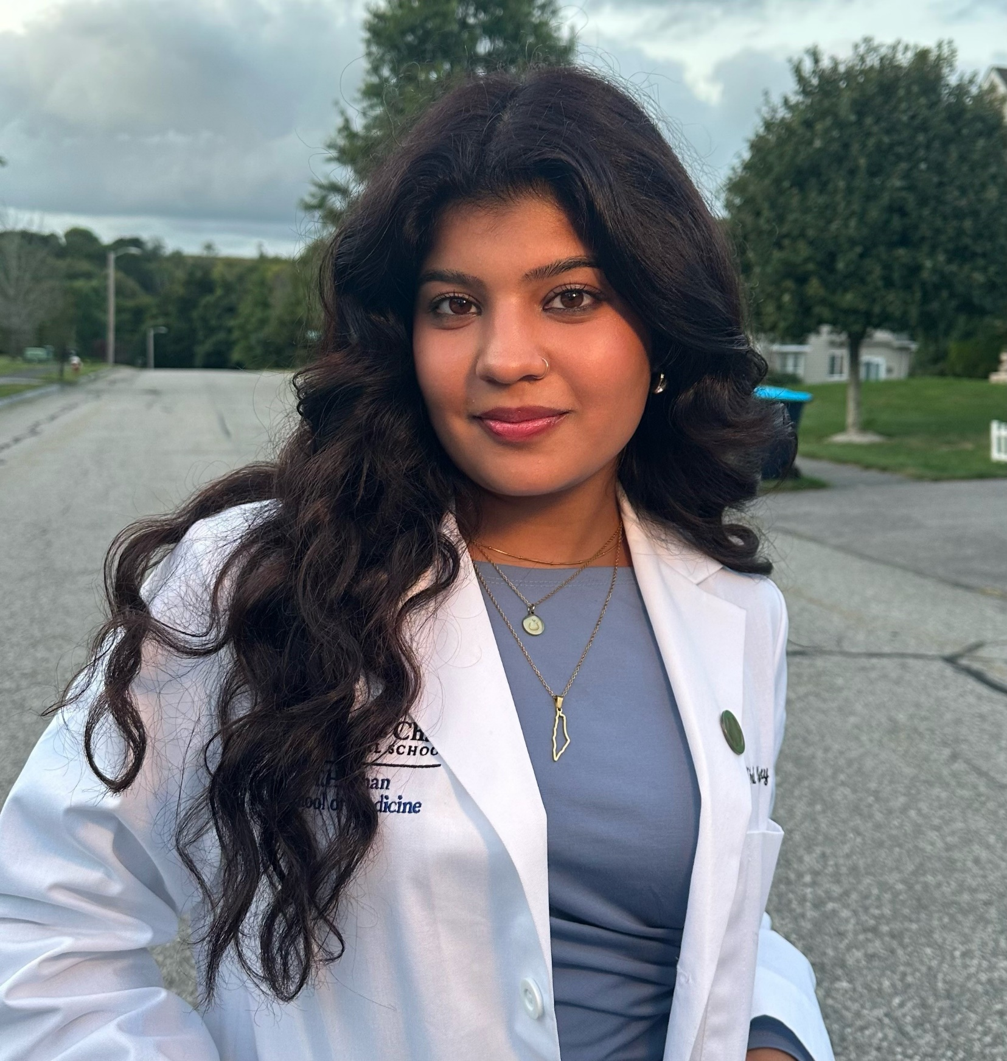
Nihal Chaudhary
UMass Chan Medical School
The Passey Family Book Award

Slide 26
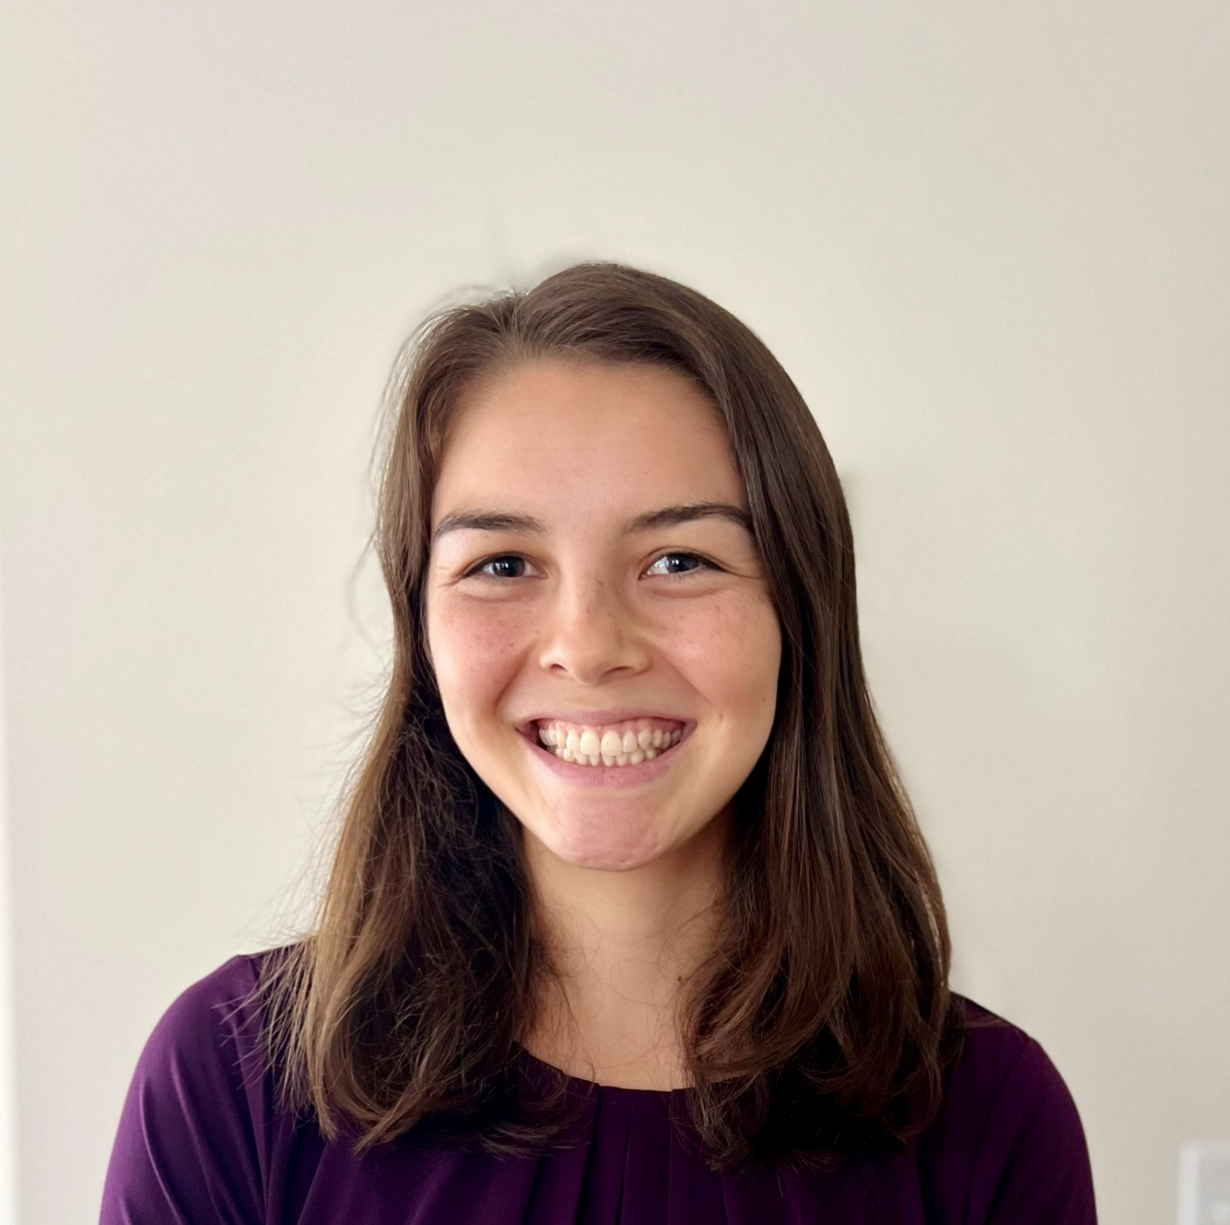
Grace Desmond
UMass Chan Medical School
The Amaral Family Book Award

Slide 27
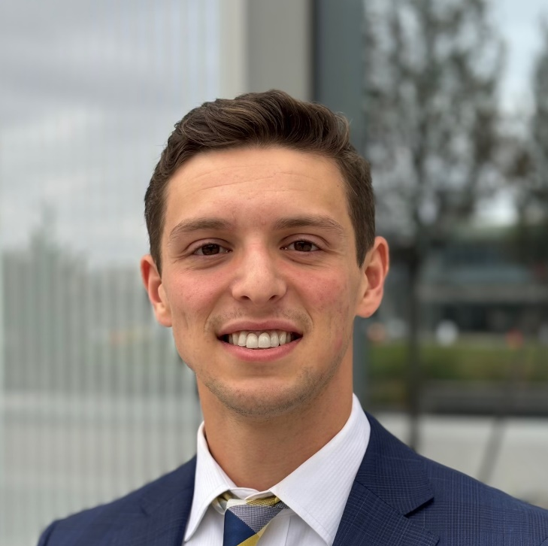
Alexander Hamel
UMass Chan Medical School
The Kenneth Kronlund
Scholarship Award

Slide 28
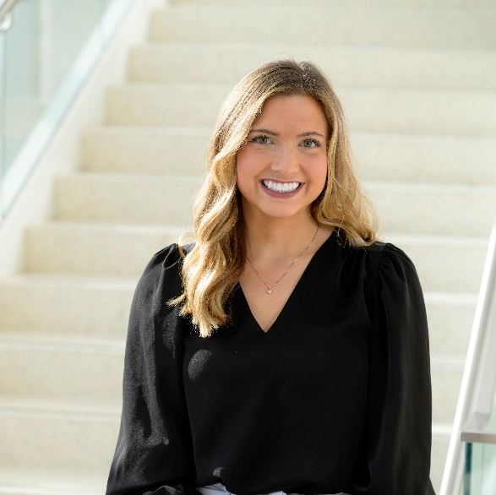
Samantha Kaliszewski
UMass Chan Medical School
The Dr. Herbert and Mrs. Suzanne Nieburgs Scholarship Award

Slide 29
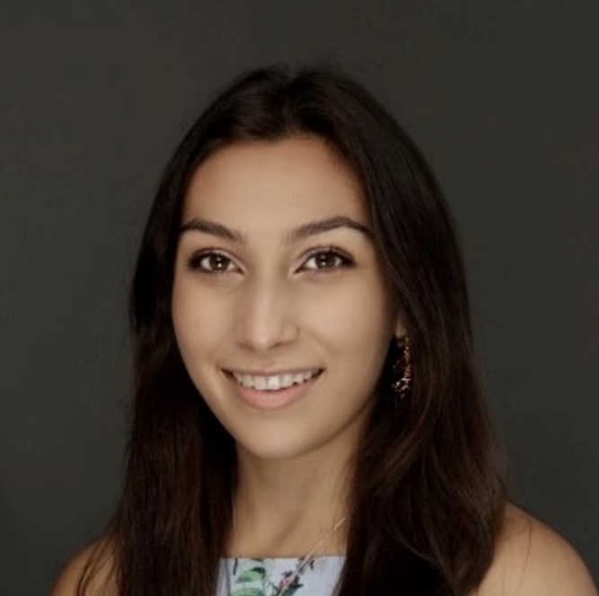
Aishwarya Khanna
UMass Chan Medical School
The St. Vincent Hospital Medical Staff Scholarship Award

Slide 30
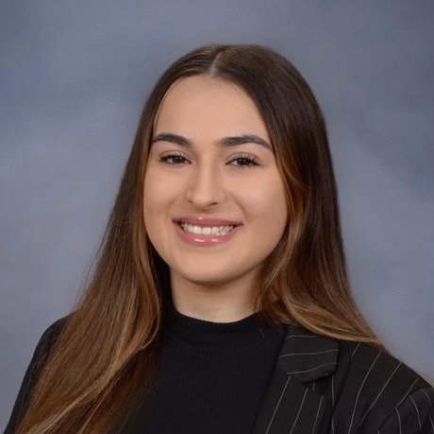
Pamela Kote
UMass Chan Medical School
The Dr. Herbert and Mrs. Suzanne Nieburgs Scholarship Award

Slide 31
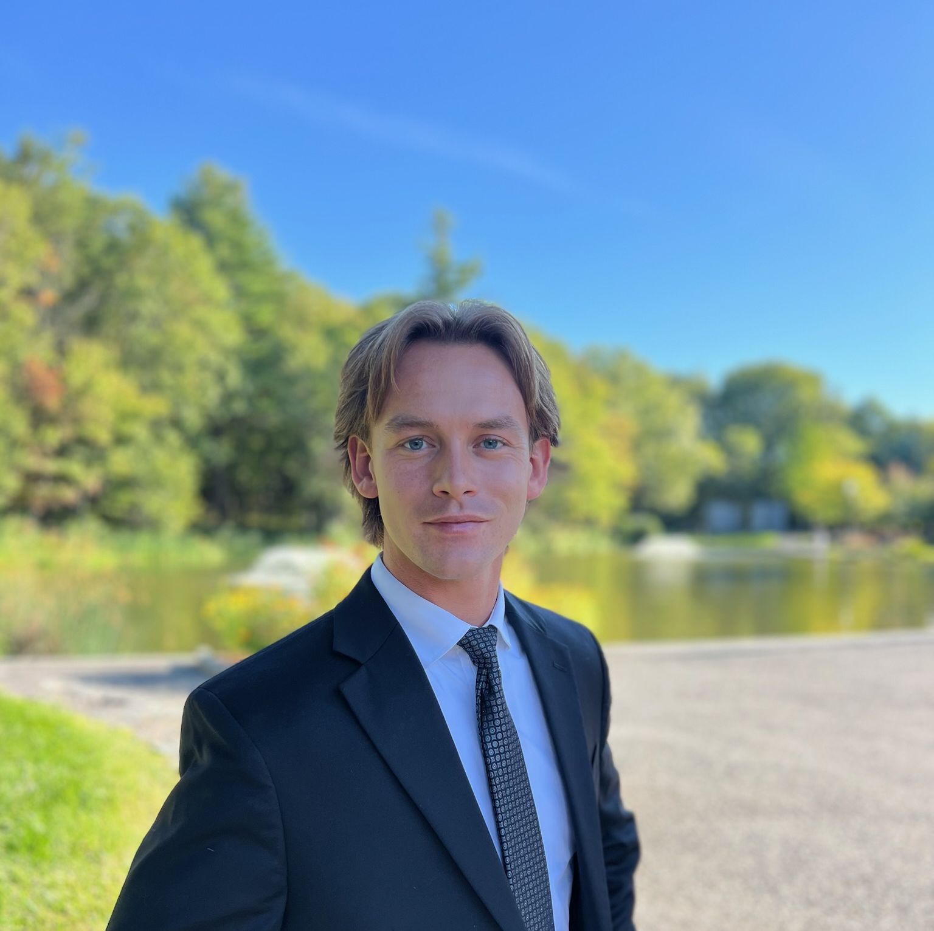
Drew Montigny
UMass Chan Medical School
The Worcester District Medical Society Gala Book Award

Slide 32
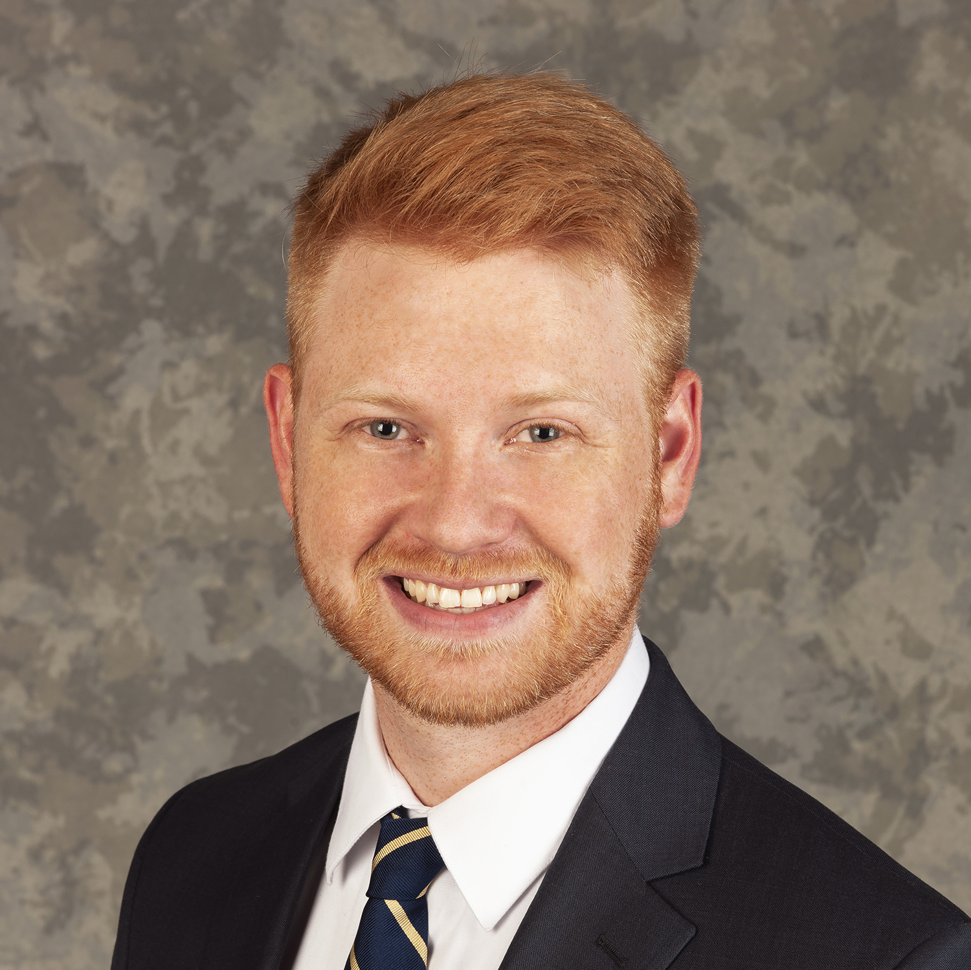
Michael Pepin
UMass Chan Medical School
The Ms. Carmen Carmona Scholarship Award

Slide 33
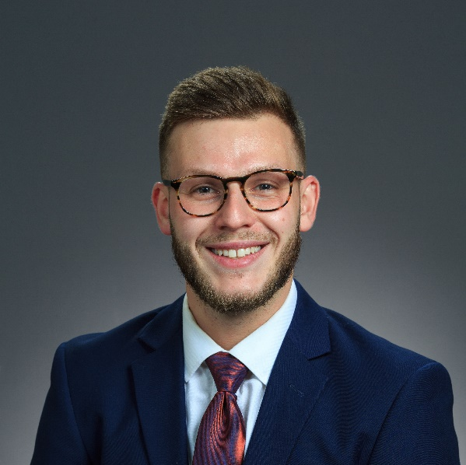
Maxim Petrovsky
Boston University School of Medicine
The Dr. Julius Tegelberg Scholarship Award

Slide 34
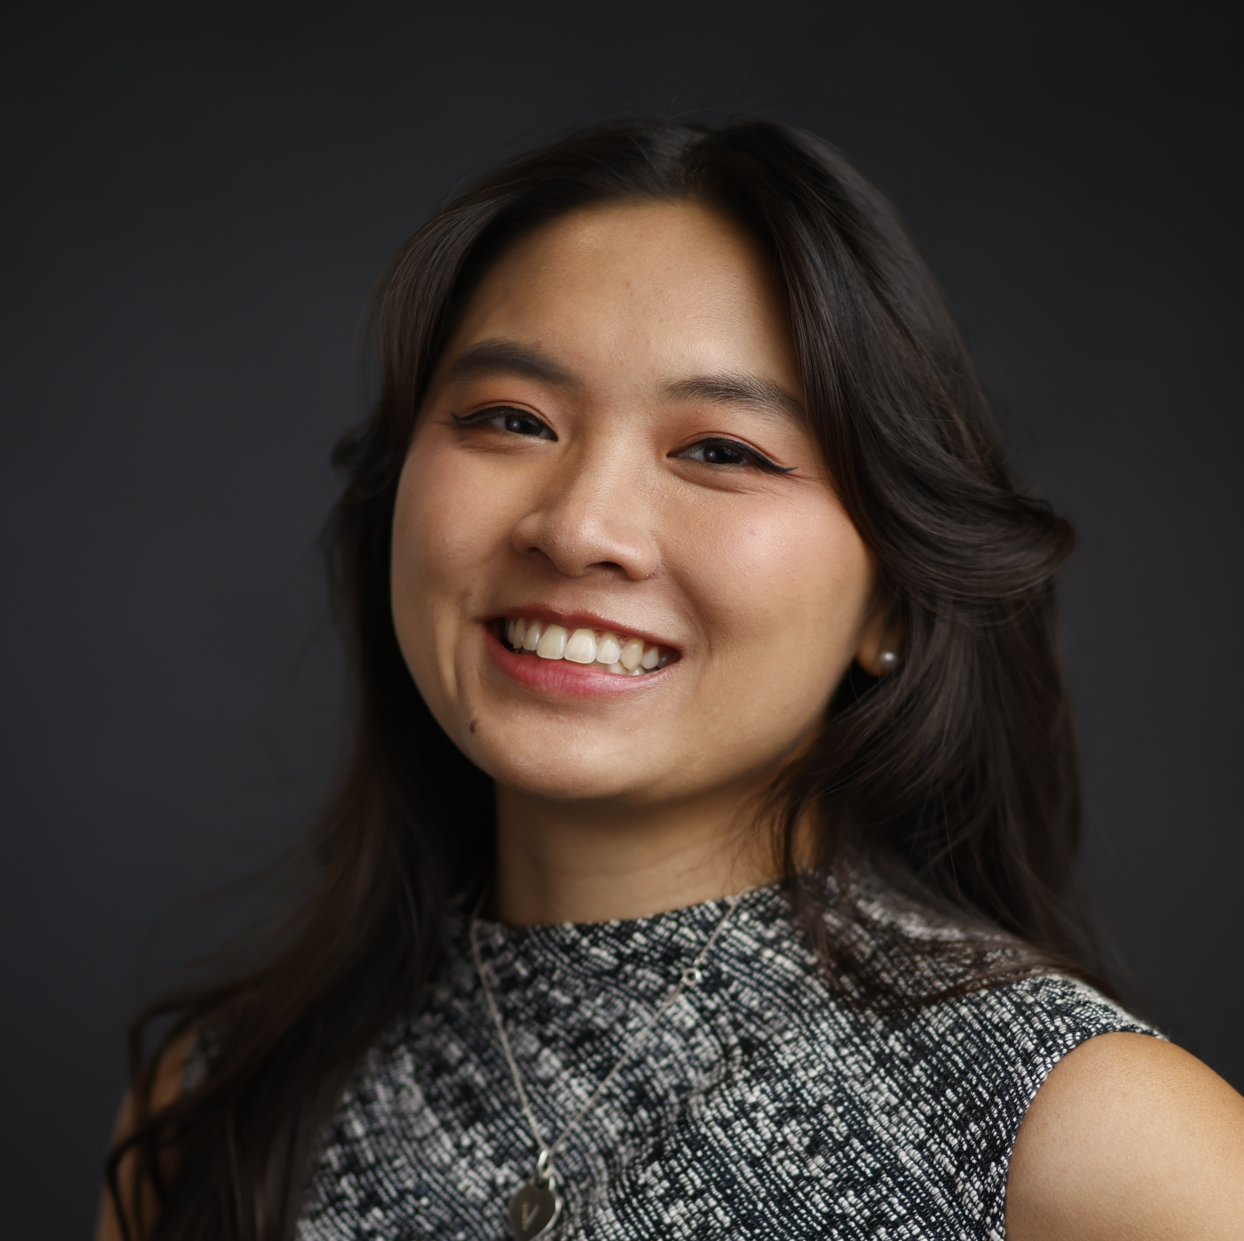
Van Anh Pham
UMass Chan Medical School
The St. Vincent Hospital Scholarship Award and
The Sidney Kadish
Book Award

Slide 35
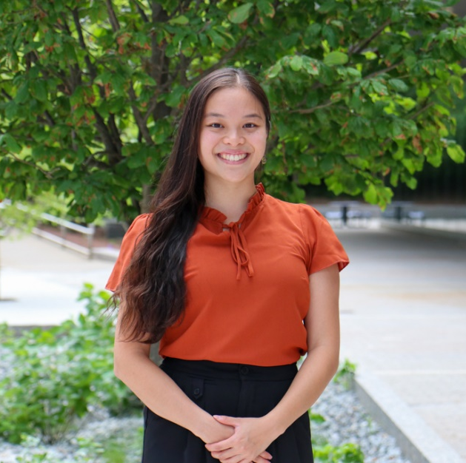
Vivien Tran
UMass Chan Medical School
The Dr. Samuel Pickens
Scholarship Award

Slide 36

Congratulations
To All of This Years Medical
Student Scholarship Recipients!

Slide 37

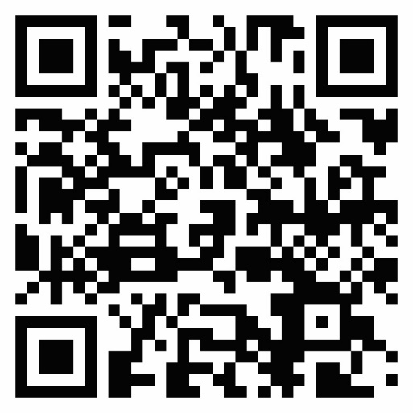
Thank you to all of our corporate and individual donors.
Your kind and generous support makes this annual scholarship program possible
Since the inception of the program in 1963, four-hundred and twenty-eight awards have been disbursed to Central Massachusetts medical students, totaling over 1 million dollars.

Slide 38
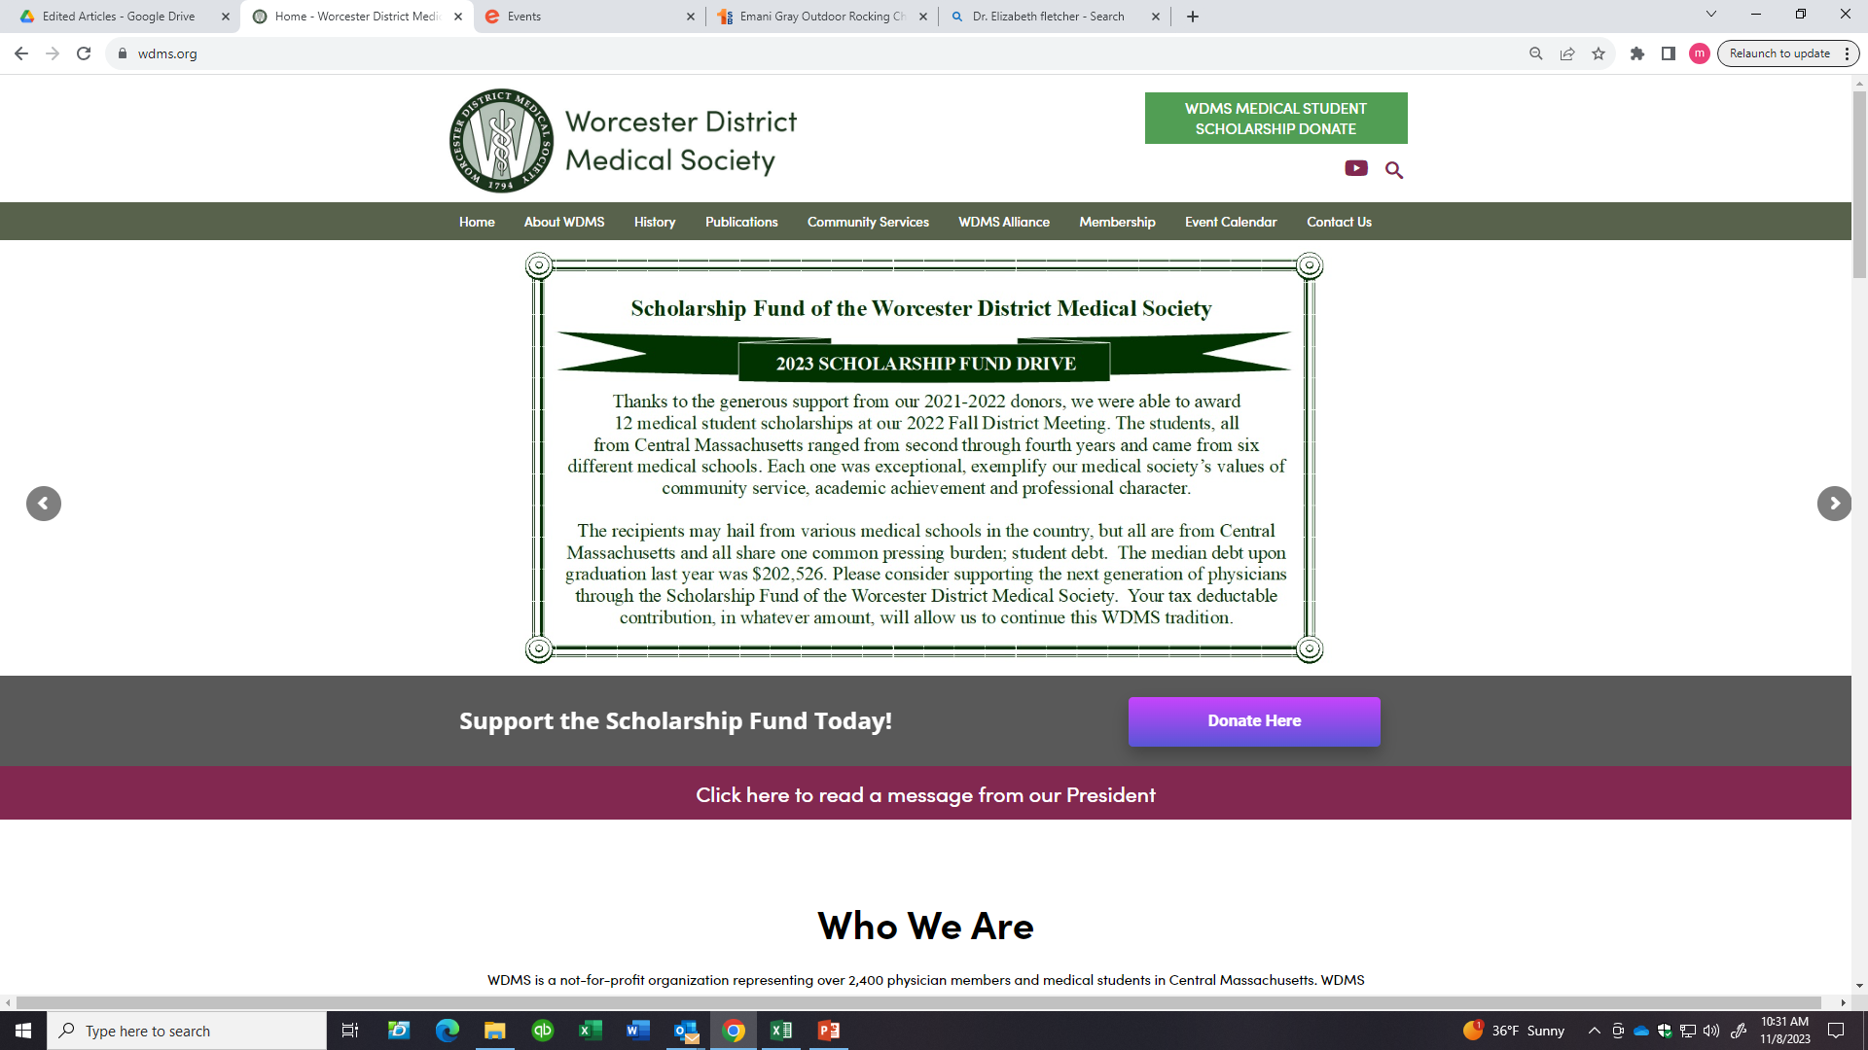
Donations to support the WDMS Scholarship Fund
Website: WDMS.org

Slide 39
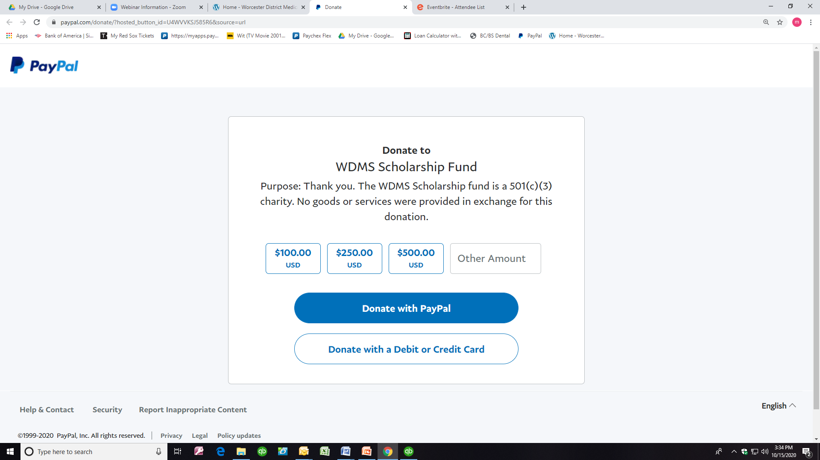
Donations to the
WDMS Scholarship Fund

Slide 40
Other Ways to Support The
Scholarship Fund of The WDMS
OPPORTUNITIES INCLUDE:
Sponsorship for a NAMED SCHOLARSHIP or a BOOK AWARD
  This can be a one-time donation or renewed year to year, based on donor preferences
Sponsorship of NAMED SCHOLARSHIP or BOOK AWARD in perpetuity
  This donation provides long term support for a named scholarship or book award on a sustained basis
To inquire, please contact Martha Wright: mwright@wdms.org or 508-753-1579

Slide 41

WDMS Alliance
Nursing Scholarships
Sheila Massarelli, RN
Maureen Zacharia, RN

Slide 42
Thank you to all of our donors
In 1959 our members established a Nursing Scholarship Fund. The scholarships have been sustained by the generosity of our members. Over the years we have sponsored various fundraising activities including White Cap Balls, fashion shows and various educational and author events.
In 1966, auxiliary member Gertrude Raymond Perry established an annual donation in perpetuity to the Scholarship Fund in memory of her husband Dr. Albert Orville Raymond.

Slide 43
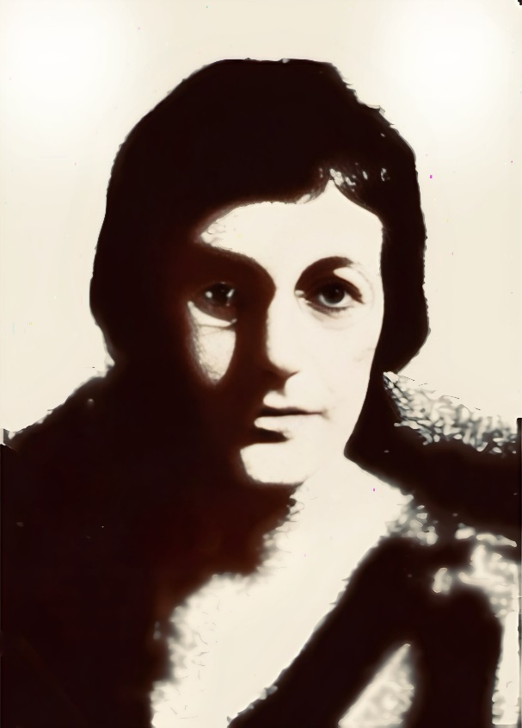
Gertrude Raymond
1891-1969
Circa 1928
In August 1966, artist, auxiliary member Gertrude J. Raymond established the Gertrude J. Raymond Trust. She designated a $300.00 annual donation be made in memory of her husband Dr. Albert Orville Raymond. He was in general practice, specializing in obstetrics. Their generosity has continued in perpetuity for that last 59 years.

Slide 44
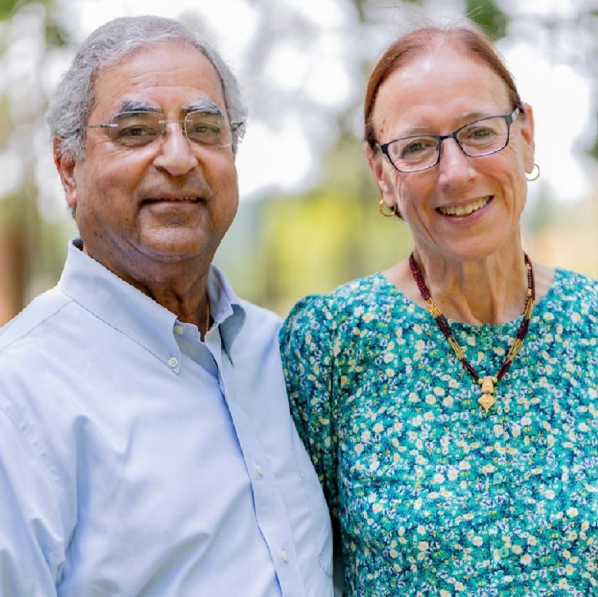
The Passey Family Nursing Scholarship Endowment
The Passey Family has recently established an endowment to the WDMSA Scholarship Fund, in honor of all nursing professionals in their family: Margaret (Shea) Knox, Helen (Lennon) Shea, Carolyn ‘Murray’ Passey, Janet (Murray) Steele, Ann Marie (Murray) Thompson, Janice (Payne) Murray, Katelyn (Passey) Pe, Colleen Murray, and Jo Hannah Murray.

Slide 45
Anne Mutie Kavale
Anna Maria College
May 2027
2025 WDMSA BSN Scholarship Award

Slide 46
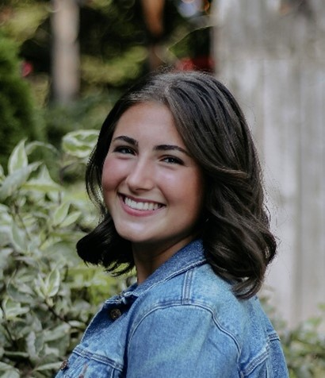
Olivia Lozoraitis
Worcester State University
May 2026
2025 WDMSA BSN Scholarship Award

Slide 47
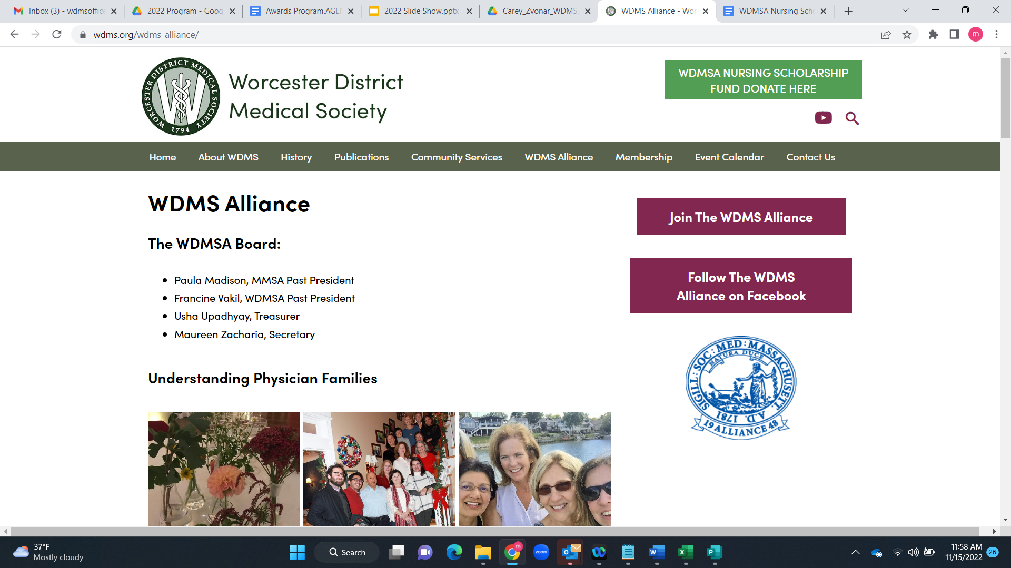
Supporting the WDMS Alliance
https://www.wdms.org/wdms-alliance/

Slide 48
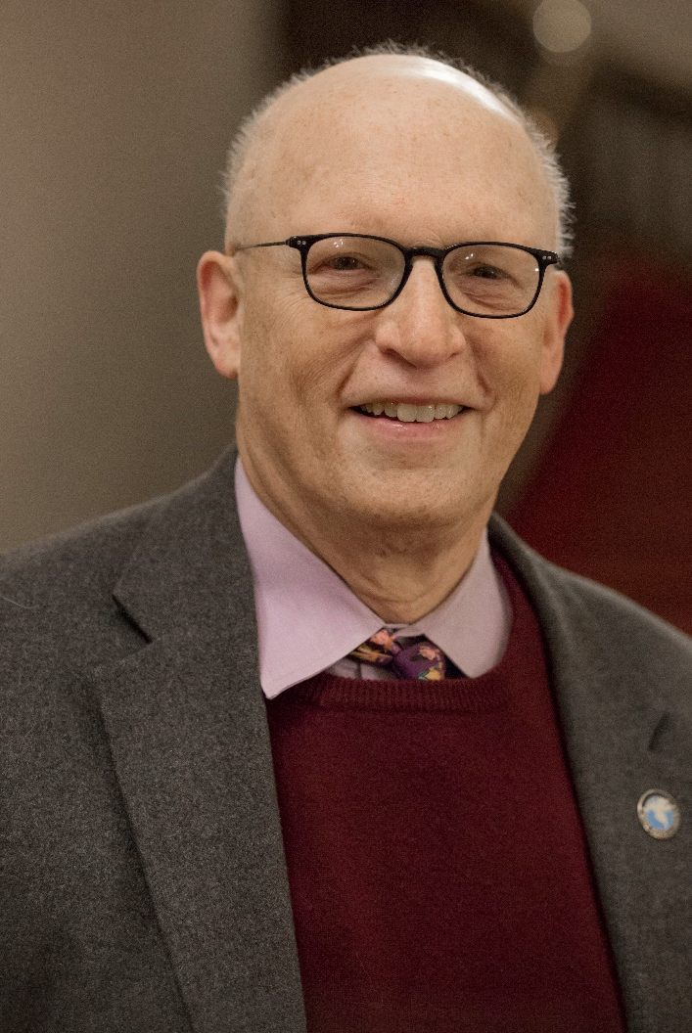
Dr. Michael Hirsh
Chair, WDMS Awards Committee

Slide 49

WDMS Awards Committee
Dr. Michael Hirsh, Chair
Dr. Frederic Baker
Dr. Robert Bessette
Dr. Bruce Karlin
Dr. Jane Lochrie
Dr. Justin Maykel
Dr. Michele Pugnaire

Slide 50

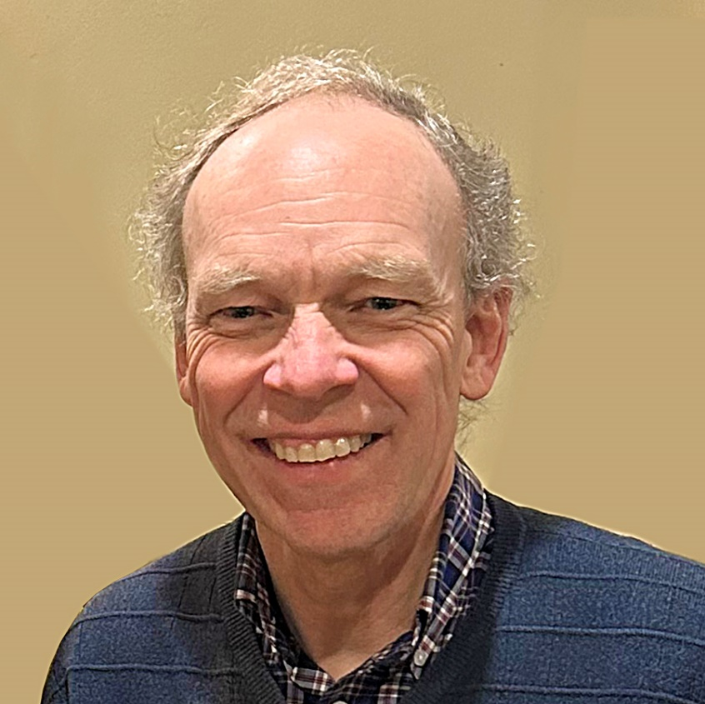
The Editor’s Award, formerly known as the Wisteria Award has been a tradition of Worcester Medicine, formerly Worcester Medical News, since 1974.
Historically, each May, there was a special dinner held at the Worcester Club where the front entrance was framed by a profuse, colorful display of Wisteria flowers, to honor an outstanding contributor of the magazine.
Dr. Samuel Bachrach, former Editor of Worcester Medical News, established the award named after a spring-flowering vine that used to surround the Worcester Club, (former home of the Editorial Board meetings and dinners). This award, is now known as the Editor’s Award and is given out at the annual Fall District Meeting.
2025 Editor’s Award
Mr. Ken Daigle, Guiding Channels
Nominated by Martha Wright, MBA
Supported by the Editorial Board

Slide 51
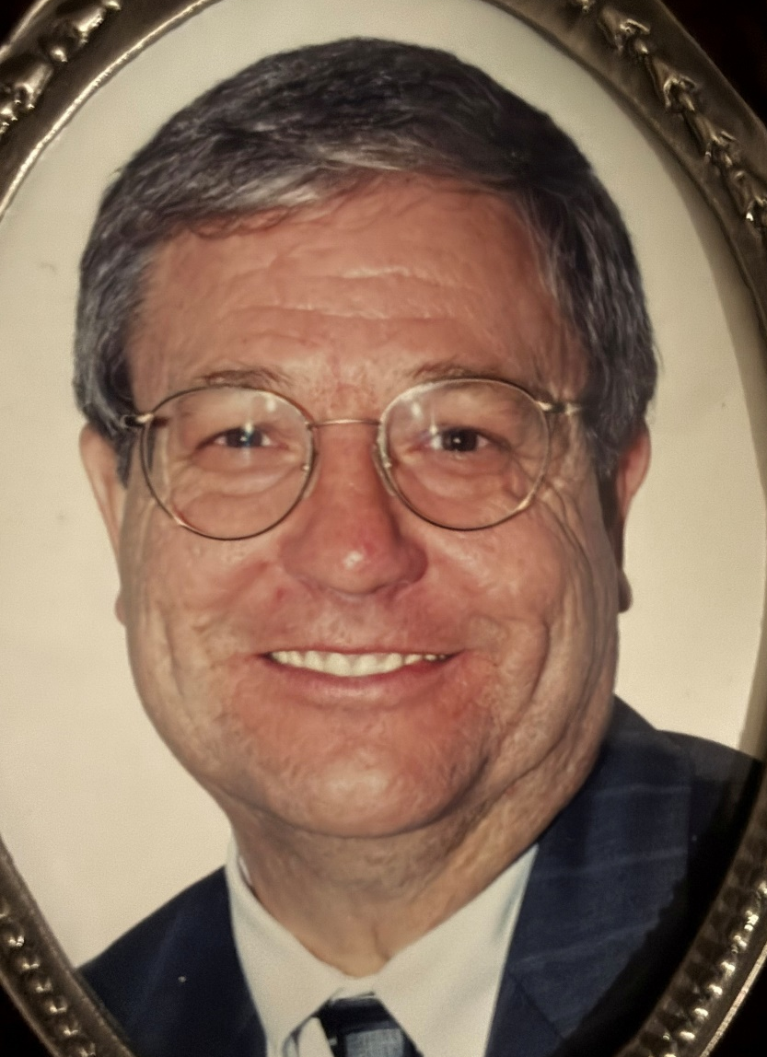
2025 Dr. A. Jane Fitzpatrick Community Service Award
This award was established by WDMS to commemorate the life-long contributions and exemplary efforts of Dr. Fitzpatrick. The award recognizes a member of the heath care community for contributions beyond professional duties to improve the health and well-being of others. A $200 donation will be sent to your preferred charity, on your behalf.
The Why Me Foundation is dedicated to providing love and support services to families with childhood cancer, including leukemia. The foundation is based in Worcester, Massachu-setts, and is run by a team of dedicated staff and volunteers who understand the unique needs of families with pediatric cancer patients. They offer a range of services, including fin-nancial and emotional support, to help families navigate the challenges of treatment and beyond. The foundation also
hosts events and activities to raise awareness and funds for leukemia research and support.
Dr. Ronald W. Pike
Nominated by Dr. Bruce Karlin
Supported by Dr. Mohammed AlHabbal

Slide 52
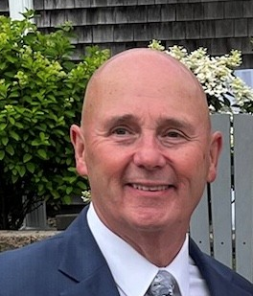
The 2025 Worcester District Medical Society
Career Achievement Award
This award was established to honor a WDMS Member who has demonstrated compassion and dedication to the medical needs of patients and or the public and has made significant contributions to the practice of medicine.
Dr. William J. Shine
Nominated by Dr. Jane Lochrie
Supported by Drs. Annie Abraham and Peter Lindblad

Slide 53
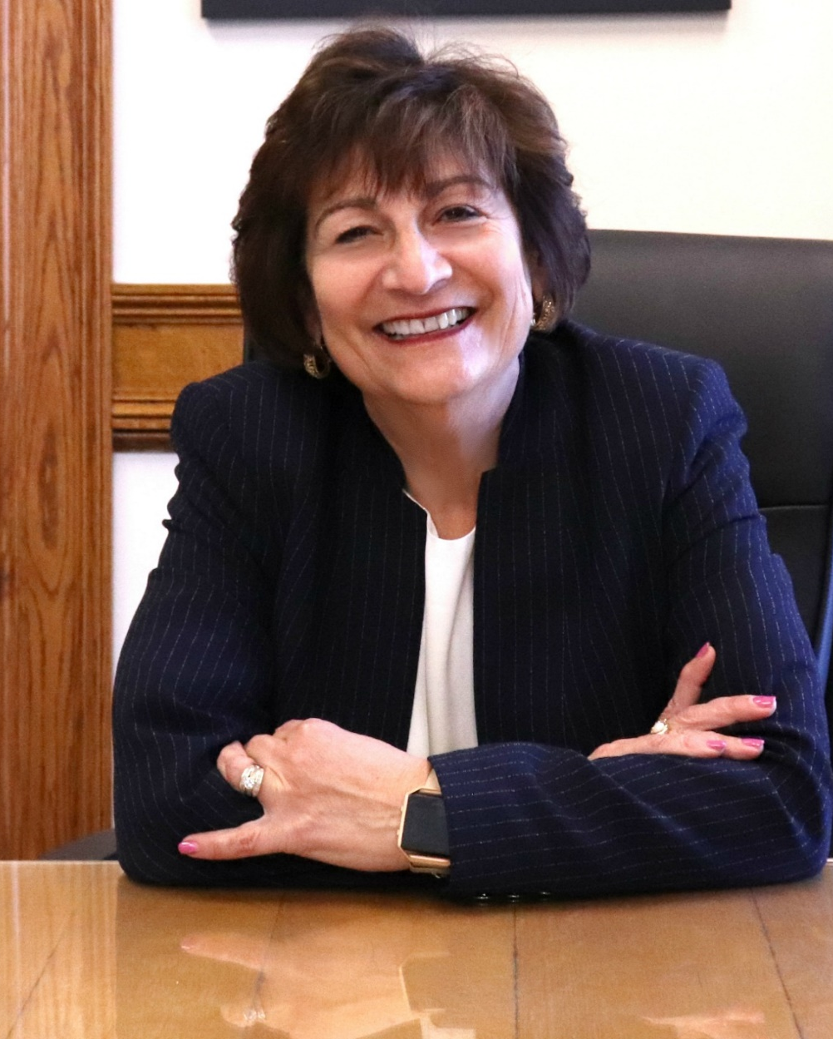
The 2025 WDMS President’s Leadership Award
This is a special award recognizing an individual for their extraordinary leadership, contributions and commitment to the health and well-being of our community and the profession of medicine.
Matilde “Mattie” Castiel, MD
Nominated by Dr. Hugh Silk
Supported by the WDMS Public Health Committee

Slide 54
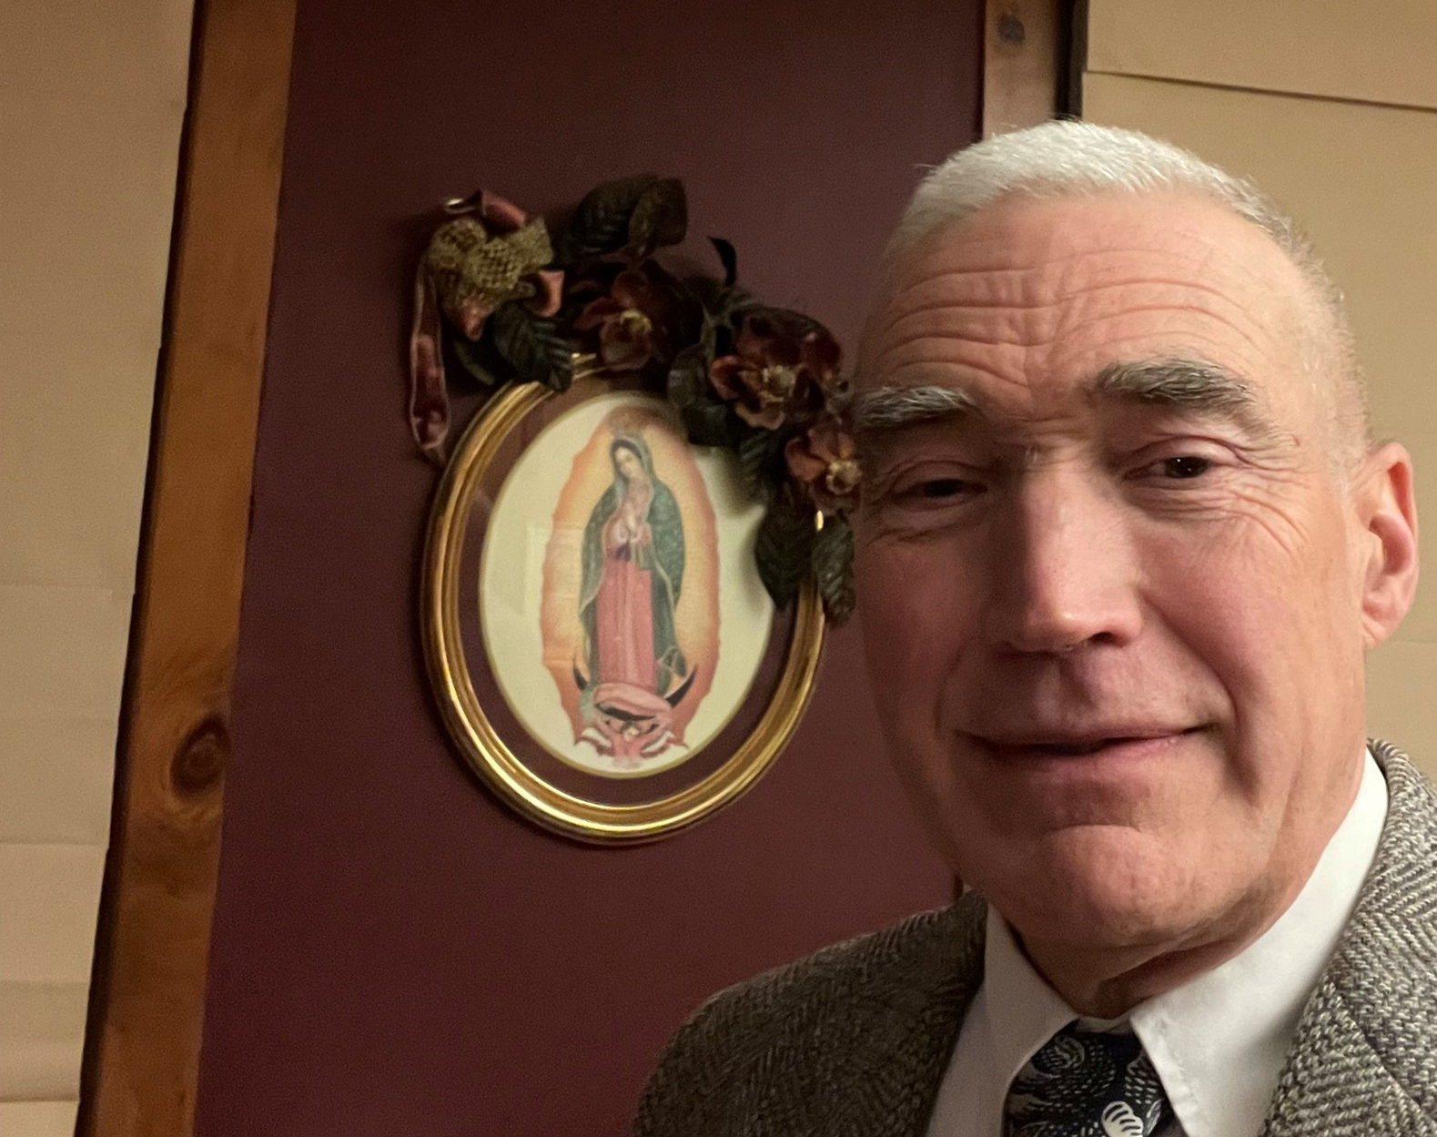
2026 MMS/WDMS CCY Award
Will be awarded at the
WDMS Annual Business Meeting, April 15, 2026
The Community Clinician of the Year Award was adopted at the Interim House of delegates meeting in November 1998. It was established to recognize a practitioner from each district medical society who has made significant contributions to patients and the community. Each district is encouraged to identify one deserving physician each year.
Dr. John W. Worden, IV

Slide 55
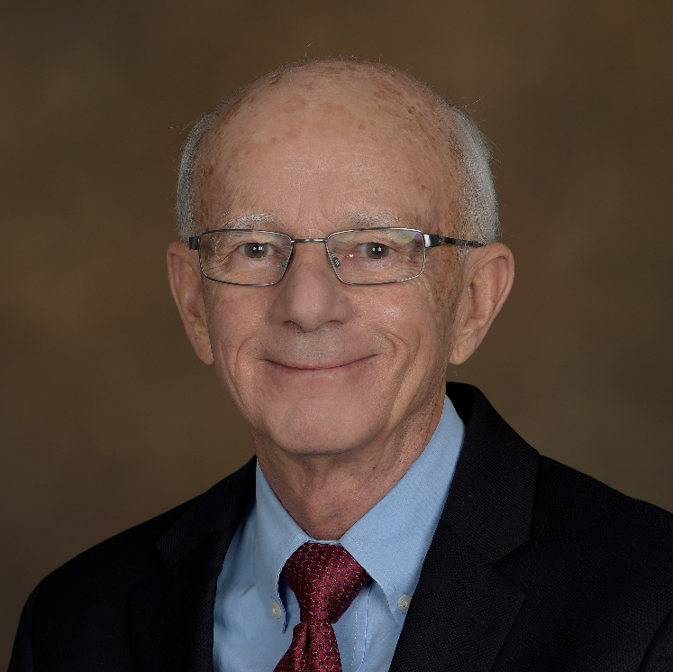
History of the Worcester Medical Library
The original Worcester Medical Library (WML) was founded in 1798, as part of the educational mission of the Worcester District Medical Society, which at that time was only four years old. In 1934, to emphasize the importance of the library collection, the district moved to incorporate the WML as a separate legal entity but maintained a partnership with this new corporation. All members of WDMS were to be members of the WML, Inc.
Dr. Robert Sorrenti, Chair
Worcester Medical Library

Slide 56
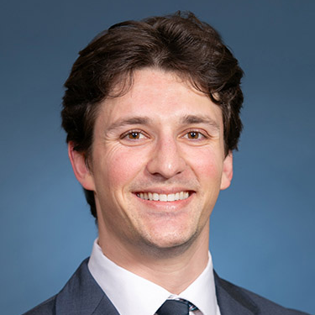
Maxwell Stukalin
Nominated by Dr. Michelle Dalal
Supported by Dr. Patrick Lowe
2025
Worcester Medical Library Student Achievement Award
This award is an achievement award based on students’ merit and accomplishments in serving the WDMS and broader Massachusetts community. It is not based on financial need and is intended to recognize the achievements of UMass Chan medical students irrespective of their legal residency.

Slide 57

Fall District Meeting & Awards Ceremony
Congratulations to all and Thank You for Attending!

Slide 58
Upcoming Events
MMS HOD I-25 Sessions – Via Zoom
Saturday, December 6, 9am to Conclusion of Business
Monday, December 8, 7-8pm - Interim Meeting Ethics Forum – Ethics & CRISPR: Exploring the Moral, Ethical, and Policy Challenges Posed by Gene Editing Technology
Movie Night and Reception
December 10, 2025, 5:30 pm, Mechanics Hall
“The Doctor” - 1991 film starring William Hurt
230th Annual Oration
February 11, 2026, 5:30 pm, Beechwood Hotel
Orator: Dr. Richard Sacra, MD
Title: "Stories from Healthcare at the Frayed Edge"

