Slide 1
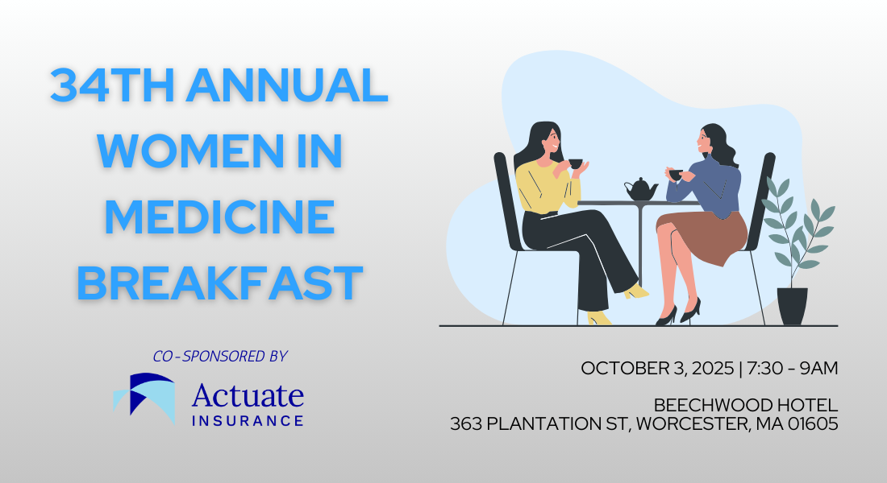

Slide 2
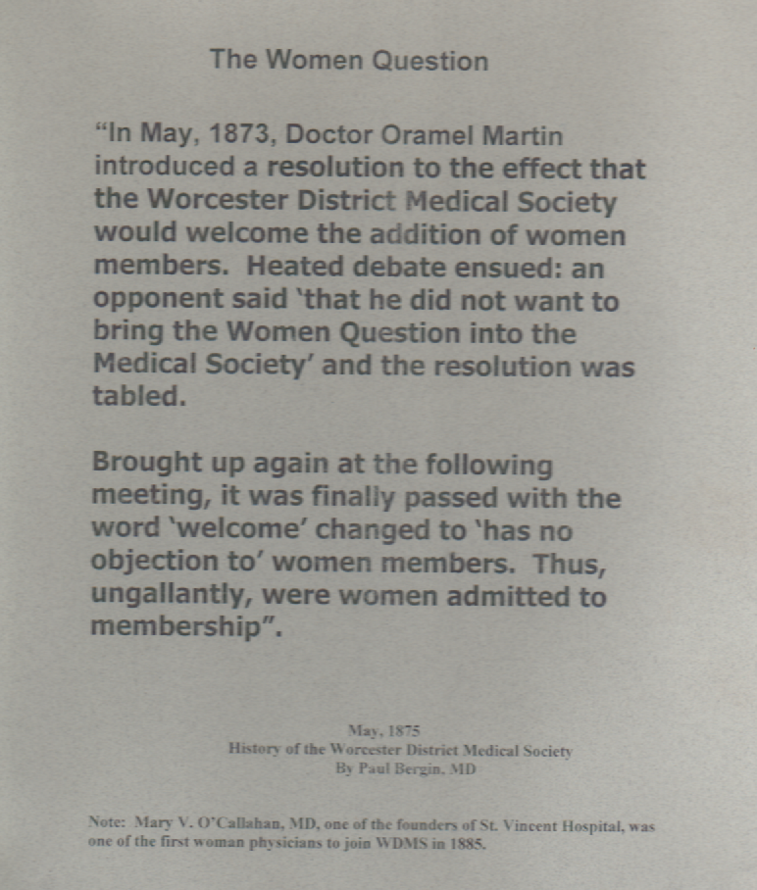

Slide 3

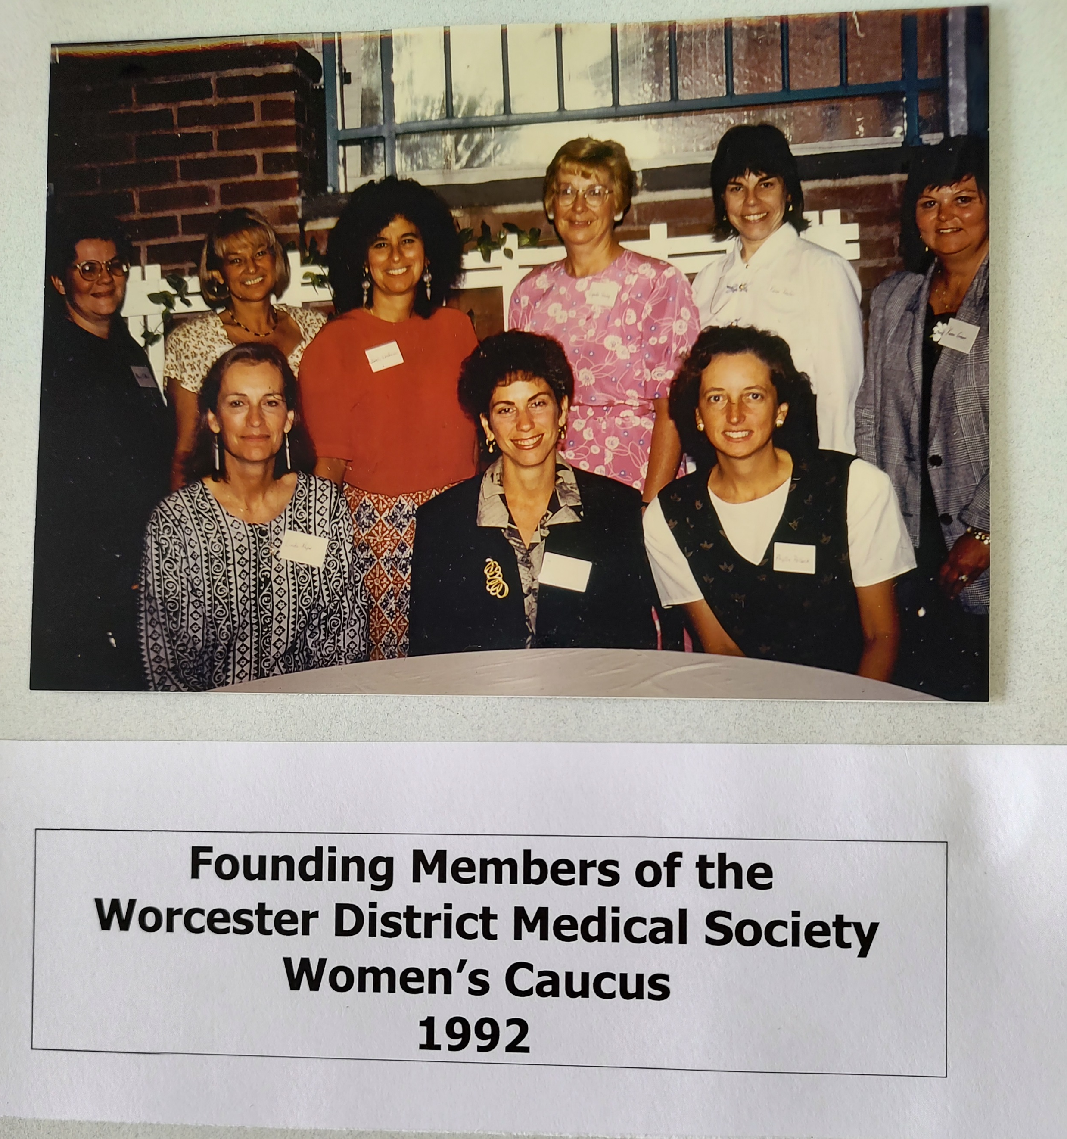
Mission of the WDMS Women’s Caucus
Address career issues specific to women physician’s and women medical Students
Promote Women’s health issues within the Society and the Community
Increase involvement of women physicians and women medical students in the Worcester District Medical Society
Increase the number of women physician leaders in the medical community

Slide 4
Current Women’s Caucus Members
Drs. Lynda Young (Chair), Annie Abraham, Janet Abrahamian, Maria Abruzzo, Nicole Cherng, Lynn Eckhert, Marianne Felice, Hari Kirin Khalsa, Rebecca Kowaloff, Jane Lochrie, Bency Louidor, Kirti Nagpal, Stacy Potts, Manjul Shukla, Rebecca Spanagel, Martha Waite, Jennifer Yates and
Residents: Charmi Bhanushali and Jessica Marconi
Medical Students: Racquel Bitar and Arianna Gray

Slide 5

Formerly, Physicians Insurance is the insurance arm of the Massachusetts Medical Society
Kate Gerheim, Director of Operations
Scott Berger, CIC, Insurance Relationship Manager

Slide 6
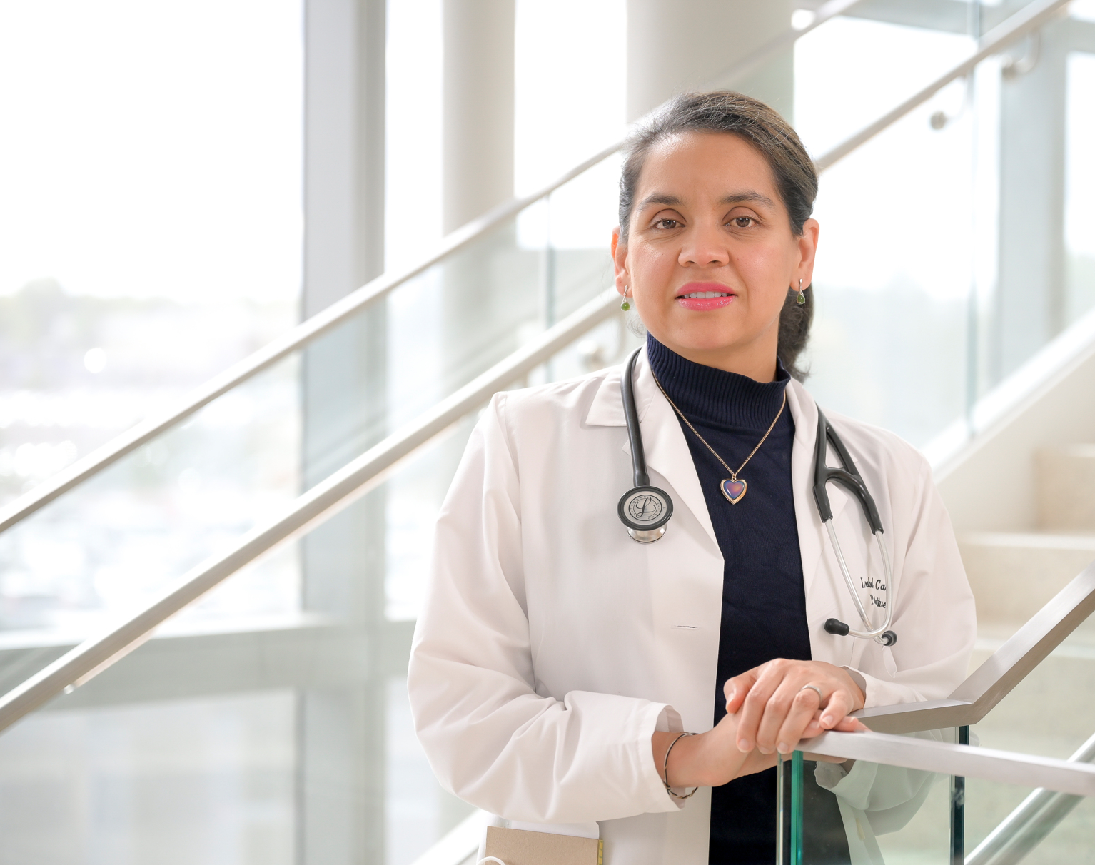
Isabel Castro, DO
Palliative Care

Slide 7
Isabel Castro, DO, Medical Specialties - Palliative Care Is an osteopathic physician practicing palliative care for the past 9 years at UMass Chan. She feels blessed to practice in a field that prides itself on getting to know patients living with a serious illness and works to improve their quality of life both from symptoms and decision making while extending support to their families. Dr. Castro completed her internal medicine residency at St. Vincent Hospital followed by a palliative fellowship in 2015 from Oregon Health and Science University in Portland, Oregon. She says that having had the opportunity to train in multiple areas of the US and has been a wonderful journey.

Slide 8
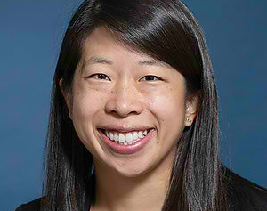
Nicole Cherng, MD Surgical Specialties

Slide 9
Nicole Cherng, MD, Surgical Specialties Is a general surgeon who specializes in bariatric and foregut surgery, abdominal wall reconstruction, and robotic surgery. She went to UMass Chan for medical school and then stayed at UMass for general surgery residency and then advanced GI minimally invasive surgery fellowship. She has been faculty for 6 years at UMass and is also the MIS fellowship director. Her academic interests are surgical education and video-based education.

Slide 10
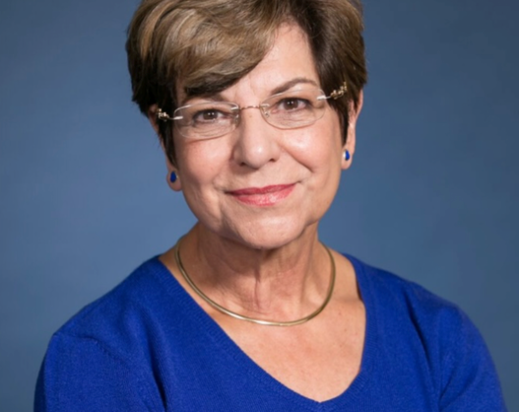
Marianne Felice, MD Pediatrics

Slide 11
Marianne E. Felice, MD, Pediatrician Is Professor Emerita of Pediatrics at the University of Massachusetts Medical School. Prior to her retirement in 2013, she was the Chair of the Department of Pediatrics and the Physician-in-Chief of the UMass Memorial Children’s Medical Center.
Dr. Felice is a graduate of the Pennsylvania State University School of Medicine in Hershey, PA. She completed a pediatric residency in Harrisburg, PA and a Fellowship in Behavioral Pediatrics/Adolescent Medicine at the University of Maryland in Baltimore, MD. Post Fellowship, Dr. Felice held faculty positions at the University of California San Diego Medical School, the University of Maryland Medical School, and, UMass Chan Medical School where she was the Chair of Pediatrics and the only woman chair for over 10 years. Dr. Felice is a tireless advocate for youth, particularly, young women.
Dr. Felice has held leadership positions in many pediatric organizations including the Society for Adolescent Health and Medicine, the American Academy of Pediatrics, the Association of Medical School Pediatric Department Chairs, and the Worcester District Medical Society. She has received over 28 million dollars in funding from local, state, and federal agencies for training programs, clinical research, and service projects. She has over 200 publications and has held various leadership roles and has been recognized by several organizations resulting in several awards locally and nationally.
In her spare time, Dr. Felice enjoys playing tennis (singles or doubles), practicing her drums (African and jazz), and attending the theatre with friends.

Slide 12
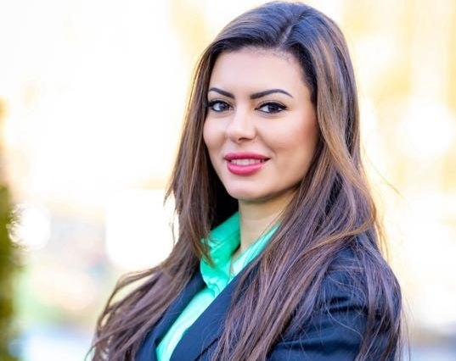
Salwa Khedr, MD, MSc Pathology

Slide 13
Salwa Khedr, MD, MSc, Pathology Is an Assistant Professor of Pathology and the Hematopathology Fellowship Director at the University of Massachusetts. She also serves as the Flow Cytometry Laboratory Medical Director and the Perinatal Pathology Service Director at the University of Massachusetts. Dr. Khedr is American board certified in Anatomic and Clinical Pathology, Hematopathology and Perinatal and Pediatric Pathology. She received fellowship training in Hematopathology at the University of Massachusetts, and Perinatal and Pediatric Pathology fellowship training at Brown University. Dr. Khedr holds a Masters of Science degree in Clinical Pathology. Dr. Khedr is a member of the College of American Pathologists and of the International Clinical Cytometry Society Education Committee. Her areas of clinical interest are hematologic malignancies, perinatal and pediatric pathology and gastrointestinal pathology.

Slide 14
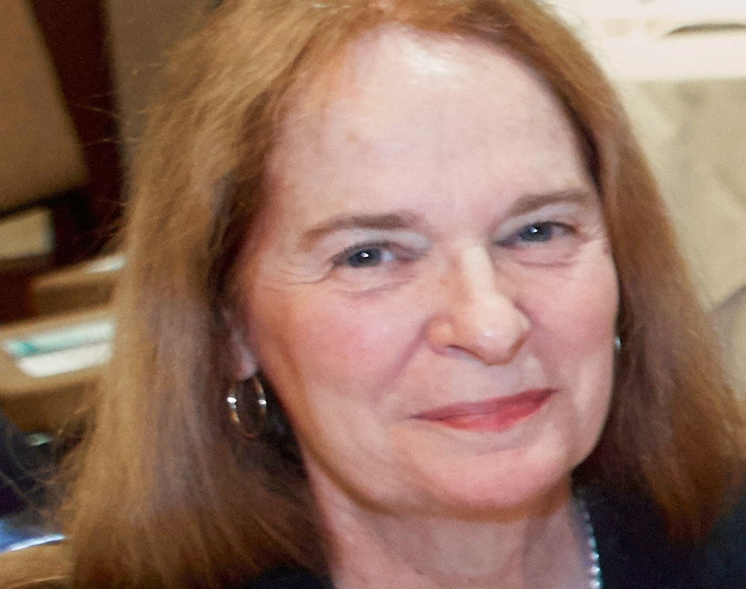
Jane Lochrie, MD
Internal Medicine

Slide 15
Jane Lochrie, MD, RN, Internal Medicine
She began her medical career as a staff nurse at Massachusetts General Hospital in 1972. She then applied to and graduated from the University of Massachusetts Medical School and completed her IM residency at St. Vincent Hospital. She has maintained her faculty position as Professor of Medicine at the University of Massachusetts.
Dr. Lochrie practiced as a General Internist for the Fallon Clinic/Reliant Medical Group from 1986 until 2017. She has held many teaching positions and earned multiple awards for her teaching prowess. She served as Site Director of Medical Student Education at Saint Vincent Hospital, and Associate Program Director and Program Director for the Internal Medicine Residency Program. She was Co-director of the Healer’s Art Program at University of Massachusetts Medical School.
Dr. Lochrie served in multiple leadership positions including President of the Medical Staff at St. Vincent Hospital, and President of WDMS. She was the cofounder of the Women’s Health Clinic for then Fallon Clinic.
Dr. Lochrie has passion for serving the underserved population and most notably volunteered for 29 years at the St. Anne’s Free Medical Program where she has been the Medical Director for the past 8 years.

Slide 16
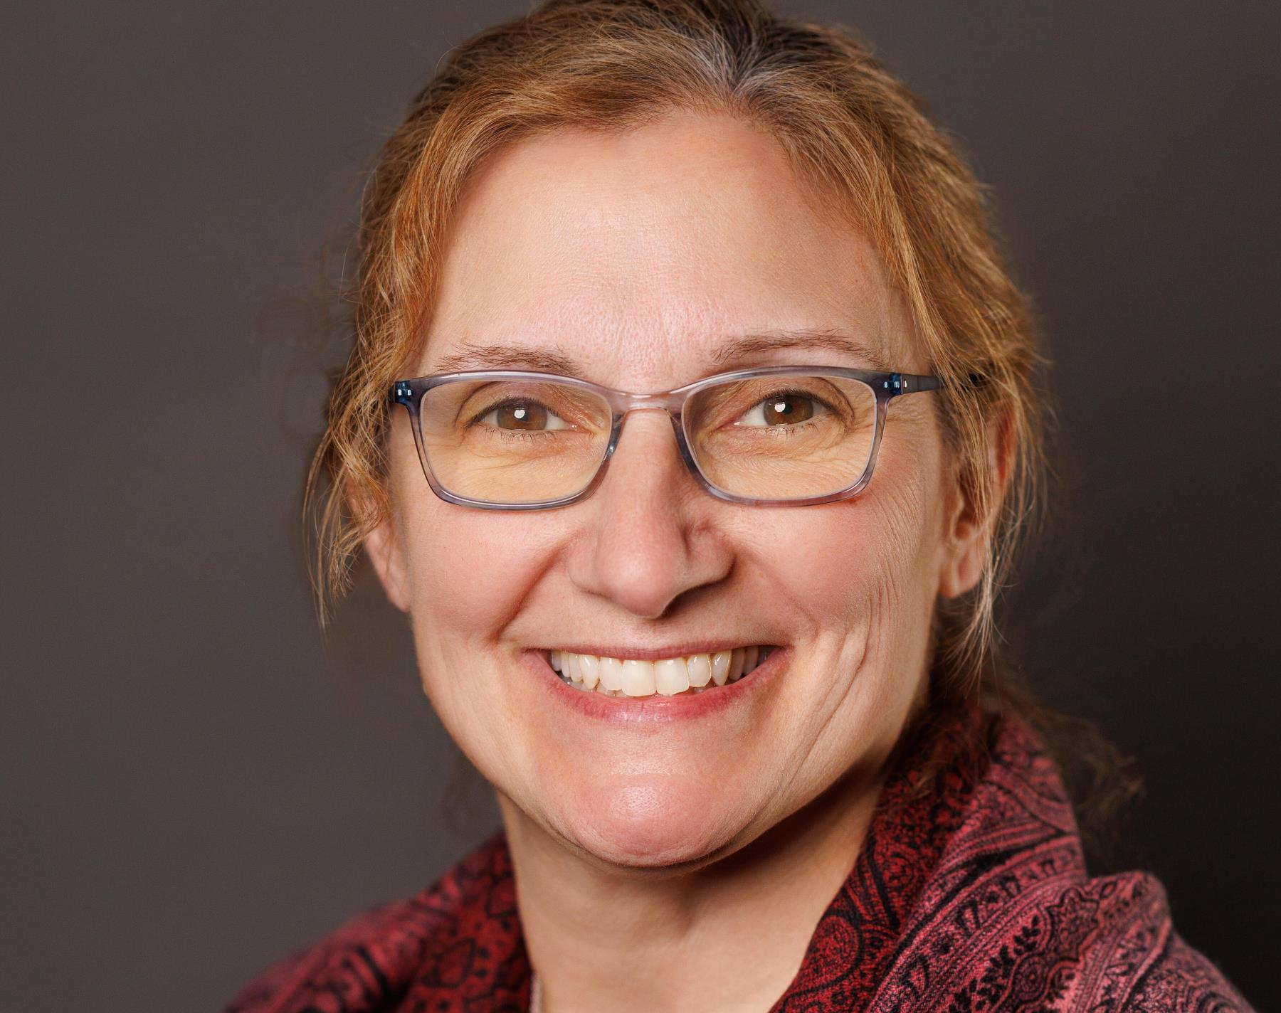
Stacy Potts, MD Family Medicine

Slide 17
Stacy Potts, MD, Family Medicine Stacy Potts the Senior Associate Dean of GME and Clinical Affairs and Professor of Family Medicine and Community Health at the University of Massachusetts Chan Medical School. She completed her undergraduate and medical degrees at the University of Vermont. She completed her Family Medicine Residency and Faculty Development Fellowship at the University of Massachusetts Chan Medical School. She received her Master’s of Education from the University of Cincinnati.
Her passion for graduate medical education has led her to multiple roles, including serving as chair of the ACGME Residency Review Committee for Family Medicine and as the Writing Group Chair for the new residency requirement revisions. She currently serves as the Vice Chair of the Medical Specialty Review Committee for the ACGME-International. She continues to practice full-spectrum family medicine, including inpatient care, maternity care, and the breadth of ambulatory care at the Barre Family Health Center. She is a proud mother and enjoys running marathons, having completed a marathon in all 50 states!

Slide 18
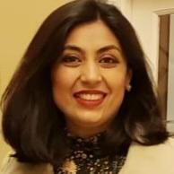
Amina Saghir, MD Radiology
Amina Saghir, MD Radiology

Slide 19
Amina Saghir, MD, Radiology
Graduated from Rawalpindi Medical College, Pakistan, completed her residency at St. Vincent Hospital and her Fellowship at UMass Chan Medical School. She specializes in Diagnostic Radiology, Abdominal Imaging and Emergency Radiology, with special interest in Advanced Body MRI. She is an Assistant Professor, UMass Chan Medical School.

Slide 20
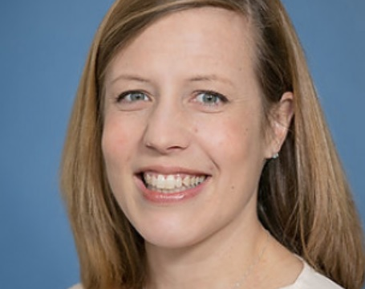
Jennifer Yates, MD Surgical Specialties

Slide 21
Jennifer Yates, MD, Surgery/Urology
Jen is an Associate Professor in the Department of Urology at the University of Massachusetts Chan Medical School, where she has practiced for 9 years. She serves as residency program director, and her practice focuses primarily on renal and bladder cancer. She has no geographic roots having been raised in a mobile military family but calls New England home after completing medical school in St. Louis, residency at Brown University, and a fellowship at Hackensack University Medical Center.

Slide 22

19th Annual Louis A. Cottle Medical Education Conference October 22, 2025, 5:30 pm, Beechwood Hotel, Worcester Speaker: Dr. Burton Lee, is the Head of Medical Education and the Head of Global Critical Care in the Critical Care Medicine Department at the National Institutes of Health (NIH) Co-Sponsored by UniBank
Annual Fall District Meeting and Awards Ceremony November 20, 2025, 5:30 pm, Beechwood Hotel
Meeting includes Voting/Approval of the 2026 Budget, and presentation of the Dr. A. Jane Fitzpatrick Community Service Award, the WDMS Career Achievement Award, the WML Medical Student Achievement Award, Medical Student Scholarship Awards, and WDMSA Nursing Scholarship Award
2025 MMS Interim HOD Opening Session (I-25) – Virtual Via Zoom
HOD First Session and Online Hearings: Monday, November 10, 2025 HOD Second Session and Closing: Saturday, December 6, 2025
Movie Night and Reception and WCFB Drive December 10, 2025, 6:00 pm, Mechanics Hall Movie: The Doctor – When a self-centered doctor is diagnosed with Cancer, he becomes better able to empathize with his patients and appreciate a life outside of his career.

Slide 23
Thank you for coming!
Stay Connected: www.wdms.org O-508-753-1579

